Slide 1


FEATURAMA
We feature your life.
Ioannis Batsios
Michael McCullough
Christopher Thacker
Hieu Vo
Jamie Weathers

Slide 2

WHAT IS IT?
Featurama is a social networking application that marries the friend system of Facebook to the board creation features of Pinterest and the silo features of Reddit. It allows users to only focus on what they are interested in and not be concerned with what their friends are eating or what their friend’s kids are doing. Unless you are into that stuff, then you can have children and food as interests and do that. Weirdo.

Slide 3

WHY IS IT NEEDED?
We envision a future in which the Internet caters to the individual. Instead of you chasing down your news, interests, hobbies, friends, etc., the Internet should bring all of that to you on your personal webpage. Imagine waking up in the morning and turning on your phone and instead of going to Discord, New York Times, Facebook, etc. it all came to you? Many of us have already digitized most of our lives with fitness apps, calendars, books, Netflix, blogs, etc. Why chase all of those things down when they can all come to you in one seamless application?

Slide 4

FUNCTIONAL
NON-FUNCTIONAL
Store and retrieve user data
Authorize login
Populate user profile
Populate friend list
Retrieve and display posts
Posts retrieve list of associated user comments
Control actions on posts based on user (is author?)
Store and retrieve set topics
Visuals and posts displayed are based on the topic retrieved
User interface
Tab-based interface
Intuitive, quick, modern
Modular design
Easy to change logic
Easy to expand
Easy to maintain
Easy to reuse pieces
Responsive design
Looks good/works on:
Desktop / Laptop
Tablet
Mobile

Slide 5
TECHNOLOGY
FEATURES REQUIRED
User Registration
User Login/Auth
Friend Lists
Filter Posts by Friends
Topics to Post for
Currently “Movies”
Ability to Add Topics to User Page
Quick Access
Select a Topic
Only See Posts for Topic.
Posts [CRUD]
Comments [CRUD]
User-Defined Favorites Lists
Responsive UI
IF TIME PERMITS...
External Auth
Facebook
Google
Twitter
User Profiles
User Messages
Searching
More Topics
Front-End
HTML
Material UI
CSS
JavaScript
React
Back-End
Node.js
JavaScript
Any necessary libraries
Express
MongoDB

Slide 6
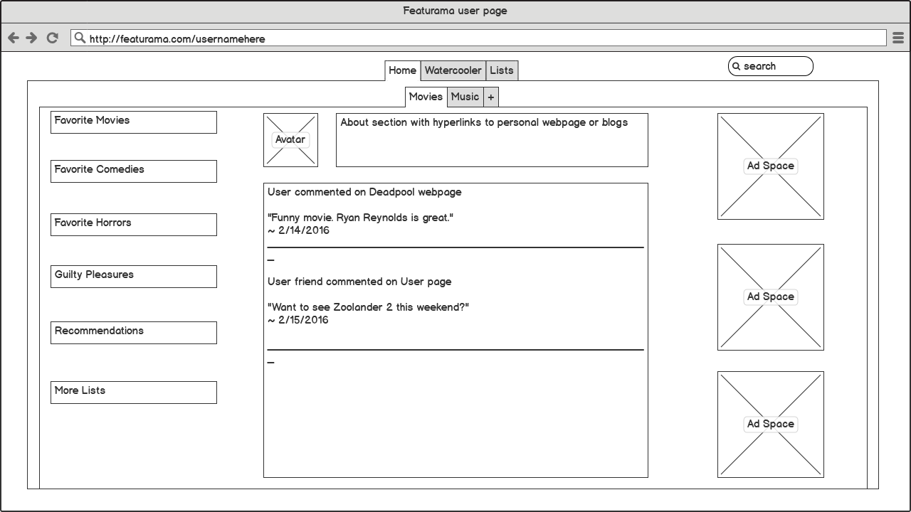
FRONT-END
React
Building User Interface
Code Reuse
Extensibility
Toolchain
Babel
Javascript Transcompiler
ESLint
Static code analysis
Webpack
Module bundler
http://ioannisbatsios.com/wireframe/wireframes.pdf

Slide 7
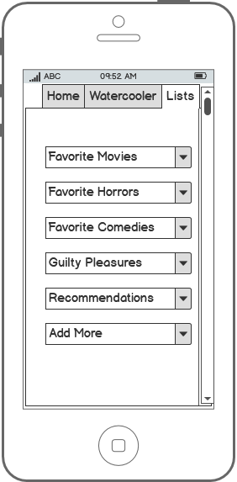
MORE FRONT-END
Considerations
Responsiveness
Mobile-First Design
Dynamic
UI
Content
Web Accessibility (a11y)

Slide 8
BACKEND
User Model
Post Model
Comment Model
List Model
uid : string
displayName : string
password : string
email : string
lists : List[]
pid : string
owner : UID
content : string
datecreated : Date
score : int
cid : string
owner : UID
content : string
datecreated : Date
score : int
name : string
posts : Post[]

Slide 9
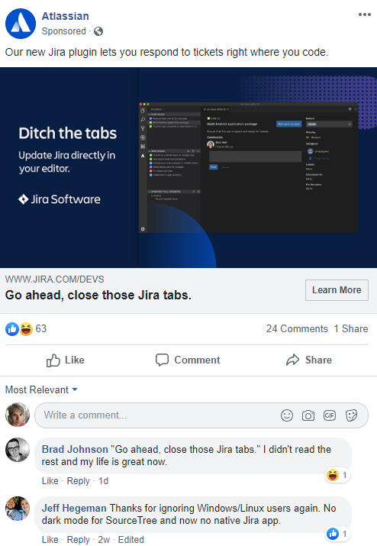
BACKEND
Algorithms/Functionality to Consider
Sort comments on post by date
Frontend displays comments via a query to the backend which helps sort comments in chronological order.
Pull trending posts per topic
Users need to see what's trending in their interests, whether a new movie trailer is out or a new album from their favorite artist.
Posting content
Allow users to be able to create a post in their interest and modify potential attributes (contains spoilers, profanity, etc.)
Overall system needs to be dynamic
Allows us, the developers, to make changes with relative ease so we have less challenges down the road.

Slide 10
DATABASE DESIGN
Pros and Cons
Pros
Use in big data applications and other processing jobs involving data that doesn't fit well in a rigid relational model
Doesn't require predefined schemas and it stores any type of data
This gives users the flexibility to create any number of fields in a document, making it easier to scale MongoDB databases
Having embedded documents reduces the need for database joins, which can reduce costs
Cons
Joining documents in MongoDB is no easy task
The relationships in MongoDB are not typically well-defined and the resulting duplicate data sets can be hard to handle
High performance is only possible with the right indexes. With shoddily implemented indexes and out of order composite indexes, MongoDB will operate at a shockingly slow speed
MongoDB doesn’t support transactions
NoSQL = Not Only SQL
MongoDB
An open source database management system that uses a document-oriented database model which supports various forms of data.

Slide 11
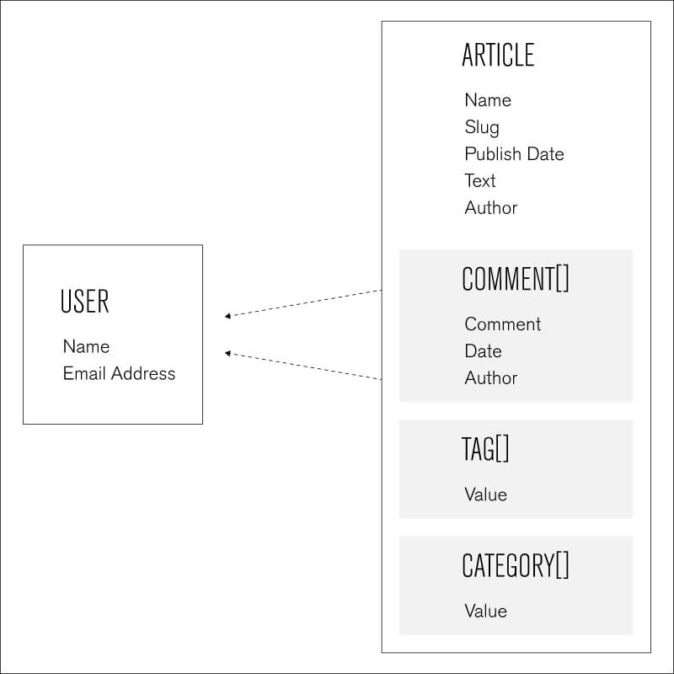
Schema
Security
Users
Posts
Comments
Lists
Etc.
MongoDB Enterprise Server brings added security features, an in-memory storage engine, administration and authentication features, and monitoring capabilities through Ops Manager. MongoDB offers various methods to verify a client's identity. MongoDB offers network encryption and can pass through disk encryption to help you protect your database and communications. TLS and SSL are both standard technologies that are used for encrypting network traffic.

Slide 12

THANK YOU
Questions?

