Slide 1
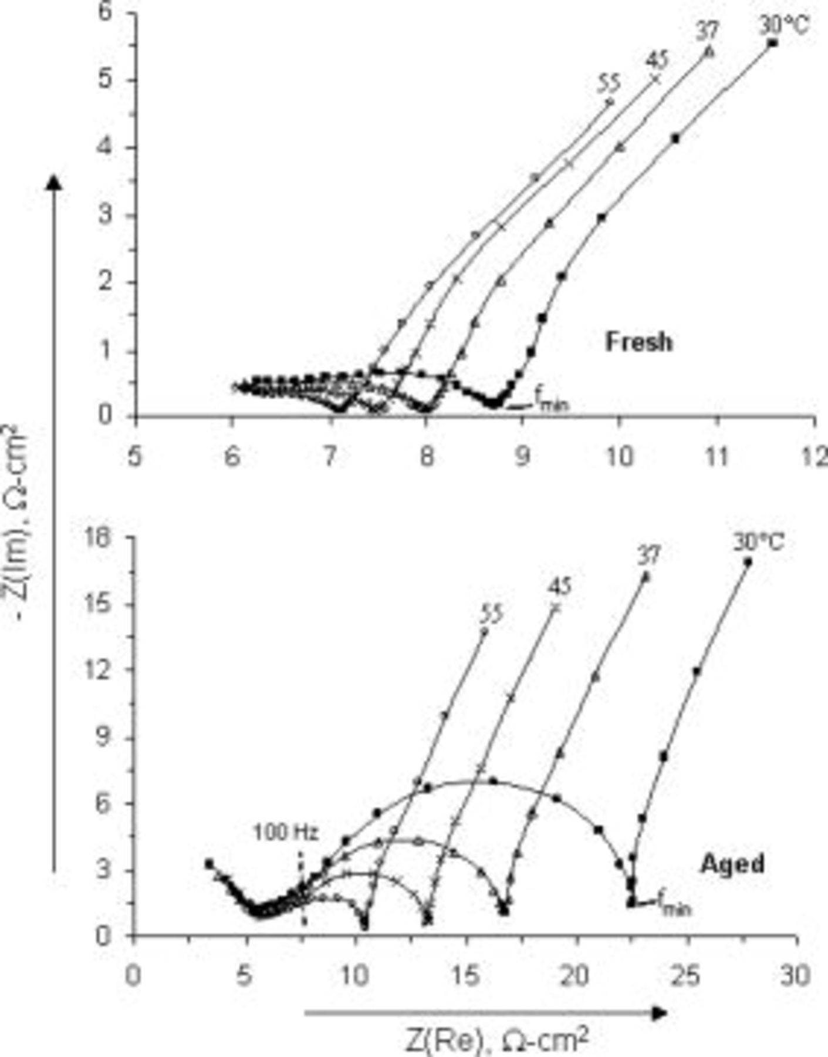

EIS data ( 10 kHz − 0.01 Hz ) as a function of test temperature for positive electrodes from fresh and aged cells, at 2.32 V full cell voltage.
D. P. Abraham et al. J. Electrochem. Soc. 2006;153:A1610-A1616
©2006 by The Electrochemical Society
Notes:
EIS data (10kHz−0.01Hz) as a function of test temperature for positive electrodes from fresh and aged cells, at 2.32V full cell voltage. Data have been adjusted so that RΩ is the same at all temperatures.

