Slide 1
Chapter 10: Mass-Storage Systems

Slide 2
Chapter 10: Mass-Storage Systems
Overview of Mass Storage Structure
Disk Structure
Disk Attachment
Disk Scheduling
Disk Management
Swap-Space Management
RAID Structure
Stable-Storage Implementation

Slide 3

Moving-head Disk Mechanism
磁道
转轴
机械臂杆
扇区
柱面
读写磁头
磁盘面
磁臂
旋转
Disk drive
磁盘驱动器

Slide 4
Overview of Mass Storage Structure
Magnetic disks provide bulk of secondary storage of modern computers
  Drives rotate at 60 to 250 times per second
  Transfer rate is rate at which data flow between drive and computer
  Positioning time (random-access time) is time to move disk arm to desired cylinder (seek time) and time for desired sector to rotate under the disk head (rotational latency)
  Head crash results from disk head making contact with the disk surface -- That’s bad
Disks can be removable
Drive attached to computer via I/O bus
  Busses vary, including EIDE, ATA, SATA, USB, Fibre Channel, SCSI, SAS, Firewire
  Host controller in computer uses bus to talk to disk controller built into drive or storage array
  控制器（controller） 是一个特殊处理器，用于执行总线上的数据传输。其中， 主机（host） 控制器是计算机上位于总线末端的控制器，而 磁盘（disk） 控制器位于磁盘驱动器内。

Slide 5
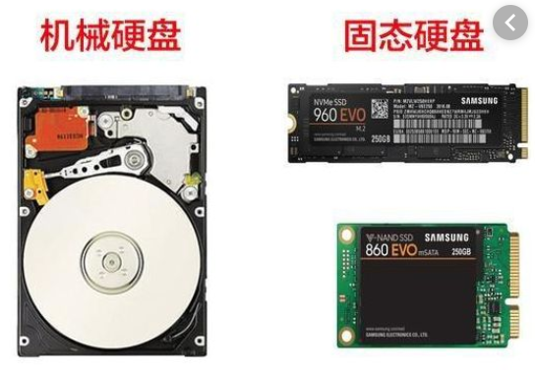
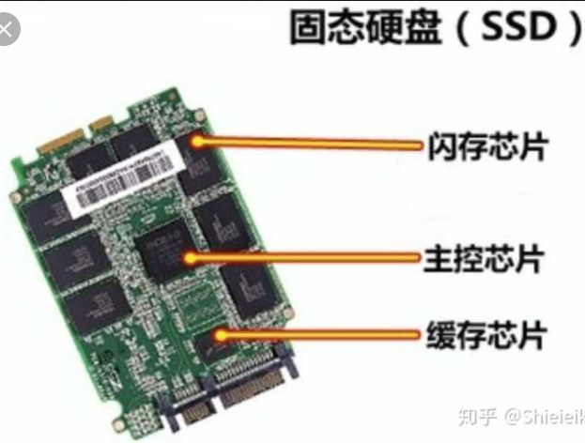
Solid-State Disks
Nonvolatile memory used like a hard drive
  Many technology variations
Can be more reliable than HDDs
More expensive per MB
Maybe have shorter life span
Less capacity
But much faster
Buses can be too slow -> connect directly to PCI for example
No moving parts, so no seek time or rotational latency

Slide 6
Disk Structure
Disk drives are addressed as large 1-dimensional arrays of logical blocks, where the logical block is the smallest unit of transfer
  Low-level formatting creates logical blocks on physical media
The 1-dimensional array of logical blocks is mapped into the sectors of the disk sequentially
  Sector 0 is the first sector of the first track on the outermost cylinder
  Mapping proceeds in order through that track, then the rest of the tracks in that cylinder, and then through the rest of the cylinders from outermost to innermost
  Logical to physical address should be easy
    Except for bad sectors
    Non-constant # of sectors per track via constant angular velocity

Slide 7
Disk Attachment（磁盘连接）
Host-attached storage accessed through I/O ports talking to I/O busses
SCSI itself is a bus, up to 16 devices on one cable, SCSI initiator requests operation and SCSI targets perform tasks
  Each target can have up to 8 logical units (disks attached to device controller)
  SCSI的英文全称为“Small Computer System Interface”（小型计算机系统接口），是同IDE（ATA）完全不同的接口，IDE接口是普通PC的标准接口，而SCSI并不是专门为硬盘设计的接口，是一种广泛应用于小型机上的高速数据传输技术。SCSI接口具有应用范围广、多任务、带宽大、CPU占用率低，以及热插拔等优点，但较高的价格使得它很难如IDE硬盘般普及，因此SCSI硬盘主要应用于中、高端服务器和高档工作站中。

Slide 8
Host-attached storage
FC （ Fibre Channel ）is high-speed serial architecture
  Large switched fabric with a 24-bit address space – the basis of storage area networks (SANs) in which many hosts attach to many storage units
  光纤通道的英文拼写是Fibre Channel，和SCSI接口一样光纤通道最初也不是为硬盘设计开发的接口技术，是专门为网络系统设计的，但随着存储系统对速度的需求，才逐渐应用到硬盘系统中。光纤通道硬盘是为提高多硬盘存储系统的速度和灵活性才开发的，它的出现大大提高了多硬盘系统的通信速度。光纤通道的主要特性有：热插拔性、高速带宽、远程连接、连接设备数量大等。
  光纤通道是为在像服务器这样的多硬盘系统环境而设计的，能满足高端工作站、服务器、海量存储子网络、外设间通过集线器、交换机和点对点连接进行双向、串行数据通讯等系统对高数据传输率的要求。

Slide 9

Network-Attached Storage
Network-attached storage (NAS) is storage made available over a network rather than over a local connection (such as a bus)
  Remotely attaching to file systems
NFS（Network File System,网络文件系统） and CIFS (Common Internet File System,通用网络文件系统) are common protocols
  CIFS 是一个新提出的协议，它使程序可以访问远程Internet计算机上的文件并要求此计算机提供服务。CIFS 使用客户/服务器模式。
Implemented via remote procedure calls (RPCs) between host and storage over typically TCP or UDP on IP network
iSCSI（Internet small computer system interface） protocol uses IP network to carry the SCSI protocol
  Remotely attaching to devices (blocks)

Slide 10
Storage Array (存储阵列)
Can just attach disks, or arrays of disks
  A disk array is a disk storage system which contains multiple disk drives.
Storage Array has controller(s), provides features to attached host(s)
  Ports to connect hosts to array
  Memory, controlling software (sometimes NVRAM, etc)
  A few to thousands of disks
  RAID, hot spares, hot swap (discussed later)
  Hot Spare：热备用: 当一个正在使用的磁盘发生故障后，一个空闲、加电并待机的磁盘将马上代替此故障盘。
  Hot Swap: 热插拔 :即带电插拔，指的是在不关闭系统电源的情况下，将模块、板卡插入或拔出系统而不影响系统的正常工作，从而提高了系统的可靠性、快速维修性、冗余性和对灾难的及时恢复能力等
  Shared storage -> more efficiency
  Features found in some file systems
    Snapshots, clones, thin provisioning, replication, deduplication, etc

Slide 11
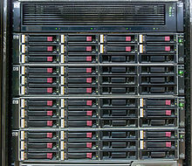
HP EVA4400 storage array, consisting of 2U controller enclosure (top) and 4 2U disk shelves
“U”在服务器领域中特指机架式服务器厚度，是一种表示服务器外部尺寸的单位，是unit的缩略语，详细的尺寸由作为业界团体的美国电子工业协会（EIA）所决定。 厚度以.cm为基本单位。
1U就是4.45cm，2U则是1U的2倍为8.9cm。

Slide 12

Storage Area Network
Network-attached storage consume bandwidth on the data network, increasing network communication latency
Storage Area Network (SAN) is a private network, common in large storage environments
Multiple hosts attached to multiple storage arrays – flexible
  主机是指计算机除去输入输出设备以外的主要机体部分。也是用于放置主板及其他主要部件的控制箱体（容器Mainframe）。通常包括 CPU、内存、硬盘、光驱、电源、以及其他输入输出控制器和接口。
  在网络技术中是关于发送与接收信息的终端设备。

Slide 13
Storage Area Network (Cont.)
SAN can connect one or more storage arrays
  Connected to one or more Fibre Channel switches
Hosts also attach to the switches
Storage made available via LUN Masking （逻辑单元数掩码 ）from specific arrays to specific servers
Easy to add or remove storage, add new host and allocate it storage
  Over low-latency Fibre Channel fabric
Why have separate storage networks and communications networks?
  Consider iSCSI, FCOE

Slide 14
Disk Scheduling
The operating system is responsible for using hardware efficiently — for the disk drives, this means having a fast access time and disk bandwidth
Minimize seek time（寻道时间）
  The seek time is the time for the disk arm to move the heads to the cylinder containing the desired sector.
Seek time ≈ seek distance
Disk bandwidth is the total number of bytes transferred, divided by the total time between the first request for service and the completion of the last transfer

Slide 15
Disk Scheduling (Cont.)
There are many sources of disk I/O request
  OS
  System processes
  Users processes
I/O request includes input or output mode, disk address for the transfer, memory address for the transfer, number of sectors to be transferred
OS maintains queue of requests, per disk or device
  磁盘驱动器（Disk Driver）又称“磁盘机”，是以磁盘作为记录信息媒体的存储装置。磁盘驱动器读取磁盘中的数据，传递给处理器。
  硬盘是电脑主要的存储媒介之一，由一个或者多个铝制或者玻璃制的碟片组成。碟片外覆盖有铁磁性材料。
Idle disk can immediately work on I/O request, busy disk means work must queue
  Optimization algorithms only make sense when a queue exists

Slide 16
Disk Scheduling (Cont.)
Note that drive controllers have small buffers and can manage a queue of I/O requests (of varying “depth”)
Several algorithms exist to schedule the servicing of disk I/O requests
The analysis is true for one or many platters
We illustrate scheduling algorithms with a request queue (0-199)
98, 183, 37, 122, 14, 124, 65, 67
Head pointer 53

Slide 17

FCFS
Illustration shows total head movement of 640 cylinders

Slide 18

SSTF
Shortest Seek Time First最短寻道时间优先 selects the request with the minimum seek time from the current head position
SSTF scheduling is a form of SJF scheduling; may cause starvation of some requests
Illustration shows total head movement of 236 cylinders

Slide 19
SCAN
The disk arm starts at one end of the disk, and moves toward the other end, servicing requests until it gets to the other end of the disk, where the head movement is reversed and servicing continues.
SCAN algorithm Sometimes called the elevator algorithm
But note that if requests are uniformly dense, largest density at other end of disk and those wait the longest
Total number of cylinders? 236

Slide 20

SCAN (Cont.)

Slide 21
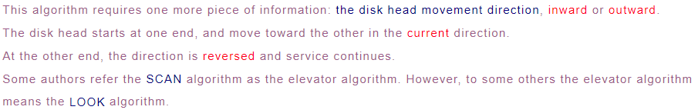
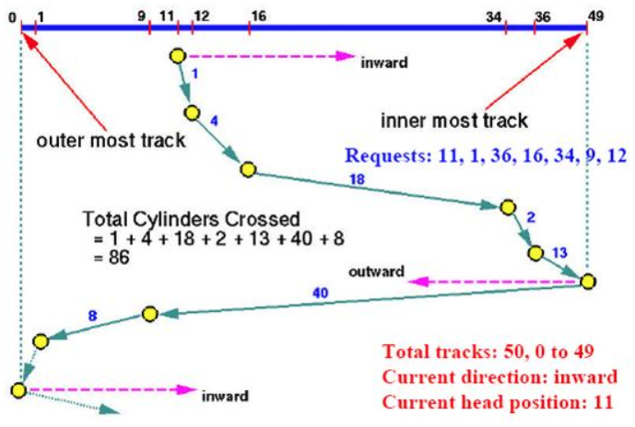

Slide 22
C-SCAN
Provides a more uniform wait time than SCAN
The head moves from one end of the disk to the other, servicing requests as it goes
  When it reaches the other end, however, it immediately returns to the beginning of the disk, without servicing any requests on the return trip
Treats the cylinders as a circular list that wraps around from the last cylinder to the first one

Slide 23

C-SCAN (Cont.)

Slide 24

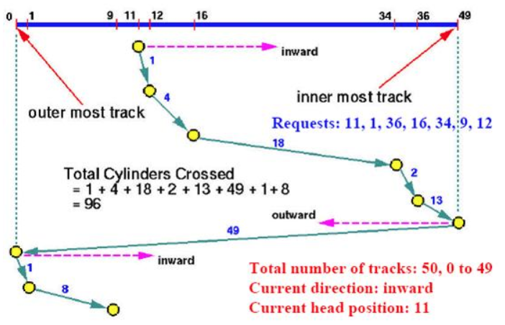

Slide 25
Disk Management
Disk initialization
Booting from disk
Bad-block recovery

Slide 26
Disk Management
Low-level formatting, or physical formatting — Dividing a disk into sectors that the disk controller can read and write
  Each sector can hold header information, plus data, plus error correction code (ECC) 纠错代码
  Usually 512 bytes of data but can be selectable
To use a disk to hold files, the operating system still needs to record its own data structures on the disk. Two steps:
  Partition the disk into one or more groups of cylinders, each treated as a logical disk
    One partition can hold a copy of the OS’s executable code, while another holds user files
  Logical formatting or “creation of a file system”
    Maps of free and allocated space and an initial empty directory
  To increase efficiency most file systems group blocks into clusters簇
    Disk I/O done in blocks
    File I/O done in clusters
    Assuring that I/O has more sequential-access and fewer random-access characteristics

Slide 27
Disk Management (Cont.)
Boot block initializes system
  The bootstrap（自举程序） is stored in ROM（只读存储器）
  Bootstrap loader program （引导加载程序） stored in boot blocks（启动块） of boot partition (a fixed location on the disk)
Methods such as sector sparing 扇区备用 used to handle bad blocks

Slide 28

Booting from a Disk in Windows
主引导记录（MBR）：包含了启动代码和分区表信息

Slide 29
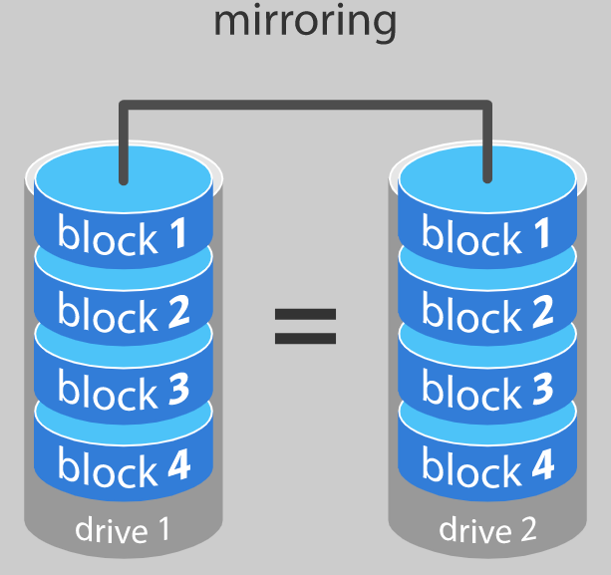
RAID Structure
RAID – redundant array of independent disks 磁盘冗余阵列
  multiple disk drives provides reliability via redundancy
Disk mirroring、mirrored volume （镜像卷）
Increases the mean time to failure
Mean time to repair – exposure time when another failure could cause data loss
Mean time to data loss based on above factors
If mirrored disks fail independently, consider disk with 100,000 mean time to failure and 10 hour mean time to repair
  Mean time to data loss is 100, 000² / (2 ∗ 10) = 500 ∗ 10⁶ hours, or 57,000 years!
Frequently combined with NVRAM to improve write performance
Several improvements in disk-use techniques involve the use of multiple disks working cooperatively

Slide 30
RAID (Cont.)
Disk striping (磁盘分条） uses a group of disks as one storage unit----increase data transfer rate, not improve reliability
RAID is arranged into six different levels
RAID schemes improve performance and improve the reliability of the storage system by storing redundant data
  Mirroring or shadowing (RAID 1) keeps duplicate of each disk
  Striped mirrors (RAID 1+0) or mirrored stripes (RAID 0+1) provides high performance and high reliability
  Block interleaved parity (RAID 4, 5, 6) uses much less redundancy
RAID within a storage array can still fail if the array fails, so automatic replication of the data between arrays is common
Frequently, a small number of hot-spare disks are left unallocated, automatically replacing a failed disk and having data rebuilt onto them

Slide 31

RAID Levels

Slide 32

RAID (0 + 1) and (1 + 0)

Slide 33
RAID Structure
采用 RAID 的主要原因是:
  增强了速度
  扩容了存储能力(以及更多的便利)
  可高效恢复磁盘

Slide 34
Other Features
Regardless of where RAID implemented, other useful features can be added
Snapshot is a view of file system before a set of changes take place (i.e. at a point in time)
  More in Ch 12
Replication is automatic duplication of writes between separate sites
  For redundancy and disaster recovery
  Can be synchronous or asynchronous
Hot spare disk is unused, automatically used by RAID production if a disk fails to replace the failed disk and rebuild the RAID set if possible
  Decreases mean time to repair

Slide 35
End of Chapter 10

