Slide 1
Chapter 1: Introduction

Slide 2

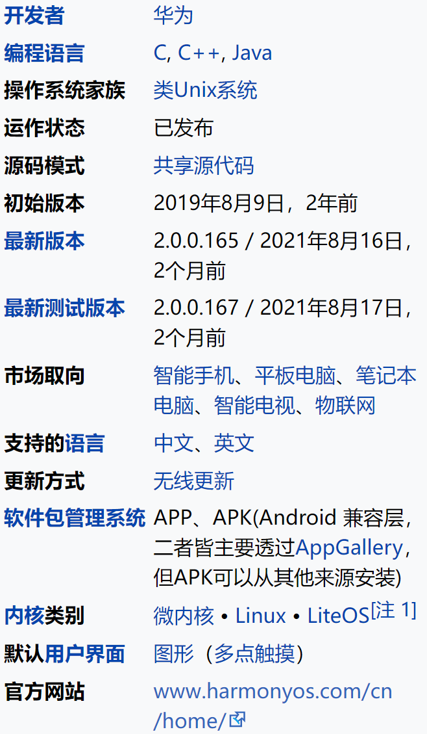
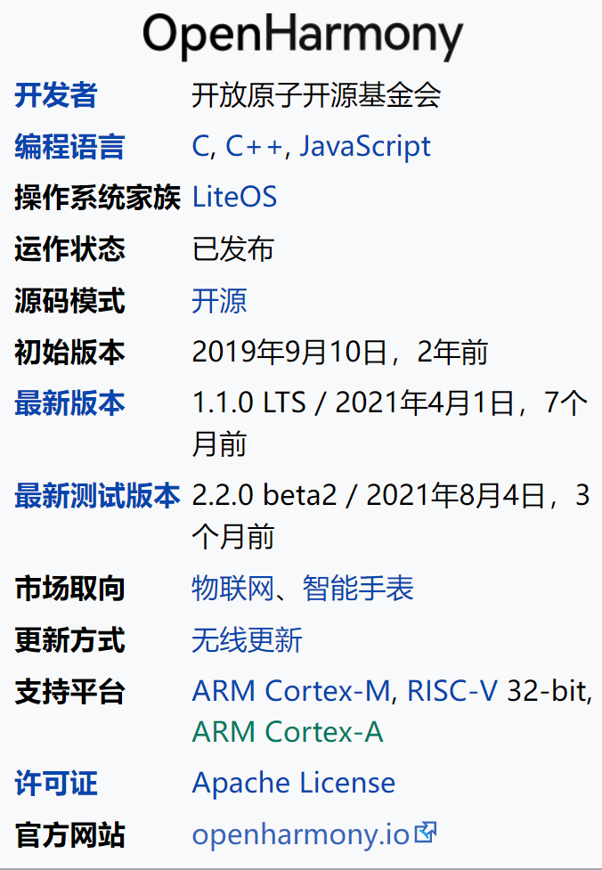
鸿蒙OS
鸿蒙（HarmonyOS，开发代号Ark）是华为自2012年开发的一款可兼容Android应用程序的跨平台分布式操作系统。系统性能包括利用“分布式”技术将各款设备融合成一个“超级终端”，便于操作和共享各设备资源。系统架构支持多内核，包括Linux内核、LiteOS和鸿蒙微内核，可按各种智能设备选择所需内核，例如在低功耗设备上使用LiteOS内核。2019年8月华为发布首款搭载鸿蒙操作系统的产品“荣耀智能屏”，之后于2021年6月发布搭载鸿蒙操作系统的智能手机、平板电脑和智能手表。

Slide 3
What is an Operating System?
A program that acts as an intermediary between a user of a computer and the computer hardware
Operating system goals:
  Execute user programs and make solving user problems easier
  Make the computer system convenient to use
  Use the computer hardware in an efficient manner

Slide 4
Definition 1: Intermediary
A program that acts as an intermediary between a user of a computer and the computer hardware

Slide 5
Intermediary (cont’d)
Computer system can be divided into four components
  Hardware – provides basic computing resources
    CPU, memory, I/O devices、SSD、 GPU
  Operating system
    Controls and coordinates use of hardware among various applications and users
  Application programs – define the ways in which the system resources are used to solve the computing problems of the users
    Word processors, compilers, web browsers, database systems, video games
  Users
    People, machines, other computers

Slide 6

Intermediary (cont’d)

Slide 7
Definition 2: Resource allocator
OS is a resource allocator
  Manages all resources
  Decides between conflicting requests for efficient and fair resource use
What is a resource?
  Anything you can run out of…
  Computing power, memory, storage space
  Energy
  Network bandwidth
  Money (!)

Slide 8
Definition 3: Control program
OS is a control program
  Controls execution of programs to prevent errors and improper use of the computer

Slide 9
Reviewing definitions
No universally accepted definition
“Everything a vendor ships when you order an operating system” is good approximation
  But varies wildly
“The one program running at all times on the computer” is the kernel. Everything else is either a system program (ships with the operating system) or an application program
Linux:/lib，/boot
\Windows\system32\NTOSKRNL.EXE

Slide 10
Computer System Structure
Computer system can be divided into four components:
  Hardware – provides basic computing resources
    CPU, memory, I/O devices
  Operating system
    Controls and coordinates use of hardware among various applications and users
  Application programs – define the ways in which the system resources are used to solve the computing problems of the users
    Word processors, compilers, web browsers, database systems, video games
  Users
    People, machines, other computers

Slide 11
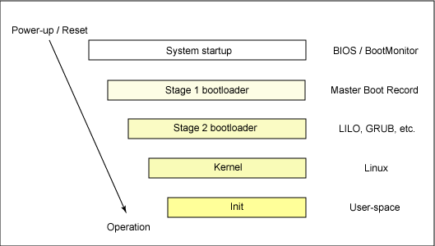
Computer Startup
bootstrap program（引导程序） is loaded at power-up or reboot
  Typically stored in ROM or EEPROM, generally known as firmware
  Initializes all aspects of system
  Loads operating system kernel and starts execution
What is the startup process（启动进程） of a Linux system?
*https://www.ibm.com/developerworks/cn/linux/l-linuxboot/

Slide 12

Computer System Organization
Computer-system operation
  One or more CPUs, device controllers connect through common bus providing access to shared memory
  Concurrent execution of CPUs and devices competing for memory cycles

Slide 13
Computer-System Operation
I/O devices and the CPU can execute concurrently
Each device controller is in charge of a particular device type
Each device controller has a local buffer
CPU moves data from/to main memory to/from local buffers
I/O is from the device to local buffer of controller
Device controller informs CPU that it has finished its operation by causing an interrupt
An interrupt is a signal from a device attached to a computer, or from a program within the computer, that tells the OS (operating system) to stop and decide what to do next.

Slide 14

How a Modern Computer Works
A Von Neumann architecture

Slide 15
Common Functions of Interrupts
Interrupt transfers control to the interrupt service routine generally, through the interrupt vector（中断向量表）, which contains the addresses of all the service routines
Interrupt architecture must save the address of the interrupted instruction
A trap(陷入) or exception（异常） is a software-generated interrupt caused either by an error or a user request
An operating system is interrupt driven
An interrupt vector is the memory location of an interrupt handler, which prioritizes interrupts and saves them in a queue if more than one interrupt is waiting to be handled.
A trap（陷入、陷阱） is a type of synchronous interrupt typically caused by an exceptional condition (e.g., breakpoint, division by zero, invalid memory access). Any kind of a control transfer to the OS.
Exception （异常） : Synchronous, program-initiated control transfer from user to the OS in response to an exceptional event. e.g. Divide by zero, TLB miss, Page fault

Slide 16
Storage Structure
Main memory – only large storage media that the CPU can access directly
  Random access
  Typically volatile
Secondary storage – extension of main memory that provides large nonvolatile storage capacity
Hard disks – rigid metal or glass platters covered with magnetic recording material
  Disk surface is logically divided into tracks, which are subdivided into sectors
  The disk controller determines the logical interaction between the device and the computer
Solid-state disks – faster than hard disks, nonvolatile
  Various technologies
  Becoming more popular

Slide 17
Storage Hierarchy
Storage systems organized in hierarchy
  Speed
  Cost
  Volatility
Caching – copying information into faster storage system; main memory can be viewed as a cache for secondary storage
Device Driver for each device controller to manage I/O
  Provides uniform interface between controller and kernel

Slide 18

Storage-Device Hierarchy

Slide 19
Caching
Important principle, performed at many levels in a computer (in hardware, operating system, software)
Information in use copied from slower to faster storage temporarily
Faster storage (cache) checked first to determine if information is there
  If it is, information used directly from the cache (fast)
  If not, data copied to cache and used there
Cache smaller than storage being cached
  Cache management important design problem
  Cache size and replacement policy

Slide 20

Migration of data “A” from Disk to Register
Multitasking environments must be careful to use most recent value, no matter where it is stored in the storage hierarchy
Multiprocessor environment must provide cache coherency in hardware such that all CPUs have the most recent value in their cache
Distributed environment situation even more complex
  Several copies of a datum can exist
  Various solutions covered in Chapter 17

Slide 21
Questions
What is an Operating System?
Enumerate three goals of operating systems.
What is an interrupt?

Slide 22
What is an Operating System?
  A program that acts as an intermediary between a user of a computer and the computer hardware
    “Everything a vendor ships when you order an operating system” is good approximation
  OS is a control program
  OS is a resource allocator
Operating system goals:
  Execute user programs and make solving user problems easier
  Make the computer system convenient to use
  Use the computer hardware in an efficient manner
An interrupt is a signal from a device attached to a computer, or from a program within the computer, that tells the OS (operating system) to stop and decide what to do next.

Slide 23
Multiprocessing
Most systems use a single general-purpose processor
  Most systems have special-purpose processors as well
Multiprocessors systems growing in use and importance
  Also known as parallel systems, tightly-coupled systems
  Advantages include:
    Increased throughput
    Economy of scale
    Increased reliability – graceful degradation or fault tolerance
  Two types:
    Asymmetric Multiprocessing（非对称多处理机） – The boss processor schedules and allocates work to the worker processors.
    Symmetric Multiprocessing（对称多处理机） – Each processor run the tasks within the Operating System.

Slide 24

Symmetric Multiprocessing Architecture

Slide 25
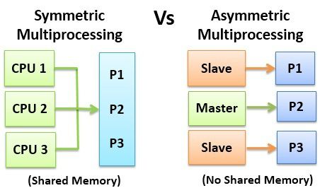
Symmetric v.s. Asymmetric

Slide 26

A Dual-Core Design
Multi-chip and multicore
Systems containing all chips
  Chassis containing multiple separate systems

Slide 27
Clustered Systems
Like multiprocessor systems, but multiple systems working together
  Usually sharing storage via a storage-area network (SAN)
  Provides a high-availability service which survives failures
    Asymmetric clustering has one machine in hot-standby mode
    Symmetric clustering has multiple nodes running applications, monitoring each other
  Some clusters are for high-performance computing (HPC)
    Applications must be written to use parallelization
  Some have distributed lock manager (DLM) to avoid conflicting operations

Slide 28

Clustered Systems

Slide 29
OS support for Multiprogramming
Uniprogramming allows only one program to be present in memory at a time.
  Single user cannot keep CPU and I/O devices busy at all times
Multiprogramming (Batch system) needed for efficiency
  Multiprogramming organizes jobs (code and data) so CPU always has one to execute
  A subset of total jobs in system is kept in memory
  What if I/O happens?
    When it has to wait (for I/O for example), OS switches to another job.
  Which job to select for running if multiple ones present in the system
    One job selected and run via job scheduling

Slide 30
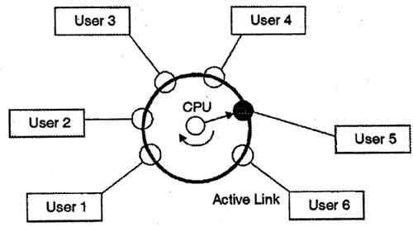
OS support for Multiprogramming
Timesharing (multitasking) is logical extension in which CPU switches jobs so frequently that users can interact with each job while it is running, creating interactive computing
  Response time should be < 1 second
  Each user has at least one program executing in memory process
  If several jobs ready to run at the same time  CPU scheduling
  If processes don’t fit in memory, swapping moves them in and out to run
  Virtual memory?
    allows execution of processes not completely in memory

Slide 31
User and Kernel Modes
Dual-mode operation of OS
  Why?
    to protect itself and other system components
  User mode
    No ability to directly access hardware or reference memory.
    Due to the protection afforded by this sort of isolation, crashes in user mode are always recoverable.
  Kernel mode
    Complete and unrestricted access to the underlying hardware.
    It can execute any CPU instruction and reference any memory address.
    Kernel mode is generally reserved for the lowest-level, most trusted functions of the operating system.
    Crashes in kernel mode are catastrophic; they will halt the entire PC.

Slide 32
User and Kernel Modes
What if an application in user mode has to access memory or hardware resources?
  Code running in user mode must delegate to system APIs to access hardware or memory.
  Mode bit provided by hardware
    Provides ability to distinguish when system is running user code or kernel code
    Some instructions designated as privileged, only executable in kernel mode
    System call changes mode to kernel, return from call resets it to user
Increasingly CPUs support multi-mode operations
  i.e. virtual machine manager (VMM) mode for guest VMs

Slide 33

Transition from User to Kernel Mode
Timer to prevent infinite loop / process hogging resources
  Timer is set to interrupt the computer after some time period
  Keep a counter that is decremented by the physical clock.
  Operating system set the counter (privileged instruction)
  When counter zero generate an interrupt
  Set up before scheduling process to regain control or terminate program that exceeds allotted time

Slide 34
Process Management
A process is a program in execution.
  It is a unit of work within the system.
  Program is a passive entity, process is an active entity.
Process needs resources to accomplish its task
  CPU, memory, I/O, files
  Initialization data
Process termination requires reclaim of any reusable resources

Slide 35
Process Management
What is program counter?
  holds the memory address of ("points to") the next instruction that would be executed.
Single-threaded process has one program counter specifying location of next instruction to execute
  Process executes instructions sequentially, one at a time, until completion
Multi-threaded process has one program counter per thread
Typically system has many processes, some user, some operating system running concurrently on one or more CPUs
  Concurrency by multiplexing the CPUs among the processes / threads

Slide 36



Kernel Data Structures
Many similar to standard programming data structures
Singly linked list
Doubly linked list
Circular linked list

Slide 37


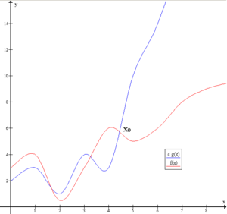
Kernel Data Structures
Binary search tree
left <= right
  Search performance is O(n)
  Balanced binary search tree is O(lg n)
f(x) = O(g(x)) if and only if there exists a positive real number M and a real number x₀ such that

Slide 38

Kernel Data Structures
Hash function can create a hash map
Bitmap – string of n binary digits representing the status of n items
Linux data structures defined in
include files <linux/list.h>, <linux/kfifo.h>, <linux/rbtree.h>

Slide 39
Computing Environments – Cloud Computing
Many types
  Public cloud – available via Internet to anyone willing to pay
  Private cloud – run by a company for the company’s own use
  Hybrid cloud – includes both public and private cloud components
  Software as a Service (SaaS) – one or more applications available via the Internet (i.e., word processor)
  Platform as a Service (PaaS) – software stack ready for application use via the Internet (i.e., a database server)
  Infrastructure as a Service (IaaS) – servers or storage available over Internet (i.e., storage available for backup use)
  扩展：云计算服务类型有哪些？一文秒懂公有云，私有云，混合云的区别 (redhat.com)

Slide 40
End of Chapter 1
Slides are created based on http://codex.cs.yale.edu/avi/os-book/OS9/slide-dir/index.html

Slide 41

https://ks.wjx.top/vj/wOHMHwM.aspx

