Slide 1
Chapter 2: Operating-System Structures

Slide 2
Chapter 2: Operating-System Structures
Operating System Services
User Operating System Interface
System Calls
Types of System Calls
System Programs
Operating System Design and Implementation
Operating System Structure
Operating System Debugging
Operating System Generation
System Boot

Slide 3
Operating System Services
Operating systems provide an environment for execution of programs and services to programs and users
One set of operating-system services provides functions that are helpful to the user:
  User interface - Almost all operating systems have a user interface (UI).
    Varies between Command-Line (CLI), Graphics User Interface (GUI), Batch interface
  Program execution - The system must be able to load a program into memory and to run that program, end execution, either normally or abnormally (indicating error)
  I/O operations - A running program may require I/O, which may involve a file or an I/O device

Slide 4

A View of Operating System Services

Slide 5
User Operating System Interface - CLI
CLI (Command-line interface) or command interpreter allows direct command entry
  Sometimes implemented in kernel, sometimes by systems program
  Sometimes multiple flavors implemented – shells
  Primarily fetches a command from user and executes it
  Sometimes commands built-in, sometimes just names of programs
    If the latter, adding new features doesn’t require shell modification

Slide 6
System Calls
Programming interface to the services provided by the OS
Typically written in a high-level language (C or C++)
Mostly accessed by programs via a high-level Application Programming Interface (API) rather than direct system call use

Slide 7
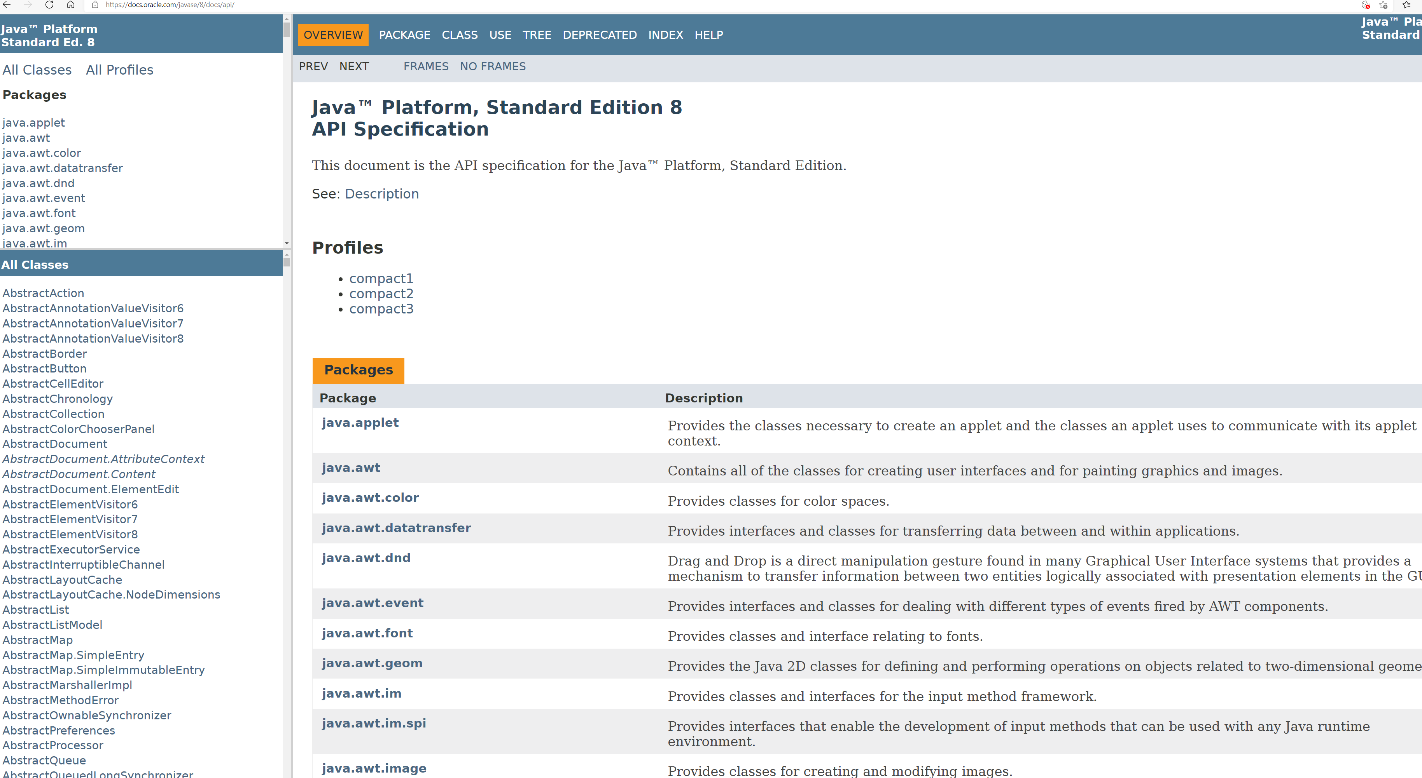
System Calls
Three most common APIs are
  Win32 API for Windows,
  POSIX API for POSIX-based systems (including virtually all versions of UNIX, Linux, and Mac OS X),
  Java API for the Java virtual machine (JVM)

Slide 8
System Call Implementation
Typically, a number associated with each system call
  System-call interface maintains a table indexed according to these numbers
The system call interface invokes the intended system call in OS kernel and returns status of the system call and any return values
The caller need know nothing about how the system call is implemented
  Just needs to obey API and understand what OS will do as a result call
  Most details of OS interface hidden from programmer by API
    Managed by run-time support library (set of functions built into libraries included with compiler)

Slide 9

API – System Call – OS Relationship

Slide 10
System Call Parameter Passing
Often, more information is required than simply identity of desired system call
  Exact type and amount of information vary according to OS and call
Three general methods used to pass parameters to the OS
  Simplest: pass the parameters in registers
    In some cases, may be more parameters than registers
  Parameters stored in a block, or table, in memory, and address of block passed as a parameter in a register
    This approach taken by Linux and Solaris
  Parameters placed, or pushed, onto the stack by the program and popped off the stack by the operating system
  Block and stack methods do not limit the number or length of parameters being passed

Slide 11

Parameter Passing via Table

Slide 12

Examples of Windows and Unix System Calls

Slide 13

Standard C Library Example
C program invoking printf() library call, which calls write() system call

Slide 14

Example of Process Control System Calls: MS-DOS
MicroSoft Disk Operating System
Single-tasking
Shell invoked when system booted
Simple method to run program
  No process created
Single memory space
Loads program into memory, overwriting all but the kernel
Program exit -> shell reloaded
At system startup running a program

Slide 15

Example of Process Control System Calls: FreeBSD
Unix variant
Multitasking
User login -> invoke user’s choice of shell
Shell executes fork() system call to create process
  Executes exec() to load program into process
  Shell waits for process to terminate or continues with user commands
Process exits with:
  code = 0 – no error
  code > 0 – error code

Slide 16
System Programs
System programs provide a convenient environment for program development and execution. They can be divided into:
  File manipulation
  Status information sometimes stored in a File modification
  Programming language support
  Program loading and execution
  Communications
  Background services
  Application programs
Most users’ view of the operation system is defined by system programs, not the actual system calls

Slide 17
System Programs (Cont.)
Background Services
  Launch at boot time
    Some for system startup, then terminate
    Some from system boot to shutdown
  Known as services, subsystems, daemons
  Provide facilities like disk checking, process scheduling, error logging, printing
  Run in user context not kernel context
Application programs
  Don’t pertain to system
  Run by users
  Not typically considered part of OS
  Launched by command line, mouse click, finger poke

Slide 18
Operating System Structure
General-purpose OS is very large program
Various ways to structure ones
  Simple structure – MS-DOS
  More complex -- UNIX
  Layered – an abstraction
  Microkernel –Mach
    http://www.cs.cmu.edu/afs/cs/project/mach/public/www/mach.html

Slide 19

Simple Structure -- MS-DOS
MS-DOS – written to provide the most functionality in the least space
  Not divided into modules
  Although MS-DOS has some structure, its interfaces and levels of functionality are not well separated

Slide 20
Non Simple Structure -- UNIX
UNIX – limited by hardware functionality, the original UNIX operating system had limited structuring. The UNIX OS consists of two separable parts
  Systems programs
  The kernel
    Consists of everything below the system-call interface and above the physical hardware
    Provides the file system, CPU scheduling, memory management, and other operating-system functions; a large number of functions for one level

Slide 21

Traditional UNIX System Structure
Beyond simple but not fully layered

Slide 22
Microkernel System Structure
Moves as much from the kernel into user space
Mach example of microkernel
  Mac OS X kernel (Darwin) partly based on Mach
Communication takes place between user modules using message passing
Benefits:
  Easier to extend a microkernel
  Easier to port the operating system to new architectures
  More reliable (less code is running in kernel mode)
  More secure
Detriments:
  Performance overhead of user space to kernel space communication

Slide 23

Microkernel System Structure

Slide 24
Modules
Many modern operating systems implement loadable kernel modules
  Uses object-oriented approach
  Each core component is separate
  Each talks to the others over known interfaces
  Each is loadable as needed within the kernel
Overall, similar to layers but with more flexible
  Linux, Solaris, etc

Slide 25

Solaris Modular Approach

Slide 26
Hybrid Systems
Most modern operating systems are actually not one pure model
  Hybrid combines multiple approaches to address performance, security, usability needs
  Linux and Solaris kernels in kernel address space, so monolithic, plus modular for dynamic loading of functionality
  Windows mostly monolithic, plus microkernel for different subsystem personalities
Apple Mac OS X hybrid, layered, Aqua UI plus Cocoa programming environment
  Below is kernel consisting of Mach microkernel and BSD Unix parts, plus I/O kit and dynamically loadable modules (called kernel extensions)

Slide 27
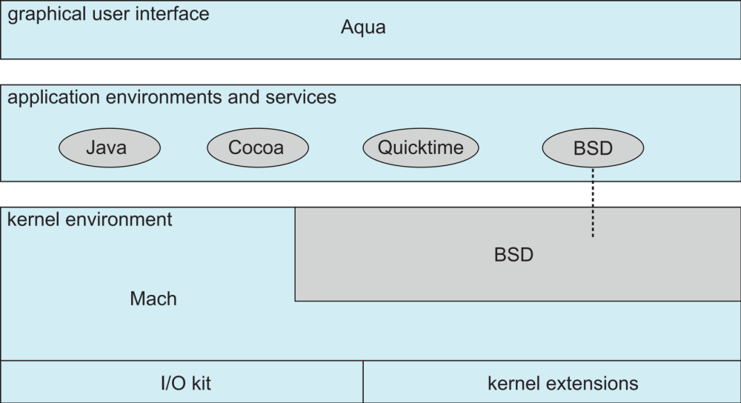
Mac OS X Structure
Apple Mac OS X hybrid, layered, Aqua UI plus Cocoa programming environment
  Below is kernel consisting of Mach microkernel and BSD Unix parts, plus I/O kit and dynamically loadable modules (called kernel extensions)

Slide 28
System Boot（系统引导）
When power initialized on system, execution starts at a fixed memory location
  Firmware ROM used to hold initial boot code
Operating system must be made available to hardware so hardware can start it
  Small piece of code – bootstrap loader, stored in ROM or EEPROM locates the kernel, loads it into memory, and starts it
  Sometimes two-step process where boot block at fixed location loaded by ROM code, which loads bootstrap loader from disk
Common bootstrap loader, GRUB, allows selection of kernel from multiple disks, versions, kernel options
Kernel loads and system is then running

Slide 29
End of Chapter 2
Slides are created based on http://codex.cs.yale.edu/avi/os-book/OS9/slide-dir/index.html

Slide 30

Chapter 2 Quiz
9:48—9:58
Or https://ks.wjx.top/vj/rX9b8vx.aspx

