Slide 1
Chapter 4: Threads

Slide 2
Review of Process, IPC, and etc
When to do Context Switch?
Multitasking – When the CPU needs to switch processes in and out of memory, so that more than one process can be running.
Kernel/User Switch – When switching between user mode to kernel mode, it may be used (but isn’t always necessary).
Interrupts – When the CPU is interrupted to return data from a disk read.

Slide 3
Review of Process, IPC, and etc
Long term schedulers
  adjust the level of multiprogramming through admission control
Medium term schedulers
  adjust the level of multiprogramming by suspending processes
Short term schedulers
  determine which process should execute next

Slide 4
Review of Process, IPC, and etc
IPC:
Shared Memory
  An area of memory shared among the processes that wish to communicate
  Synchronization
Message Passing
  Direct communication
    One link is associated to exactly one pair of processes
  Indirect communication
    Mailbox
Communications in Client-Server Systems: Sockets, remote procedure calls, pipes

Slide 5
Chapter 4: Threads
Overview
Multicore Programming
Multithreading Models
Thread Libraries
Implicit Threading
Threading Issues
Operating System Examples

Slide 6

Single and Multithreaded Processes

Slide 7
Motivation
Most modern applications are multithreaded
Threads run within application
Multiple tasks with the application can be implemented by separate threads
  Update display
  Fetch data
  Spell checking
  Answer a network request
Process creation is heavy-weight while thread creation is light-weight
Can simplify code, increase efficiency
Kernels are generally multithreaded

Slide 8
Multicore Programming
Parallelism implies a system can perform more than one task simultaneously
Concurrency supports more than one task making progress
  Single processor / core, scheduler providing concurrency

Slide 9
Multicore Programming (Cont.)
Types of parallelism
  Data parallelism – distributes subsets of the same data across multiple cores, same operation on each
  Task parallelism – distributing threads across cores, each thread performing unique operation
As # of threads grows, so does architectural support for threading
  CPUs have cores as well as hardware threads
  Consider Oracle SPARC T4 with 8 cores, and 8 hardware threads per core

Slide 10


Concurrency vs. Parallelism
Concurrent execution on single-core system:
Parallelism on a multi-core system:

Slide 11
User Threads and Kernel Threads
User threads - management done by user-level threads library
Three primary thread libraries:
  POSIX Pthreads
  Windows threads
  Java threads
Kernel threads - Supported by the Kernel
Examples – virtually all general purpose operating systems, including:
  Windows
  Solaris
  Linux
  Tru64 UNIX
  Mac OS X

Slide 12
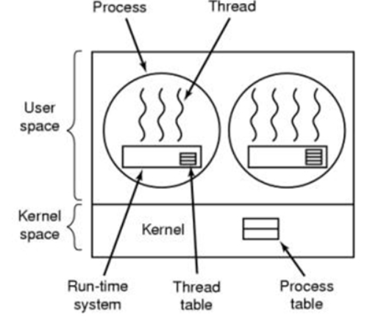
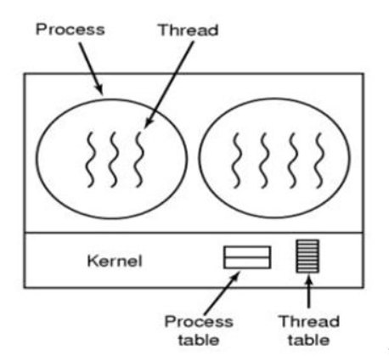
用户线程 内核线程

Slide 13
Multithreading Models
Many-to-One
One-to-One
Many-to-Many

Slide 14

Many-to-One
Many user-level threads mapped to single kernel thread
One thread blocking causes all to block
Multiple threads may not run in parallel on multicore system because only one may be in kernel at a time
Few systems currently use this model
Examples:
  Solaris Green Threads
  GNU Portable Threads

Slide 15

One-to-One
Each user-level thread maps to kernel thread
Creating a user-level thread creates a kernel thread
More concurrency than many-to-one
Number of threads per process sometimes restricted due to overhead
Examples
  Windows
  Linux
  Solaris 9 and later
The one-to-one model allows greater concurrency, but the developer has to be careful not to create too many threads within an application

Slide 16

Many-to-Many Model
Allows many user level threads to be mapped to many kernel threads
Allows the operating system to create a sufficient number of kernel threads
Solaris prior to version 9
Windows with the ThreadFiber package

Slide 17

Two-level Model
Similar to M:M, except that it allows a user thread to be bound to kernel thread
Examples
  IRIX
  HP-UX
  Tru64 UNIX
  Solaris 8 and earlier

Slide 18
Thread Libraries
Thread library provides programmer with API for creating and managing threads
Two primary ways of implementing
  Library entirely in user space
  Kernel-level library supported by the OS
Three primary thread libraries:
  POSIX Pthreads
  Windows threads
  Java threads

Slide 19
Pthreads
May be provided either as user-level or kernel-level
A POSIX standard (IEEE 1003.1c) API for thread creation and synchronization
Specification, not implementation
API specifies behavior of the thread library, implementation is up to development of the library
Common in UNIX operating systems (Solaris, Linux, Mac OS X)

Slide 20

Pthreads Example

Slide 21
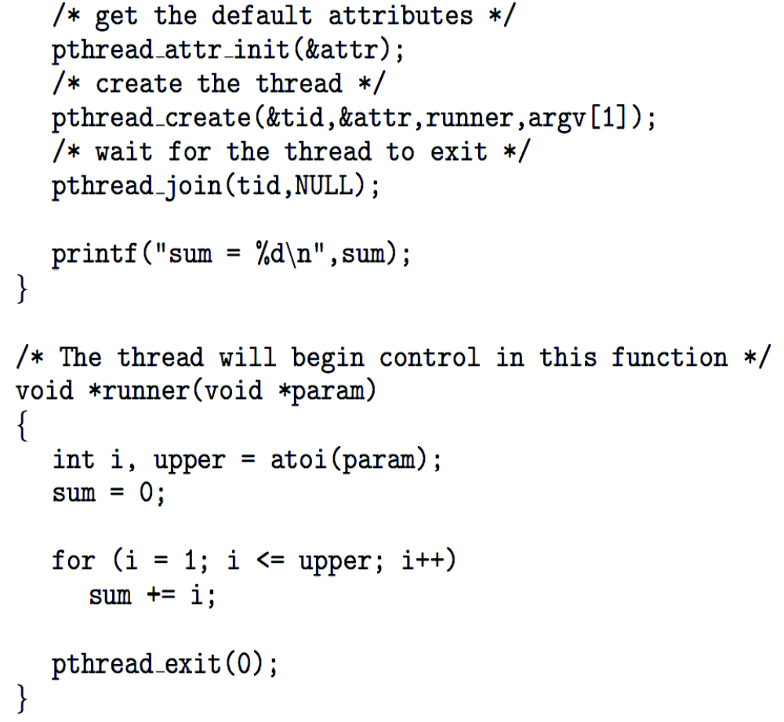
Pthreads Example (Cont.)

Slide 22
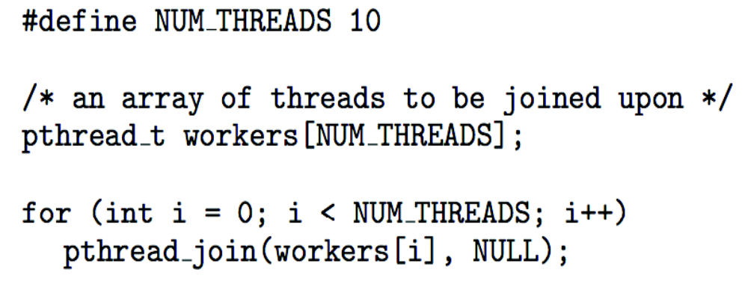
Pthreads Code for Joining 10 Threads
https://blog.csdn.net/qq517986554/article/details/79035714
pthread里一些函数的使用心得

Slide 23
Implicit Threading
Growing in popularity as numbers of threads increase, program correctness more difficult with explicit threads
Creation and management of threads done by compilers and run-time libraries rather than programmers
Three methods explored
  Thread Pools
  OpenMP
  Grand Central Dispatch
Other methods include Microsoft Threading Building Blocks (TBB), java.util.concurrent package

Slide 24

Thread Pools
Create a number of threads in a pool where they await work
Advantages:
  Usually slightly faster to service a request with an existing thread than create a new thread
  Allows the number of threads in the application(s) to be bound to the size of the pool
  Separating task to be performed from mechanics of creating task allows different strategies for running task
    i.e. Tasks could be scheduled to run periodically
Windows API supports thread pools:

Slide 25
Threading Issues
Semantics of fork() and exec() system calls
Signal handling
  Synchronous and asynchronous
Thread cancellation of target thread
  Asynchronous or deferred
Thread-local storage
Scheduler Activations

Slide 26
Semantics of fork() and exec()
Does fork()duplicate only the calling thread or all threads?
  Some UNIXes have two versions of fork
exec() usually works as normal – replace the running process including all threads

Slide 27
Signal Handling
Signals are used in UNIX systems to notify a process that a particular event has occurred.
A signal handler is used to process signals
  Signal is generated by particular event
  Signal is delivered to a process
  Signal is handled by one of two signal handlers:
    default
    user-defined
Every signal has default handler that kernel runs when handling signal
  User-defined signal handler can override default
  For single-threaded, signal delivered to process

Slide 28

Thread Cancellation
Terminating a thread before it has finished
Thread to be canceled is target thread
Two general approaches:
  Asynchronous cancellation terminates the target thread immediately
  Deferred cancellation allows the target thread to periodically check if it should be cancelled
Pthread code to create and cancel a thread:

Slide 29

Thread Cancellation (Cont.)
Invoking thread cancellation requests cancellation, but actual cancellation depends on thread state
If thread has cancellation disabled, cancellation remains pending until thread enables it
Default type is deferred
  Cancellation only occurs when thread reaches cancellation point
    I.e. pthread_testcancel()
    Then cleanup handler is invoked
On Linux systems, thread cancellation is handled through signals

Slide 30
Thread-Local Storage
Thread-local storage (TLS) allows each thread to have its own copy of data
  For example, in a transaction-processing system, we might service each transaction in a separate thread
Useful when you do not have control over the thread creation process (i.e., when using a thread pool)
Different from local variables
  Local variables visible only during single function invocation
  TLS visible across function invocations
Similar to static data
  TLS is unique to each thread

Slide 31

Scheduler Activations
Both M:M and Two-level models require communication to maintain the appropriate number of kernel threads allocated to the application
Typically use an intermediate data structure between user and kernel threads – lightweight process (LWP)
  Appears to be a virtual processor on which process can schedule user thread to run
  Each LWP attached to kernel thread
  How many LWPs to create?
Scheduler activations provide upcalls - a communication mechanism from the kernel to the upcall handler in the thread library
This communication allows an application to maintain the correct number of kernel threads

Slide 32

Linux Threads
Linux refers to them as tasks rather than processes or threads
Thread creation is done through clone() system call
clone() allows a child task to share the address space of the parent task (process)
  Flags control behavior
struct task_struct points to process data structures (shared or unique)

Slide 33

Chap. 4 Review
https://ks.wjx.top/vj/rtOTYVb.aspx
扫码或打开链接提交
提交截止日期：12月1日（下周三）早晨7:30

Slide 34

作业
英文教材第九版 P192： 4.8，4.15，4.17
扫码或打开链接提交
提交截止日期：12月1日（下周三）早晨7:30

Slide 35
End of Chapter 4
Slides are created based on http://codex.cs.yale.edu/avi/os-book/OS9/slide-dir/index.html

