Slide 1
Chapter 5: CPU Scheduling

Slide 2

Chapter 6: CPU Scheduling
Basic Concepts
Scheduling Criteria
Scheduling Algorithms
Thread Scheduling
Multiple-Processor Scheduling
Real-Time CPU Scheduling
Operating Systems Examples
Algorithm Evaluation

Slide 3

Basic Concepts
States of a process
  New: This is the initial state when a process is first started/created；
  Ready： The process is waiting to be assigned to a processor.
  Running： when the processor executes its instructions.
  Waiting：Process moves into the waiting state if it needs to wait for a resource, such as waiting for user input, or waiting for a file to become available.
  Terminated or Exit：Once the process finishes its execution, or it is terminated by the operating system.

Slide 4
CPU Scheduler
Short-term scheduler selects from among the processes in ready queue, and allocates the CPU to one of them
  Queue may be ordered in various ways
CPU scheduling decisions may take place when a process:
  1. Switches from running to waiting state (I/O requests occur)
  2. Switches from running to ready state （interrupts occur）
  3. Switches from waiting to ready (I/O operation finishes)
  Terminates
Scheduling under 1 and 4 is nonpreemptive
All other scheduling is preemptive
  Consider access to shared data
  Consider preemption while in kernel mode
  Consider interrupts occurring during crucial OS activities

Slide 5
Dispatcher
Dispatcher module gives control of the CPU to the process selected by the short-term scheduler; this involves:
  switching context
  switching to user mode
  jumping to the proper location in the user program to restart that program
Dispatch latency – time it takes for the dispatcher to stop one process and start another running

Slide 6
Scheduling Criteria
CPU utilization – keep the CPU as busy as possible
Throughput – # of processes that complete their execution per time unit
Turnaround time – amount of time to execute a particular process
Waiting time – amount of time a process has been waiting in the ready queue
Response time – amount of time it takes from when a request was submitted until the first response is produced, not output (for time-sharing environment)

Slide 7


First- Come, First-Served (FCFS) Scheduling
Process Burst Time
P₁ 24
P₂ 3
P₃ 3
Suppose that the processes arrive in the order: P₁ , P₂ , P₃
The Gantt Chart for the schedule is:
Waiting time for P₁ = 0; P₂ = 24; P₃ = 27
Average waiting time of all processes: (0 + 24 + 27)/3 = 17

Slide 8

Why FCFS is NOT great?
Suppose that the processes arrive in the order:
P₂ , P₃ , P₁
The Gantt chart for the schedule is:
Waiting time for P₁ = 6; P₂ = 0; P₃ = 3
Average waiting time: (6 + 0 + 3)/3 = 3
Much better than previous case
Convoy effect - short process behind long process
  Consider one CPU-bound and many I/O-bound processes

Slide 9
Shortest-Job-First (SJF) Scheduling
Associate with each process the length of its next CPU burst
  Use these lengths to schedule the process with the shortest time
SJF is optimal – gives minimum average waiting time for a given set of processes
  The difficulty is knowing the length of the next CPU request
  Could ask the user

Slide 10

Example of SJF
ProcessArriva l Time Burst Time
P₁ 0.0 6
P₂ 2.0 8
P₃ 4.0 7
P₄ 5.0 3
SJF scheduling chart
Average waiting time = (3 + 16 + 9 + 0) / 4 = 7

Slide 11
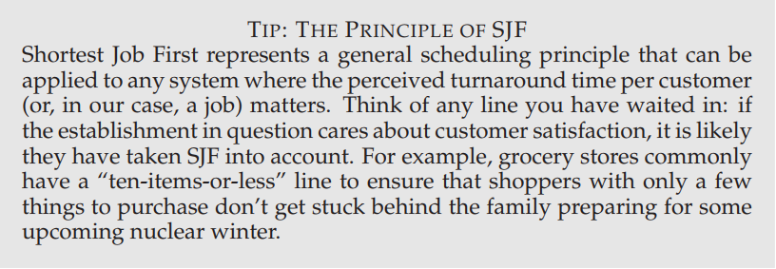
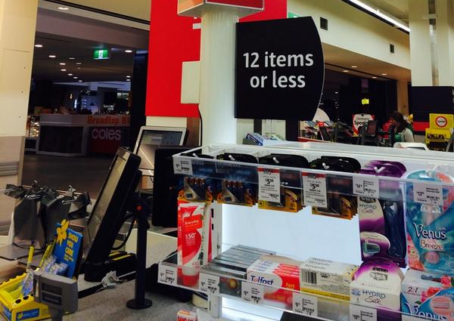


Example of SJF

Slide 12


Determining Length of Next CPU Burst
Can only estimate the length – should be similar to the previous one
  Then pick process with shortest predicted next CPU burst
Can be done by using the length of previous CPU bursts, using exponential averaging
Commonly, α is set to ½
Preemptive version called shortest-remaining-time-first（最短剩余时间优先）

Slide 13

Example of Shortest-remaining-time-first
Now we add the concepts of varying arrival times and preemption to the analysis
ProcessA arri Arrival TimeT Burst Time
P₁ 0 8
P₂ 1 4
P₃ 2 9
P₄ 3 5
Preemptive SJF Gantt Chart
Average waiting time = [(10-1)+(1-1)+(17-2)+5-3)]/4 = 26/4 = 6.5 msec

Slide 14
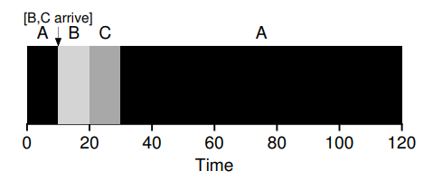
Example of Shortest-remaining-time-first
A: CPU burst time 100, arriving at time 0
B: CPU burst time 10
C: CPU burst time 10
B and C at time 10
New metric : the response time.
  0 for job A,
  0 for B,
  and 10 for C
  average: 3.33.

Slide 15
Priority Scheduling
A priority number (integer) is associated with each process
The CPU is allocated to the process with the highest priority (smallest integer ≡ highest priority)
  Preemptive
  Nonpreemptive
SJF is priority scheduling where priority is the inverse of predicted next CPU burst time
Problem ≡ Starvation – low priority processes may never execute
Solution ≡ Aging – as time progresses increase the priority of the process

Slide 16

Example of Priority Scheduling
ProcessA arri Burst TimeT Priority
P₁ 10 3
P₂ 1 1
P₃ 2 4
P₄ 1 5
P₅ 5 2
Priority scheduling Gantt Chart
Average waiting time = 8.2 msec

Slide 17

Round Robin (RR)
Each process gets a small unit of CPU time (time quantum q), usually 10-100 milliseconds. After this time has elapsed, the process is preempted and added to the end of the ready queue.
If there are n processes in the ready queue and the time quantum is q, then each process gets 1/n of the CPU time in chunks of at most q time units at once. No process waits more than (n-1)q time units.
Timer interrupts every quantum to schedule next process
Performance
  q large ⇒ FIFO
  q small ⇒ q must be large with respect to context switch, otherwise overhead is too high

Slide 18

Example of RR with Time Quantum = 4
Process Burst Time
P₁ 24
P₂ 3
P₃ 3
The Gantt chart is:
Typically, higher average turnaround than SJF, but better response
q should be large compared to context switch time
q usually 10ms to 100ms, context switch < 10 ms

Slide 19

Time Quantum and Context Switch Time

Slide 20

Turnaround Time Varies With The Time Quantum
80% of CPU bursts should be shorter than q

Slide 21
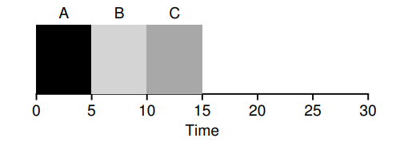
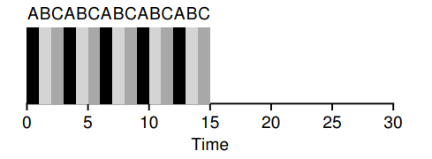
SJF v.s. RR
SJF
Bad for response time
RR
Good for response time

Slide 22
Multilevel Queue
Ready queue is partitioned into separate queues, eg:
  foreground (interactive)
  background (batch)
Process permanently in a given queue
Each queue has its own scheduling algorithm:
  foreground – RR
  background – FCFS
Scheduling must be done between the queues:
  Fixed priority scheduling; (i.e., serve all from foreground then from background). Possibility of starvation.
  Time slice – each queue gets a certain amount of CPU time which it can schedule amongst its processes; i.e., 80% to foreground in RR，20% to background in FCFS

Slide 23

Multilevel Queue Scheduling

Slide 24
Multilevel Feedback Queue
A process can move between the various queues; aging can be implemented this way
Multilevel-feedback-queue scheduler defined by the following parameters:
  number of queues
  scheduling algorithms for each queue
  method used to determine when to upgrade a process
  method used to determine when to demote a process
  method used to determine which queue a process will enter when that process needs service

Slide 25

Example of Multilevel Feedback Queue
Three queues:
  Q₀ – RR with time quantum 8 milliseconds
  Q₁ – RR time quantum 16 milliseconds
  Q₂ – FCFS
Scheduling
  A new job enters queue Q₀ which is served FCFS
    When it gains CPU, job receives 8 milliseconds
    If it does not finish in 8 milliseconds, job is moved to queue Q₁
  At Q₁ job is again served FCFS and receives 16 additional milliseconds
    If it still does not complete, it is preempted and moved to queue Q₂

Slide 26
Thread Scheduling
Distinction between user-level and kernel-level threads
When threads supported, threads scheduled, not processes
Many-to-one and many-to-many models, thread library schedules user-level threads to run on LWP
  Known as process-contention scope (PCS) since scheduling competition is within the process
  Typically done via priority set by programmer
Kernel thread scheduled onto available CPU is system-contention scope (SCS) – competition among all threads in system

Slide 27
Pthread Scheduling
API allows specifying either PCS or SCS during thread creation
  PTHREAD_SCOPE_PROCESS schedules threads using PCS scheduling
  PTHREAD_SCOPE_SYSTEM schedules threads using SCS scheduling
Can be limited by OS – Linux and Mac OS X only allow PTHREAD_SCOPE_SYSTEM

Slide 28
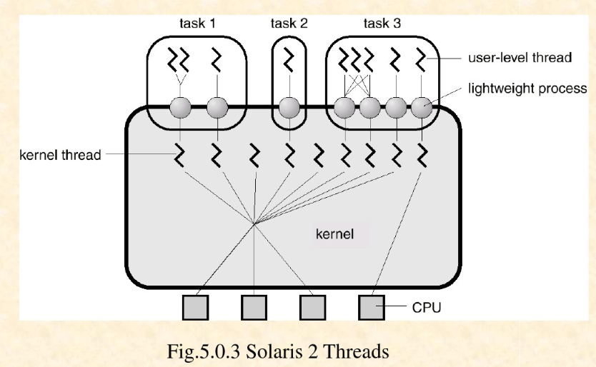

Slide 29
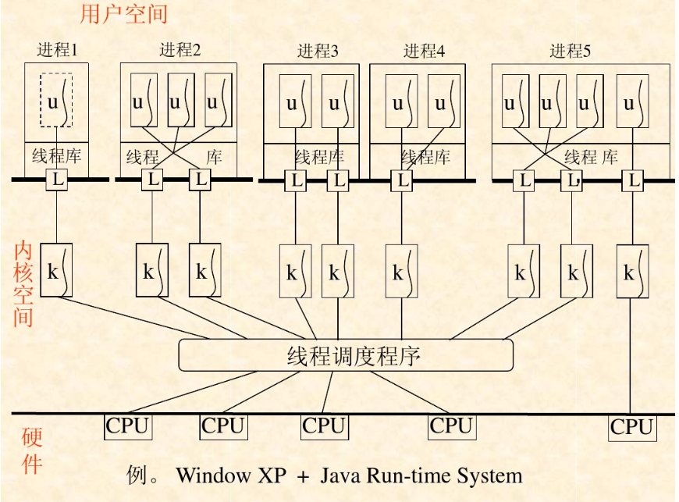

Slide 30
Multiple-Processor Scheduling
CPU scheduling more complex when multiple CPUs are available
Homogeneous processors within a multiprocessor
Asymmetric multiprocessing – only one processor accesses the system data structures, alleviating the need for data sharing
Symmetric multiprocessing (SMP) – each processor is self-scheduling, all processes in common ready queue, or each has its own private queue of ready processes
  Currently, most common
Processor affinity – process has affinity for processor on which it is currently running
  soft affinity
  hard affinity
  Variations including processor sets

Slide 31

NUMA and CPU Scheduling
Note that memory-placement algorithms can also consider affinity

Slide 32

Real-Time CPU Scheduling
Can present obvious challenges
Soft real-time systems – no guarantee as to when critical real-time process will be scheduled
Hard real-time systems – task must be serviced by its deadline
Two types of latencies affect performance
  Interrupt latency – time from arrival of interrupt to start of routine that services interrupt
  Dispatch latency – time for schedule to take current process off CPU and switch to another

Slide 33
Operating System Examples
Linux scheduling
Windows scheduling
Solaris scheduling

Slide 34
Linux Scheduling in Version 2.6.23 +
Completely Fair Scheduler (CFS)
Scheduling classes
  Each has specific priority
  Scheduler picks highest priority task in highest scheduling class
  Rather than quantum based on fixed time allotments, based on proportion of CPU time
  2 scheduling classes included, others can be added
    default
    real-time
Quantum calculated based on nice value from -20 to +19
  Lower value is higher priority
  Calculates target latency – interval of time during which task should run at least once
  Target latency can increase if say number of active tasks increases
CFS scheduler maintains per task virtual run time in variable vruntime
  Associated with decay factor based on priority of task – lower priority is higher decay rate
  Normal default priority yields virtual run time = actual run time
To decide next task to run, scheduler picks task with lowest virtual run time

Slide 35

Linux Scheduling (Cont.)
Real-time scheduling according to POSIX.1b
  Real-time tasks have static priorities
Real-time plus normal map into global priority scheme
Nice value of -20 maps to global priority 100
Nice value of +19 maps to priority 139

Slide 36
Windows Scheduling
Windows uses priority-based preemptive scheduling
Highest-priority thread runs next
Dispatcher is scheduler
Thread runs until (1) blocks, (2) uses time slice, (3) preempted by higher-priority thread
Real-time threads can preempt non-real-time
32-level priority scheme
Variable class is 1-15, real-time class is 16-31
Priority 0 is memory-management thread
Queue for each priority
If no run-able thread, runs idle thread

Slide 37

Assignments
英文教材第九版 Operation System Concepts (9th)
p306-p309： 6.3， 6.5， 6.16
https://ks.wjx.top/vj/rBmXBKb.aspx 或扫描二维码

Slide 38
End of Chapter 6
Slides are created based on http://codex.cs.yale.edu/avi/os-book/OS9/slide-dir/index.html

Slide 39
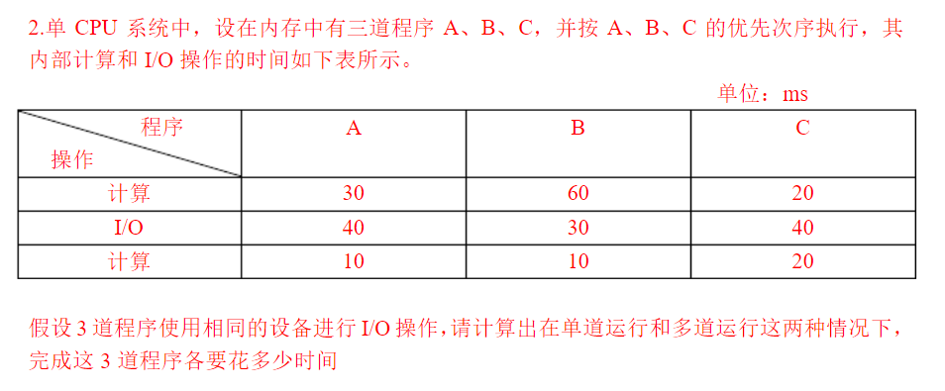


Slide 40
