Slide 1
Chapter 8: Memory Management

Slide 2
Chapter 8: Memory Management
Background
Swapping
Contiguous Memory Allocation
Segmentation
Paging
Structure of the Page Table
Example: The Intel 32 and 64-bit Architectures
Example: ARM Architecture

Slide 3

Base and Limit Registers
A pair of base （基地址寄存器）and limit registers（界限地址寄存器） define the logical address space
CPU must check every memory access generated in user mode to be sure it is between base and limit for that user

Slide 4

Hardware Address Protection

Slide 5
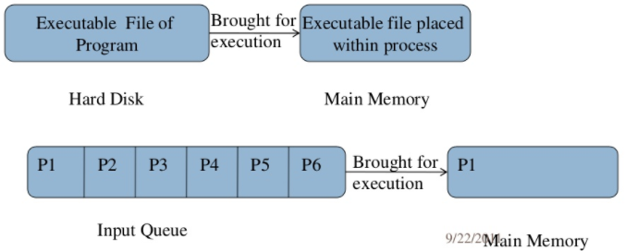
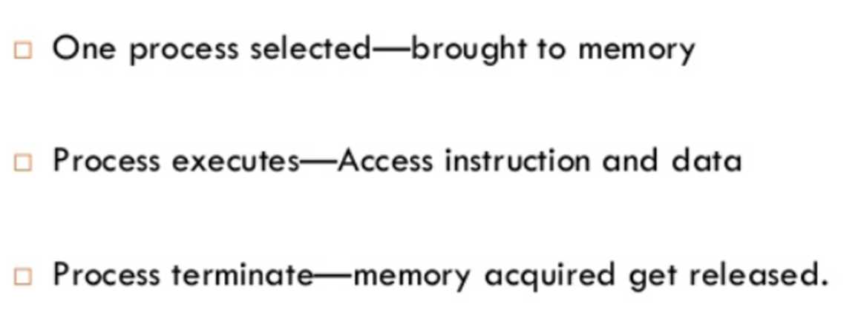
Address Binding
Programs on disk, ready to be brought into memory to execute form an input queue
  Without support, must be loaded into address 0000

Slide 6
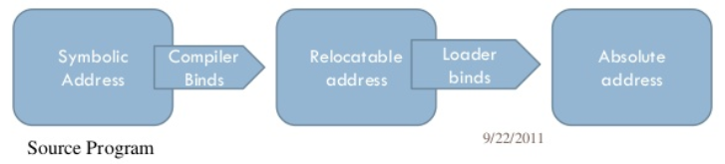
Address Binding
Inconvenient to have first user process physical address always at 0000
  How can it not be? （影响用户程序能够使用的空间）
Further, addresses represented in different ways at different stages of a program’s life
  Source code addresses usually symbolic
  Compiled code addresses bind to relocatable addresses（可重定位地址）
    i.e. “14 bytes from beginning of this module”
  Linker or loader will bind relocatable addresses to absolute addresses（绝对地址）
    i.e. 74014
  Each binding maps one address space to another

Slide 7
Binding of Instructions and Data to Memory
Address binding of instructions and data to memory addresses can happen at three different stages
  Compile time: If memory location known a priori, absolute code （绝对代码）can be generated; must recompile code if starting location changes
  Load time: Must generate relocatable code（可重定位代码） if memory location is not known at compile time
  Execution time: Binding delayed until run time if the process can be moved during its execution from one memory segment to another
    Need hardware support for address maps (e.g., base and limit registers)

Slide 8

Multistep Processing of a User Program

Slide 9

Logical vs. Physical Address Space
The concept of a logical address space that is bound to a separate physical address space is central to proper memory management
  Logical address – generated by the CPU; also referred to as virtual address
  Physical address – address seen by the memory unit
Logical and physical addresses are the same in compile-time and load-time address-binding schemes; logical (virtual) and physical addresses differ in execution-time address-binding scheme
Logical address space is the set of all logical addresses generated by a program
Physical address space is the set of all physical addresses generated by a program

Slide 10
Memory-Management Unit (MMU)
Hardware device that at run time maps virtual to physical address
Many methods possible, covered in the rest of this chapter
To start, consider simple scheme where the value in the relocation register is added to every address generated by a user process at the time it is sent to memory
  Base register now called relocation register（重定位寄存器）
  MS-DOS on Intel 80x86 used 4 relocation registers
The user program deals with logical addresses; it never sees the real physical addresses
  Execution-time binding occurs when reference is made to location in memory
  Logical address bound to physical addresses

Slide 11

Dynamic relocation using a relocation register

Slide 12
Dynamic loading
Routine is not loaded until it is called
Better memory-space utilization; unused routine is never loaded
All routines kept on disk in relocatable load format
Useful when large amounts of code are needed to handle infrequently occurring cases
No special support from the operating system is required
  Implemented through program design
  OS can help by providing libraries to implement dynamic loading

Slide 13
Dynamic Linking
Static linking – system libraries and program code combined by the loader into the binary program image
Dynamic linking –linking postponed until execution time
  This feature is usually used with system libraries, such as language subroutine libraries. Without dynamic linking, each program on a system must include a copy of its language library (or at least the routines referenced by the program) in the executable image. This requirement wastes both disk space and main memory.
Small piece of code, stub, used to locate the appropriate memory-resident library routine or how to load the library if the routine is not already present.
Stub replaces itself with the address of the routine, and executes the routine

Slide 14
Dynamic Linking
Operating system checks if routine is in processes’ memory address
  If not in address space, add to address space
Dynamic linking is particularly useful for libraries
System also known as shared libraries
Consider applicability to patching system libraries
  Versioning may be needed

Slide 15
Swapping
A process can be swapped temporarily out of memory to a backing store, and then brought back into memory for continued execution
  Total physical memory space of processes can exceed physical memory
Backing store – fast disk large enough to accommodate copies of all memory images for all users; must provide direct access to these memory images
Roll out, roll in – swapping variant used for priority-based scheduling algorithms; lower-priority process is swapped out so higher-priority process can be loaded and executed
Major part of swap time is transfer time; total transfer time is directly proportional to the amount of memory swapped
System maintains a ready queue of ready-to-run processes which have memory images on disk

Slide 16

Schematic View of Swapping

Slide 17
Swapping on Mobile Systems
Not typically supported
  Flash memory based
    Small amount of space
    Limited number of write cycles
    Poor throughput between flash memory and CPU on mobile platform
Instead use other methods to free memory if low
  iOS asks apps to voluntarily relinquish allocated memory
    Read-only data thrown out and reloaded from flash if needed
    Failure to free can result in termination
  Android terminates apps if low free memory, but first writes application state to flash for fast restart
  Both OSes support paging as discussed below

Slide 18
Contiguous Memory Allocation
Main memory must support both OS and user processes
Limited resource, must allocate efficiently
Contiguous allocation is one early method
Main memory is usually divided into two partitions:
  Resident operating system, usually held in low memory with interrupt vector
  User processes then held in high memory
  Each process contained in single contiguous section of memory

Slide 19

Multiple-partition allocation
Multiple-partition allocation
  Degree of multiprogramming limited by number of partitions
  Variable-partition sizes for efficiency (sized to a given process’ needs)
  Hole – block of available memory; holes of various size are scattered throughout memory
  When a process arrives, it is allocated memory from a hole large enough to accommodate it
  Process exiting frees its partition, adjacent free partitions combined
  Operating system maintains information about:
  a) allocated partitions b) free partitions (hole)

Slide 20
Dynamic Storage-Allocation Problem
How to satisfy a request of size n from a list of free holes?
First-fit: Allocate the first hole that is big enough
Best-fit: Allocate the smallest hole that is big enough; must search entire list, unless ordered by size
  Produces the smallest leftover hole
Worst-fit: Allocate the largest hole; must also search entire list
  Produces the largest leftover hole
First-fit and best-fit better than worst-fit in terms of speed and storage utilization

Slide 21
Fragmentation
External Fragmentation – total memory space exists to satisfy a request, but it is not contiguous
Internal Fragmentation – allocated memory may be slightly larger than requested memory; this size difference is memory internal to a partition, but not being used
  Suppose that the next process requests 18,462 bytes. If we allocate exactly the requested block, we are left with a hole of 2 bytes. The overhead to keep track of this hole will be substantially larger than the hole itself.

Slide 22
Fragmentation
First-fit analysis reveals that given N blocks allocated, 0.5 N blocks lost to fragmentation
  Statistical analysis of ﬁrst ﬁt, for instance, reveals that, even with some optimization, given N allocated blocks, another 0.5 N blocks will be lost to fragmentation.
  1/3 may be unusable -> 50-percent rule

Slide 23
Fragmentation (Cont.)
Reduce external fragmentation by compaction
  Shuffle memory contents to place all free memory together in one large block
  Compaction is possible only if relocation is dynamic, and is done at execution time
  I/O problem
    Latch job in memory while it is involved in I/O
    Do I/O only into OS buffers
Now consider that backing store has same fragmentation problems

Slide 24
Segmentation
Memory-management scheme that supports user view of memory
A program is a collection of segments
  A segment is a logical unit such as:
main program
procedure
function
method
object
local variables, global variables
common block
stack
symbol table
arrays

Slide 25

User’s View of a Program

Slide 26
Logical View of Segmentation
1
1
4
2
3
4
2
3
user space
physical memory space

Slide 27
Segmentation Architecture
Logical address consists of a two tuple:
<segment-number, offset>,
Segment table – maps two-dimensional user-defined addresses into one-dimensional physical addresses; each table entry has:
  base – contains the starting physical address where the segments reside in memory
  limit – specifies the length of the segment
A logical address consists of two parts:
  A segment number s
  An offset into that segment d

Slide 28

Segmentation Hardware

Slide 29
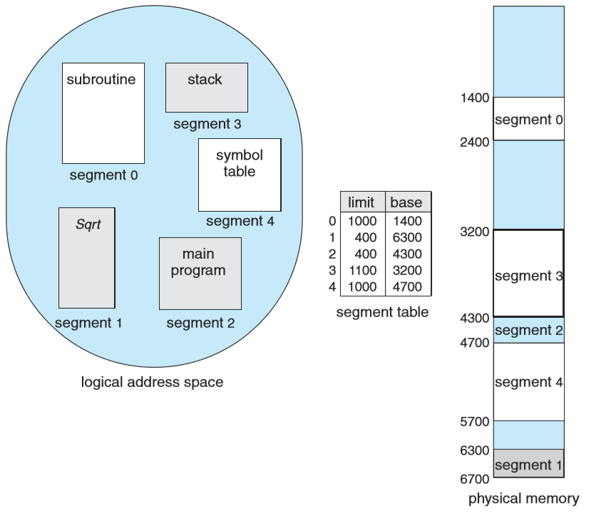
Example of segmentation

Slide 30
Example of segmentation
Five segments numbered from 0 to 4, stored in physical memory.
The segment table has a separate entry for each segment, giving the beginning address of the segment in physical memory (or base) and the length of that segment (or limit).

Slide 31
Example of segmentation
For example, segment 2 is 400 bytes long and begins at location 4300.Thus,a reference to byte 53 of segment 2 is mapped onto location 4300+53=4353.
A reference to segment 3, byte 852, is mapped to 3200 (the base of segment 3) + 852 = 4052.

Slide 32
Example of segmentation
A reference to byte 1222 of segment 0 would result in a trap to the operating system, as this segment is only 1,000 bytes long.

Slide 33
Content
Background
Swapping
Contiguous Memory Allocation
Segmentation
Paging
Structure of the Page Table
Example: The Intel 32 and 64-bit Architectures
Example: ARM Architecture

Slide 34
Paging
Physical address space of a process can be noncontiguous; process is allocated physical memory whenever the latter is available
  Avoids external fragmentation
  Avoids problem of varying sized memory chunks
Divide physical memory into fixed-sized blocks called frames
  Size is power of 2, between 512 bytes and 16 Mbytes
Divide logical memory into blocks of same size called pages
Keep track of all free frames
To run a program of size N pages, need to find N free frames and load program

Slide 35
Paging
Set up a page table to translate logical to physical addresses
Backing store likewise split into frames
  The backing store is divided into ﬁxed-sized blocks that are the same size as the memory frames or clusters of multiple frames.
Still have Internal fragmentation

Slide 36

Address Translation Scheme
Address generated by CPU is divided into:
  Page number (p) – used as an index into a page table which contains base address of each page in physical memory
  Page offset (d) – combined with base address to define the physical memory address that is sent to the memory unit
  For given logical address space 2^{m} and page size 2^{n}
  假设page size 为a，根据page number p得到基地址f，页偏移为d，则物理地址为：
  ^{f * a + d}

Slide 37

Paging Hardware
The page number is used as an index into a page table.
The page table contains the base address of each page in physical memory.
This base address is combined with the page offset to deﬁne the physical memory address that is sent to the memory unit.

Slide 38

Paging Model of Logical and Physical Memory

Slide 39

Paging Example
Using a page size of 4 bytes and a physical memory of 32 bytes (8 pages).
Logical address 0 is page 0, offset 0. Indexing into the page table, we ﬁnd that page 0 is in frame 5. Thus, logical address 0 maps to physical address 20 [= (5×4) + 0].
Logical address3 (page 0, offset3) maps to physical address23 [= (5×4) + 3].
Logical address 4 is page 1, offset 0; according to the page table, page 1 is mapped to frame 6. Thus, logical address 4 maps to physical address 24 [= (6 ×4) + 0].
Logical address13 maps to physical address 9.
n=2 and m=4 32-byte memory and 4-byte pages

Slide 40
Paging (Cont.)
Calculating internal fragmentation
  Page size = 2,048 bytes
  Process size = 72,766 bytes
  35 pages + 1,086 bytes
  Internal fragmentation of 2,048 - 1,086 = 962 bytes
  Worst case fragmentation = 1 frame – 1 byte
  On average fragmentation = 1 / 2 frame size per process
  So small frame sizes desirable?
  But each page table entry takes memory to track
  Page sizes growing over time
    Solaris supports two page sizes – 8 KB and 4 MB
Process view and physical memory now very different
By implementation process can only access its own memory

Slide 41
Implementation of Page Table
Page table is kept in main memory
Page-table base register (PTBR) points to the page table
Page-table length register (PTLR) indicates size of the page table
In this scheme every data/instruction access requires two memory accesses
  One for the page table and one for the data / instruction
The two memory access problem can be solved by the use of a special fast-lookup hardware cache called associative memory or translation look-aside buffers (TLBs) 转换表缓冲区

Slide 42
Implementation of Page Table (Cont.)
Some TLBs store address-space identifiers (ASIDs) in each TLB entry – uniquely identifies each process to provide address-space protection for that process
  Otherwise need to flush at every context switch
TLBs typically small (64 to 1,024 entries)
On a TLB miss, value is loaded into the TLB for faster access next time
  Replacement policies must be considered
  Some entries can be wired down for permanent fast access

Slide 43
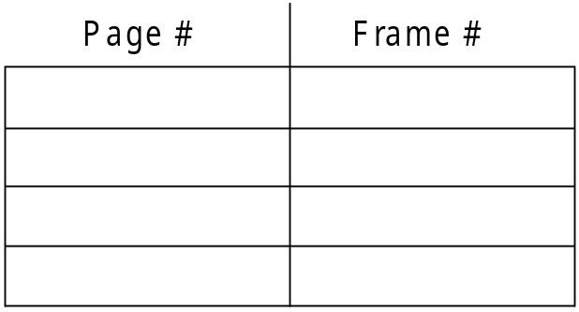
Associative Memory
Associative memory – parallel search
Address translation (p, d)
  If p is in associative register, get frame # out
  Otherwise get frame # from page table in memory

Slide 44

Paging Hardware With TLB

Slide 45
Effective Access Time
Associative Lookup = ε time unit
  Can be < 10% of memory access time
Hit ratio = α
  Hit ratio – percentage of times that a page number is found in the associative registers; ratio related to number of associative registers
Consider α = 80%, ε = 20ns for TLB search, 100ns for memory access， m is the main memory access time.
Effective Access Time (EAT)
EAT = (m + ε) α + (2m + ε)(1 – α)
= 2m + ε – mα
Consider α = 80%, ε = 20ns for TLB search, 100ns for memory access
  EAT = 0.80 x 100 + 0.20 x 200 = 120ns
Consider more realistic hit ratio -> α = 99%, ε = 20ns for TLB search, 100ns for memory access
  EAT = 0.99 x 100 + 0.01 x 200 = 101ns

Slide 46
Consider α = 80%, ε = 20ns for TLB search, 100ns for memory access
  EAT = 0.80 x 100 + 0.20 x 200 = 120ns
Consider more realistic hit ratio -> α = 99%, ε = 20ns for TLB search, 100ns for memory access
  EAT = 0.99 x 100 + 0.01 x 200 = 101ns
Consider α = 80%, ε = 20ns for TLB search, 100ns for memory access
  EAT = 0.80 x (20+100) + 0.20 x (20+100 + 100) = 140ns
Consider more realistic hit ratio -> α = 99%, ε = 20ns for TLB search, 100ns for memory access
  EAT = 0.99 x (20+ 100) + 0.01 x (20+100+100) = 121ns

Slide 47
Structure of the Page Table
Memory structures for paging can get huge using straight-forward methods
  Consider a 32-bit logical address space as on modern computers
  Page size of 4 KB (2¹²)
  Page table would have 1 million entries (2³² / 2¹²)
  If each entry is 4 bytes -> 4 MB of physical address space / memory for page table alone
    That amount of memory used to cost a lot
    Don’t want to allocate that contiguously in main memory
Hierarchical Paging
Hashed Page Tables
Inverted Page Tables

Slide 48
Hierarchical Page Tables
Break up the logical address space into multiple page tables
A simple technique is a two-level page table
We then page the page table

Slide 49
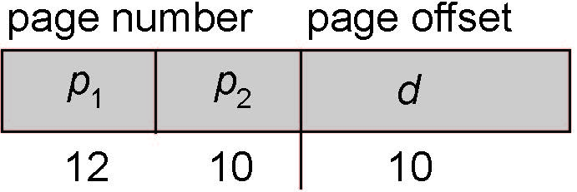
Two-Level Paging Example
A logical address (on 32-bit machine with 1K page size) is divided into:
  a page number consisting of 22 bits
  a page offset consisting of 10 bits
Since the page table is paged, the page number is further divided into:
  a 12-bit page number
  a 10-bit page offset
Thus, a logical address is as follows:
where p₁ is an index into the outer page table, and p₂ is the displacement位移within the page of the inner page table
Known as forward-mapped page table（前向映射页表）

Slide 50

Address-Translation Scheme

Slide 51
Hashed Page Tables
Common in address spaces > 32 bits
The virtual page number is hashed into a page table
  This page table contains a chain of elements hashing to the same location
Each element contains (1) the virtual page number (2) the value of the mapped page frame (3) a pointer to the next element
Virtual page numbers are compared in this chain searching for a match
  If a match is found, the corresponding physical frame is extracted
Variation for 64-bit addresses is clustered page tables（群集页表）
  Similar to hashed but each entry refers to several pages (such as 16) rather than 1
  Especially useful for sparse address spaces (where memory references are non-contiguous and scattered)

Slide 52
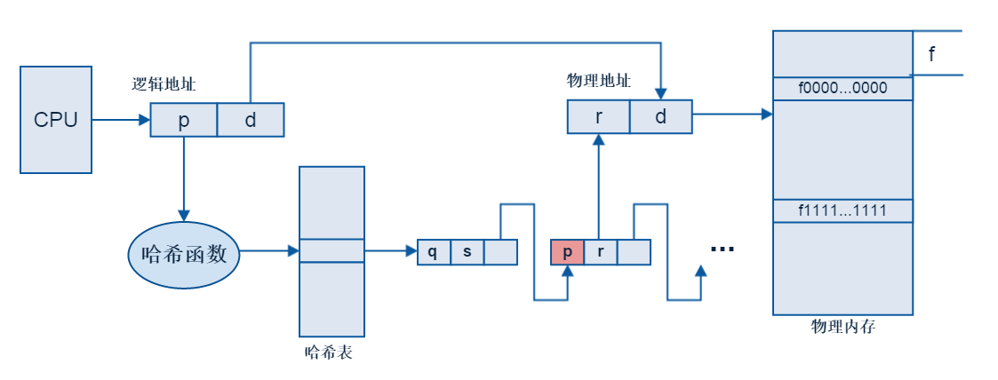
Hashed Page Table

Slide 53
Inverted Page Table
Rather than each process having a page table and keeping track of all possible logical pages, track all physical pages
One entry for each real page of memory
Entry consists of the virtual address of the page stored in that real memory location, with information about the process that owns that page
Decreases memory needed to store each page table, but increases time needed to search the table when a page reference occurs
Use hash table to limit the search to one — or at most a few — page-table entries
  TLB can accelerate access
But how to implement shared memory?
  One mapping of a virtual address to the shared physical address

Slide 54
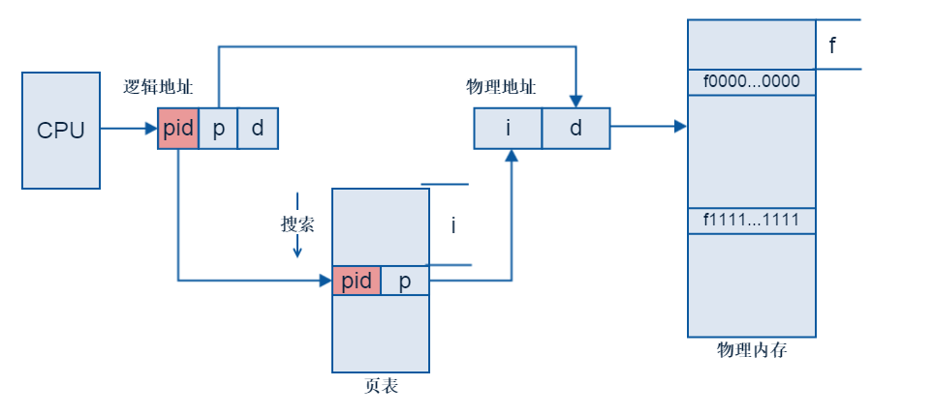
Inverted Page Table Architecture

