Slide 1
Chapters 1 & 2

Slide 2
1. Multiprogramming systems:
A. Are easier to develop than single programming systems
B. Execute each job faster
C. Execute more jobs in the same time period
D. Are used only one large mainframe computers.
2. Which is the first program run on a computer when the computer boots up?
A. System software
B. Operating system
C. System operations
D. None
3. Which is built directly on the hardware?
A. Computer Environment
B. Application Software
C. Operating System
D. Database System

Slide 3
1. Multiprogramming systems:
A. Are easier to develop than single programming systems
B. Execute each job faster
C. Execute more jobs in the same time period
D. Are used only one large mainframe computers.
2. Which is the first program run on a computer when the computer boots up?
A. System software
B. Operating system
C. System operations
D. None
3. Which is built directly on the hardware?
A. Computer Environment
B. Application Software
C. Operating System
D. Database System

Slide 4
4. Which of the following Operating System does not implement multitasking truly?
A. Windows 98
B. Windows NT
C. Windows XP
D. MS DOS
5. Which runs on computer hardware and serve as platform for other software to run on?
A. Operating System
B. Application Software
C. System Software
D. All
6. Which is the layer of a computer system between the hardware and the user program
A. Operating environment
B. Operating system
C. System environment
D. None

Slide 5
4. Which of the following Operating System does not implement multitasking truly?
A. Windows 98
B. Windows NT
C. Windows XP
D. MS DOS
5. Which runs on computer hardware and serve as platform for other software to run on?
A. Operating System
B. Application Software
C. System Software
D. All
6. Which is the layer of a computer system between the hardware and the user program
A. Operating environment
B. Operating system
C. System environment
D. None

Slide 6
7. The primary purpose of an operating system is:
A. To make the most efficient use of the computer hardware
B. To allow people to use the computer
C. To keep systems programmers employed
D. To make computers easier to use
8. When a computer is first turned on or restarted, a special type of absolute loader called ____ is executed
A. Compile and Go loader
B. Boot loader
C. Bootstrap loader
D. Relating loader
9. The operating system manages
A. Memory
B. Processes
C. Disks and I/O devices
D. All of the above

Slide 7
7. The primary purpose of an operating system is:
A. To make the most efficient use of the computer hardware
B. To allow people to use the computer
C. To keep systems programmers employed
D. To make computers easier to use
8. When a computer is first turned on or restarted, a special type of absolute loader called ____ is executed
A. Compile and Go loader
B. Boot loader
C. Bootstrap loader
D. Relating loader
9. The operating system manages
A. Memory
B. Processes
C. Disks and I/O devices
D. All of the above

Slide 8
13. What is the function of an operating system?
A. Manages computer’s resources very efficiently
B. Takes care of scheduling jobs for execution
C. Manages the flow of data and instructions
D. All of the above
14. Which is not the function of the Operating System?
A. Memory management
B. Disk management
C. Application management
D. Virus Protection

Slide 9
13. What is the function of an operating system?
A. Manages computer’s resources very efficiently
B. Takes care of scheduling jobs for execution
C. Manages the flow of data and instructions
D. All of the above
14. Which is not the function of the Operating System?
A. Memory management
B. Disk management
C. Application management
D. Virus Protection

Slide 10
31. What is an ISR in Operating Systems?
A. Information Service Request
B. Interrupt Service Request
C. Interrupt Service Routine
D. Information Service Routine
32. How does the software trigger an interrupt ?
A. Sending signals to CPU through bus
B. Executing a special operation called system call
C. Executing a special program called system program
D. Executing a special program called interrupt trigger program
33. An interrupt vector
A. is an address that is indexed to an interrupt handler
B. is a unique device number that is indexed by an address
C. is a unique identity given to an interrupt
D. none of the mentioned

Slide 11
31. What is an ISR in Operating Systems?
A. Information Service Request
B. Interrupt Service Request
C. Interrupt Service Routine
D. Information Service Routine
32. How does the software trigger an interrupt ?
A. Sending signals to CPU through bus
B. Executing a special operation called system call
C. Executing a special program called system program
D. Executing a special program calle interrupt trigger program
33. An interrupt vector
A. is an address that is indexed to an interrupt handler
B. is a unique device number that is indexed by an address
C. is a unique identity given to an interrupt
D. none of the mentioned

Slide 12
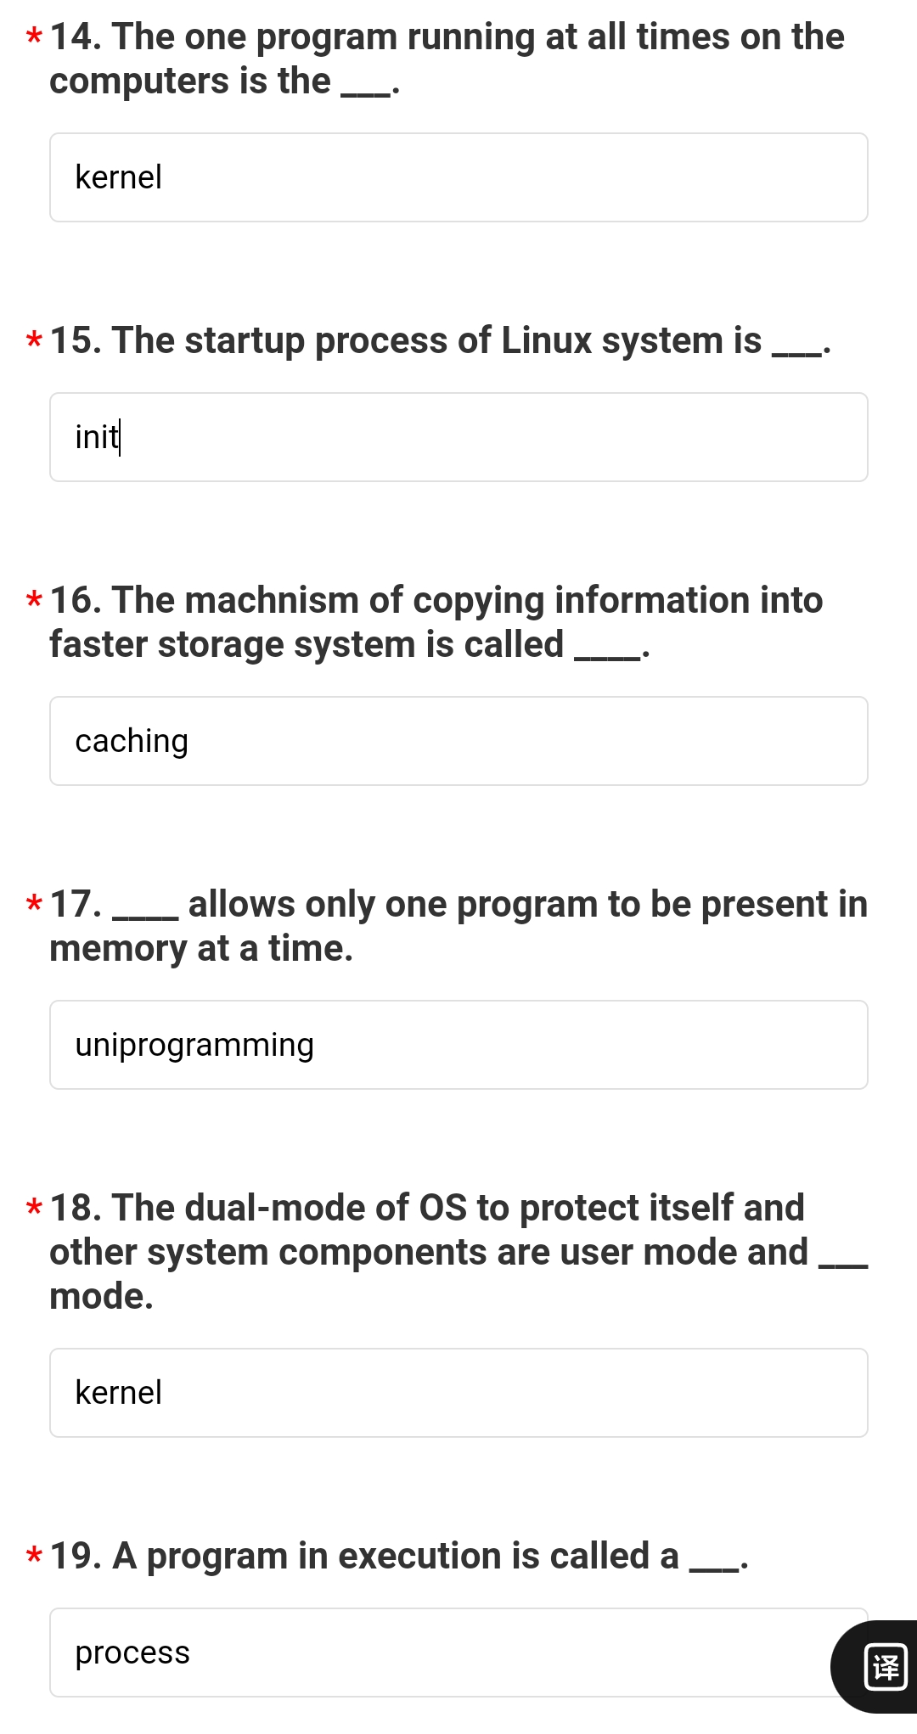
1. The one program running at all times on the computers is the kernel.
2. The startup process of Linux system is init.
3.The machnism of copying information into faster storage system is called caching.
4. Uniprograming allows only 1 program to be present in memory at a time.
5.The dual mode of OS to protect itself and other system components are user mode and kernel mode.
6.A program in execution is called a process.

Slide 13
