Slide 1


Equality
presenters：陈实 段振忠

Slide 2

When it comes to ‘equality’,
what comes to your mind ?

Slide 3
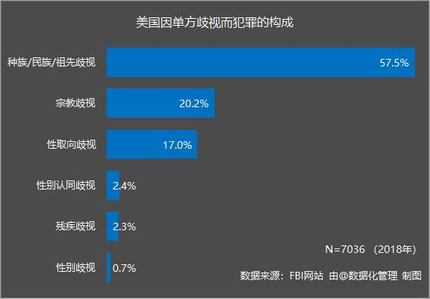
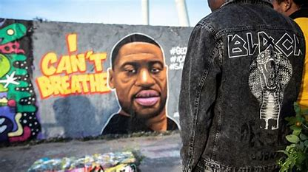
knowledge equality
When it comes to ‘Equality’, what comes to your mind

Slide 4
What is ‘knowledge equality’
Anyone can learn anything in any way anytime anywhere

Slide 5
realistic and achievable
Accessible

Slide 6
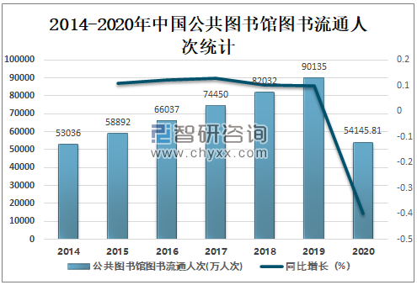
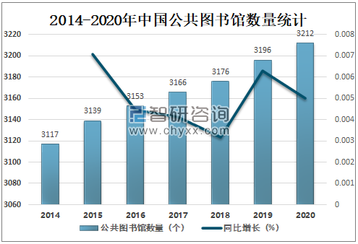
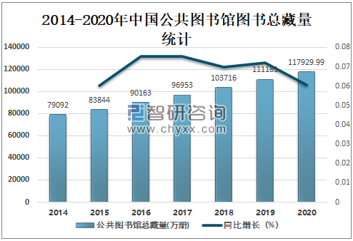
When it comes to ‘Equality’, what comes to your mind

Slide 7

Read books in libraries
Knowledge is open to all social levels.
Knowledge equality is realistic and achievable.
Impressed the principal
Studied hard to get scholarship

Slide 8
Easier to realize
knowledge equality
Internet

Slide 9
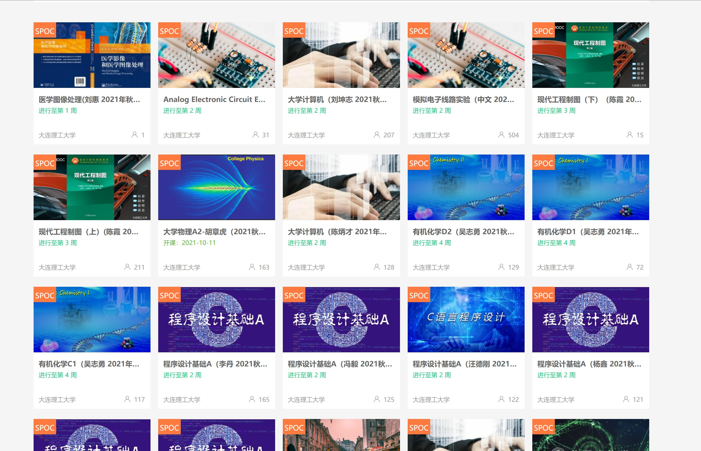
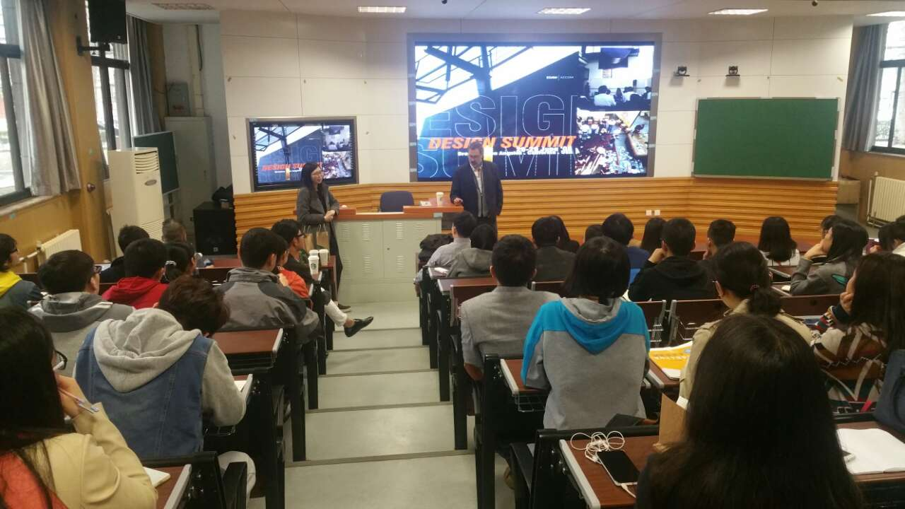
the courses of famous schools
MOOC
When it comes to ‘Equality’, what comes to your mind

Slide 10
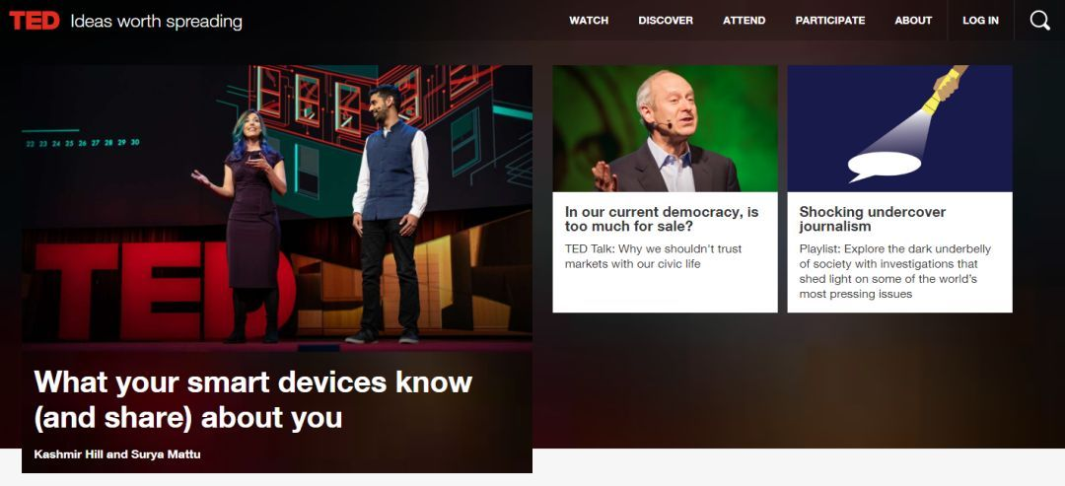
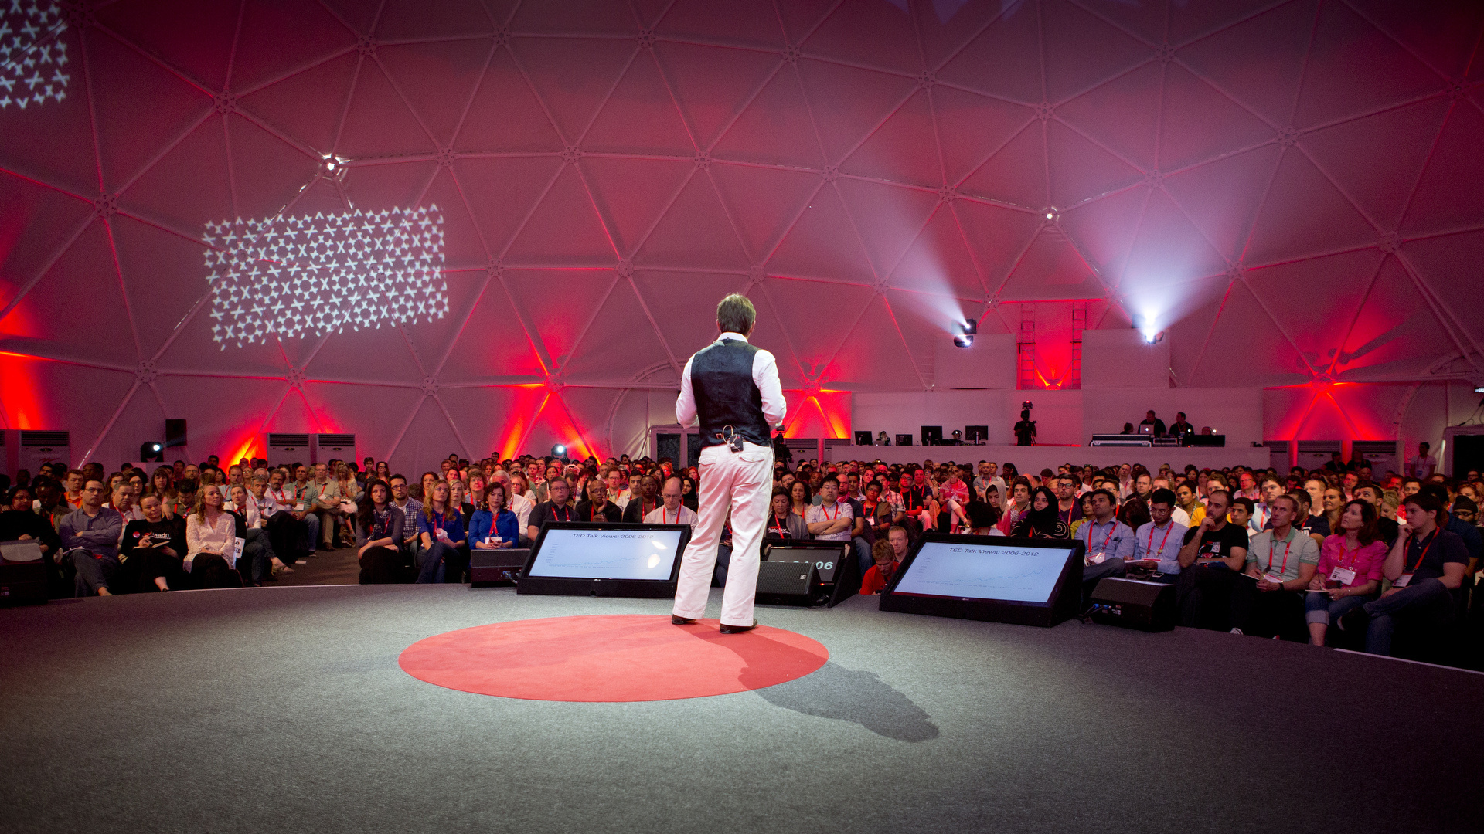
TED Speech on the spot
TED Speech online
When it comes to ‘Equality’, what comes to your mind

Slide 11
Think
How should we be ourselves

Slide 12
equality
knowledge equality

Slide 13

Thank you!

