Slide 1
Exceptions
Throwing Errors/Catching
Colorado State University
Computer Science Department
Slides Originally Created by Albert Lionelle (Albert.Lionelle@colostate.edu)

Slide 2
What’s The Deal With Exceptions?
We are used to errors happening with the compiler
Bad syntax
Wrong type assigned
Specific to C++ Language
What if we want to give more information to the user?

Slide 3
Basic Syntax
try { … }
Execute some code, which might throw an exception
throw value;
Throw an exception. At that point, program execution transfers to any applicable catch clause. If no catch clause applies, then the program dies.
catch (specification) { … }
Deal with an exception.
Specification is very much like a function argument

Slide 4

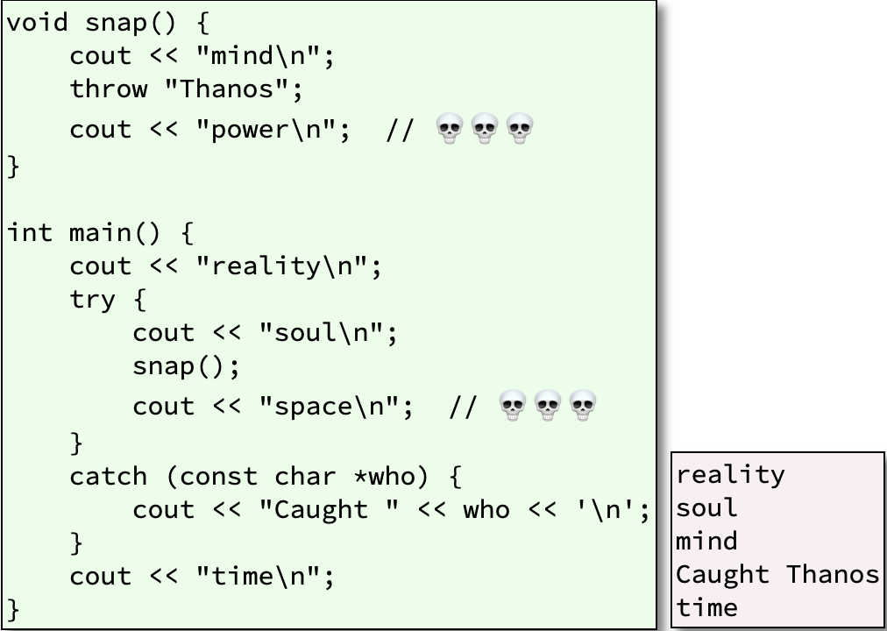
Examples

Slide 5
Trickery
throw without catch
If something is thrown but never caught, then the special function terminate() is called, which complains in an implementation defined manner, and stops the program by calling abort().
A Special Case
For the g++ compiler, an uncaught standard exception gets a .what() string displayed.

Slide 6
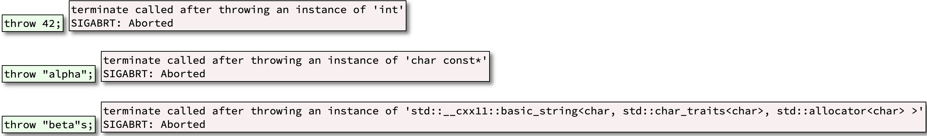
Throw Anything… I Mean Anything
REALLY. You can throw anything and catch anything.

Slide 7
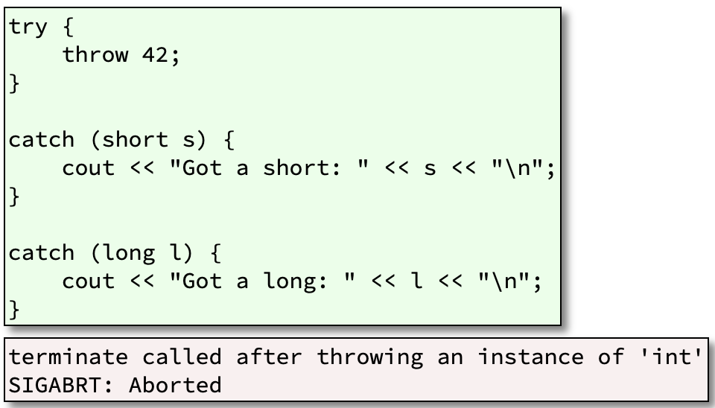
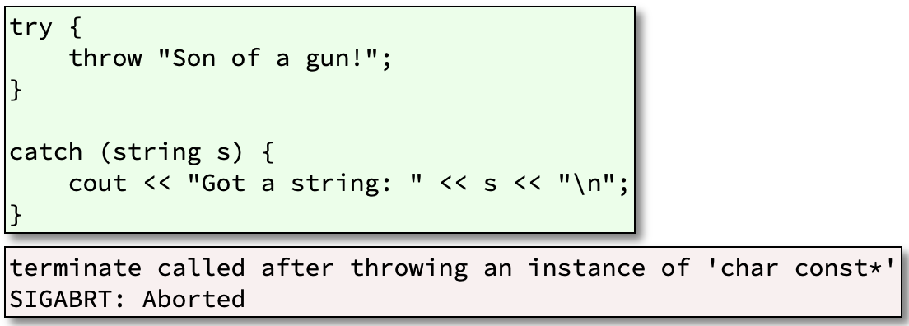
Multiple Catches
Multiple catch clauses are executed in order written.
Therefore, catch the most specific things first, and the least specific last.
catch (…) is the least specific of all, so it must go last.
A good compiler may warn of an unreachable catch. Don’t count on it.

