Slide 1
Loops! For & While
Colorado State University
Computer Science Department
Slides Originally Created by Albert Lionelle (Albert.Lionelle@colostate.edu)

Slide 2
What Are Computers Good At?
Computers are good at three things
Calculations
Formal logic
Repeating what you just asked it to do (iteration) - Loops
Coincidently
Three things humans tend to struggle with
If you understand
Calculations
Formal Logic
And Loops
You will be able to accomplish impressive programs

Slide 3
Basic Syntax For Loop
for (initialization; condition; increase) {statement}
initialization is executed. Generally, this declares a counter variable, and sets it to some initial value. This is executed a single time, at the beginning of the loop.
condition is checked. If it is true, the loop continues; otherwise, the loop ends, and statement is skipped, going directly to step 5.
statement is executed. As usual, it can be either a single statement or a block enclosed in curly braces { }.
increase is executed, and the loop gets back to step 2.
the loop ends: execution continues by the next statement after it.

Slide 4
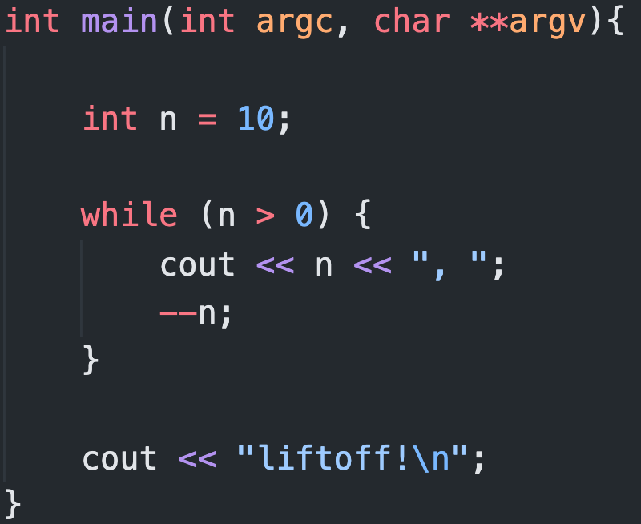
Basic Syntax While Loop
while (expression) {statement}
n is assigned a value
The while condition is checked (n>0). At this point there are two possibilities
condition is true: the statement is executed (to step 3)
condition is false: ignore statement and continue after it (to step 5)
Execute statement:
End of block. Return automatically to step 2.
Continue the program right after the block: print liftoff! and end the program.

Slide 5
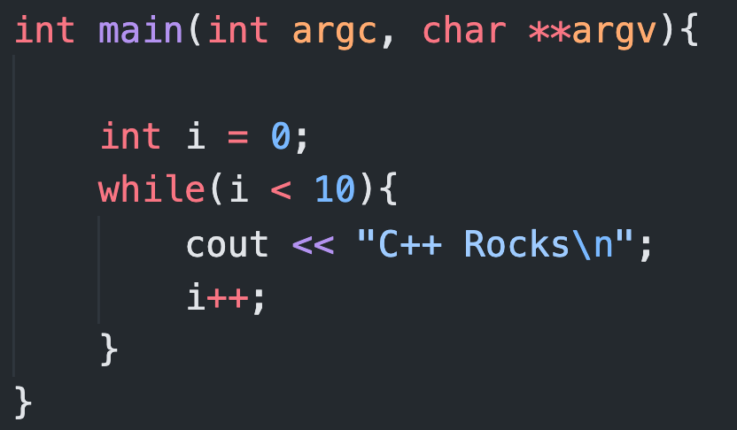
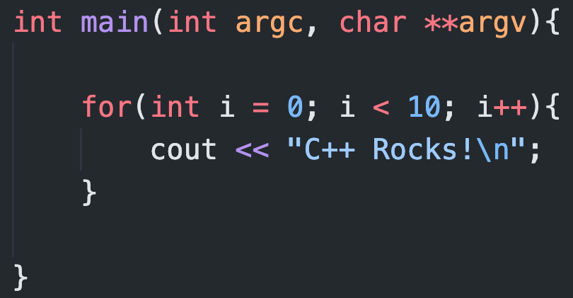
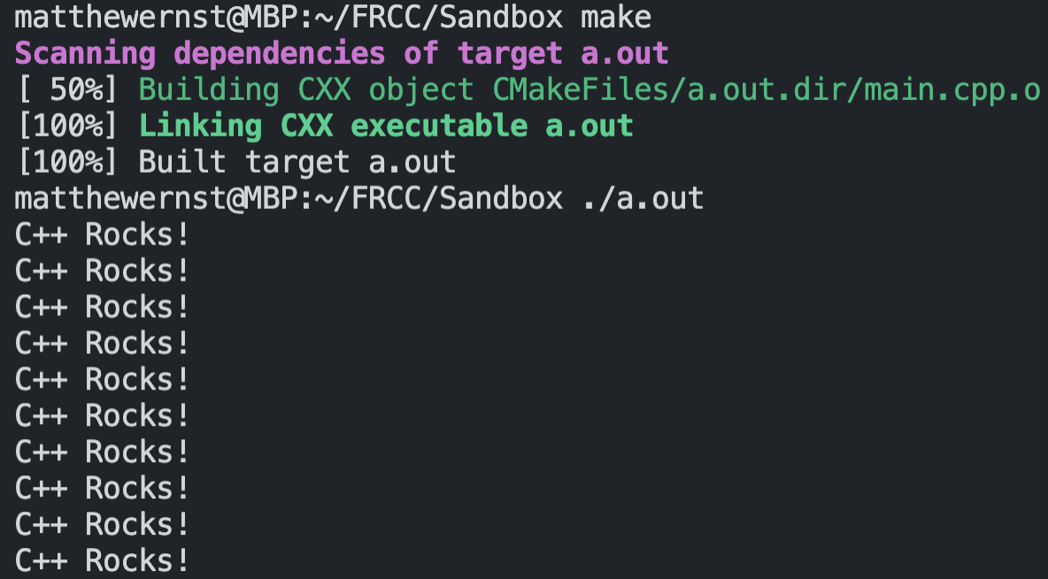
Examples

Slide 6
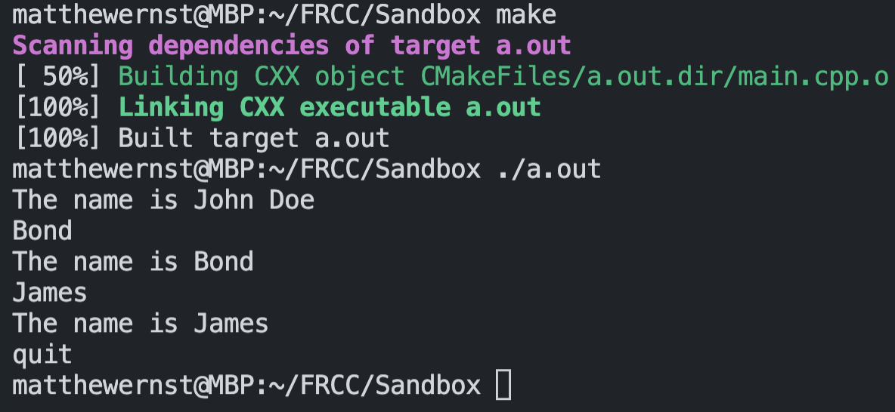
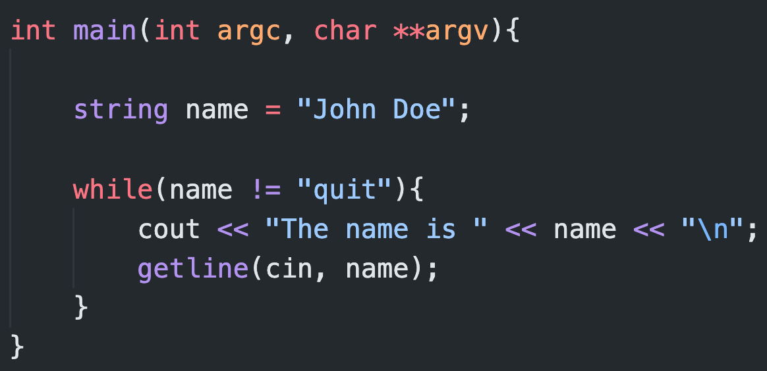
While Loop More Power!

Slide 7
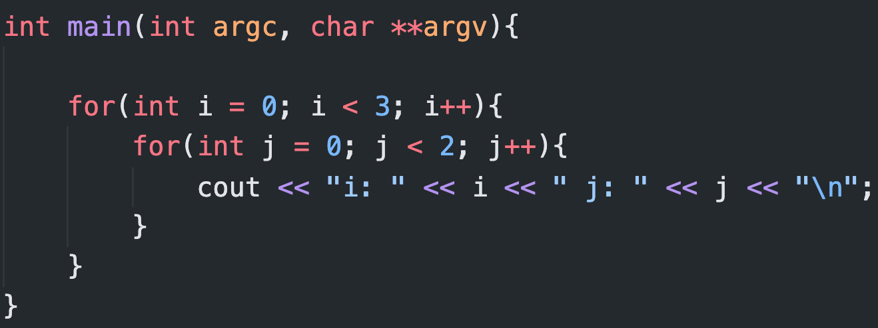
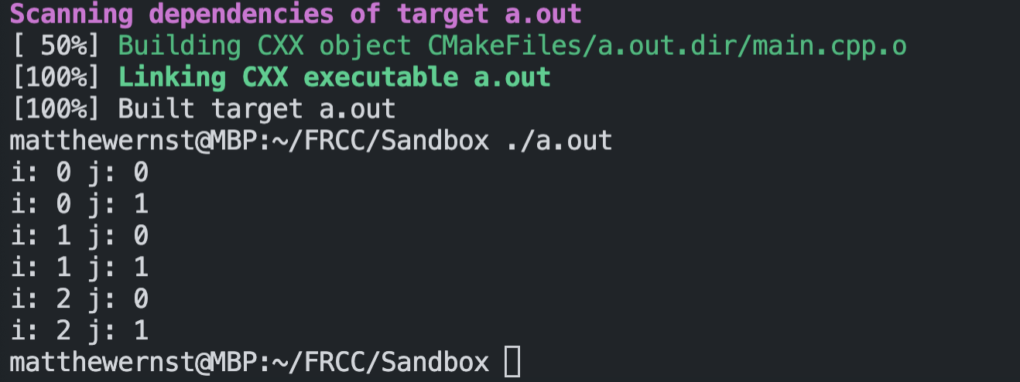
Nested For Loops

