Slide 1
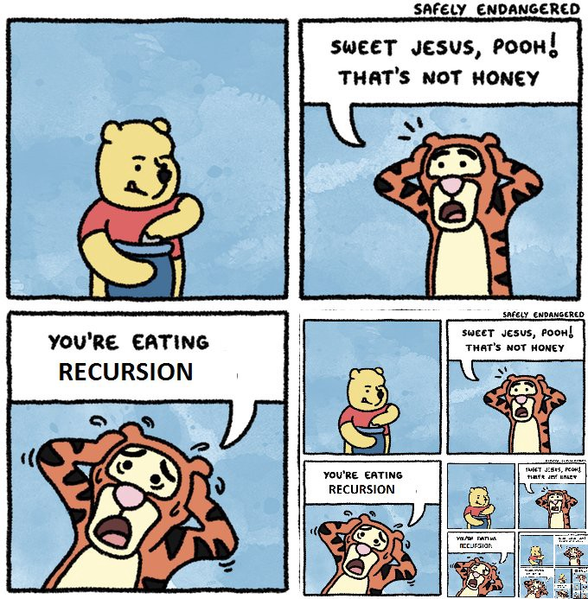
Recursion

Slide 2
What Is Recursion?
The simple answer, it’s a function or method that calls itself.
Recursion can be thought like a loop
Where the loop ending condition is called a base case

Slide 3
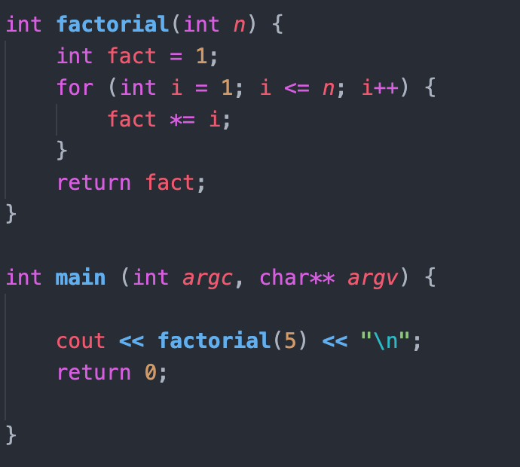
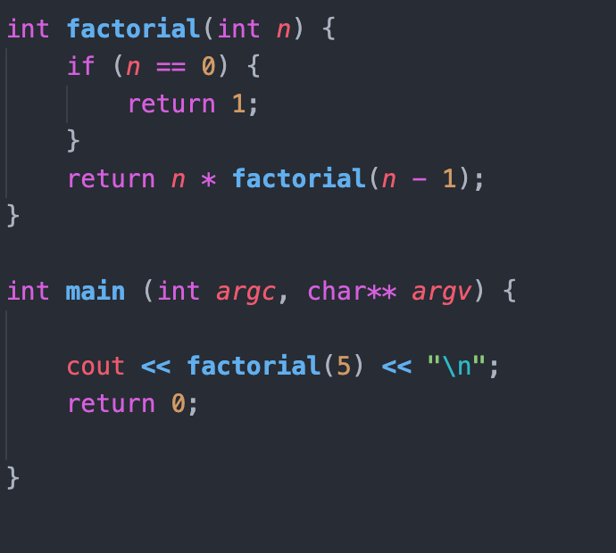
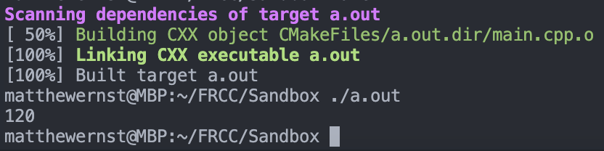
Example For Loop vs Recursion
For Loop
For Recursion

Slide 4
Recursion Is A Loop!
You have already been doing it!
How?
All the menus
Recursion is simply a function/method calling itself
However, to be useful, you always need
Base Case
And method call

Slide 5
Recursion Function Breakdown
Always write the base case first!
Includes a simple return
Base Case
Recursive Call

Slide 6
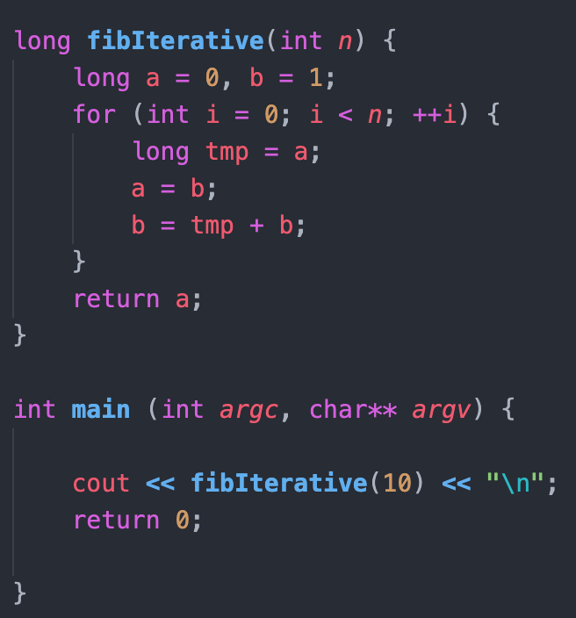
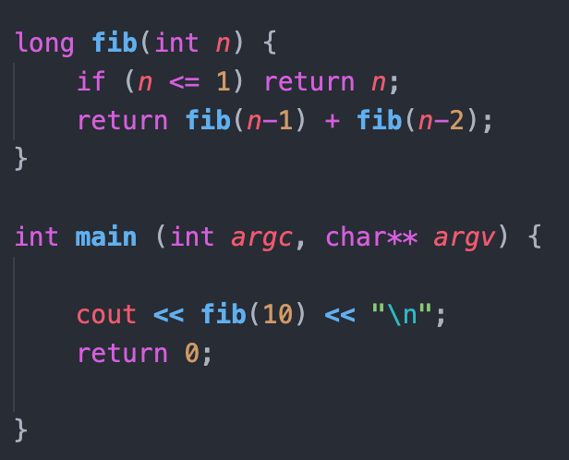
Why Don’t I Just Use A Loop?
Fibonacci sequence
Simplicity
Some solutions to problems are naturally recursive

Slide 7

Ray Tracing

Slide 8
Ray Tracing (The Whole Picture)
Recursive by nature
Point of light to each polygon
Light bounces to next polygon
We can recursively calculate the color moving backwards
But be careful with recursion
What makes up the ray tracer
Matrices
Matrices are incredibly important for Artificial Intelligence, Dynamic Programming and Graphics
Strong Object-Oriented design (Not the scope of this class)
Inheritance
Objects - makes your life easier!

