Slide 1

Namespaces

Slide 2
What Is A Namespace?
Namespaces provide a method for preventing name conflicts in large projects.
Symbols declared inside a namespace block are placed in a named scope that prevents them from being mistaken for identically-named symbols in other scopes.
Multiple namespace blocks with the same name are allowed. All declarations within those blocks are declared in the named scope.

Slide 3
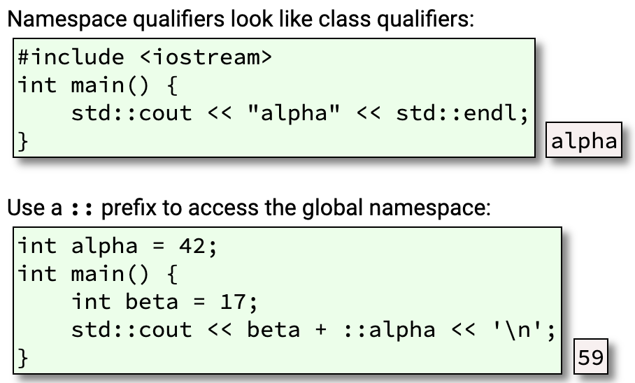
Overview
Namespaces contain symbols:
functions (std::exit())
types
classes (std::runtime_error)
typedefs (std::size_t)
variables
scalars (?)
objects (std::cout)
constants (std::nothrow)
templates (std::vector<>)
namespaces (std::regex_constants)
This is great for organization! You put your stuff in your namespace, I put my stuff in my namespace

Slide 4
Built in Namespaces (std & global)
std
The built in standardized C++ namespace
cout, cin, string, etc
global
The global namespace has a zero-length name, referred to by ::.
It’s reserved for your stuff.
It’s considered poor form for a library or header unnecessarily pollute the global namespace, because that’s not your stuff.
Certain things must go there, for instance, main().
PLEASE DO NOT PUT ANY OF YOUR STUFF IN THESE NAMESPACES. More on this later….

Slide 5
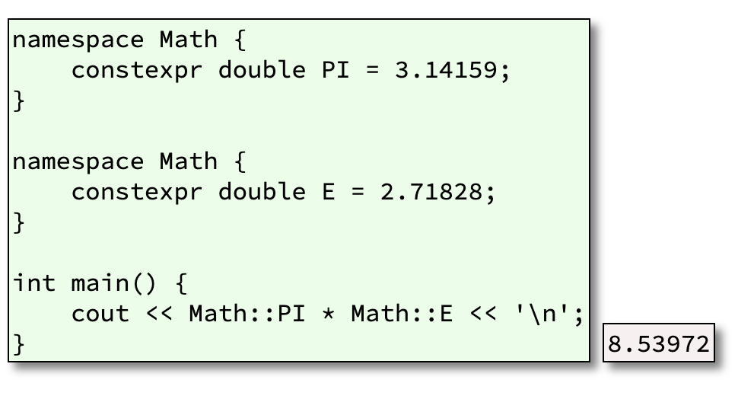
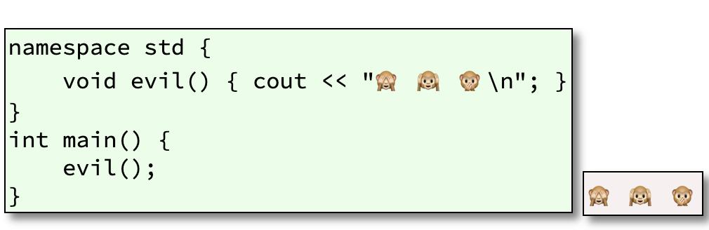
Intricacies of Namespace
A namespace you define is open 👍
The std namespace is “closed” 👎
Okay, technically it’s not. But C++ standards would want you ostracized if you did do this. This becomes implementation defined behavior! AH! BAD NEWS! Who knows what you meant by evil? Only YOU!

Slide 6
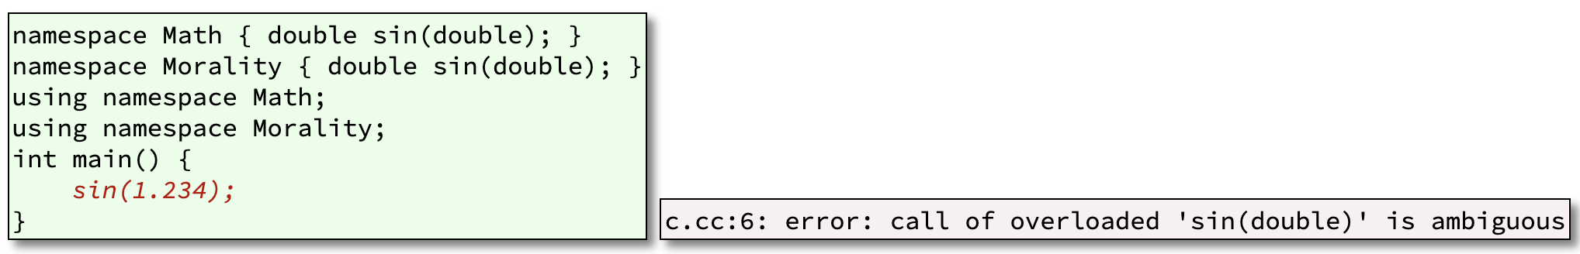
This is Wack. Where The Heck Would I Use This?
When there’s ambiguity!
How does the compiler know which one to use?

Slide 7
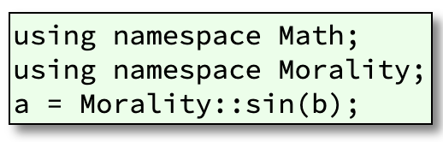
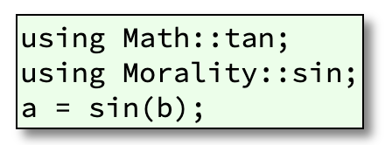
Solutions
Solution 1: Dismantle the ambiguity
Solution 2: Only bring in the functions you need

Slide 8
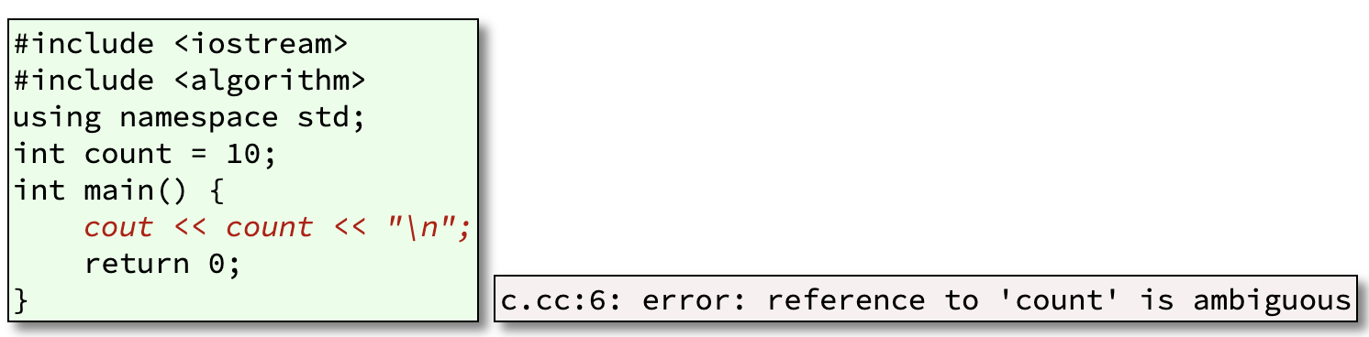
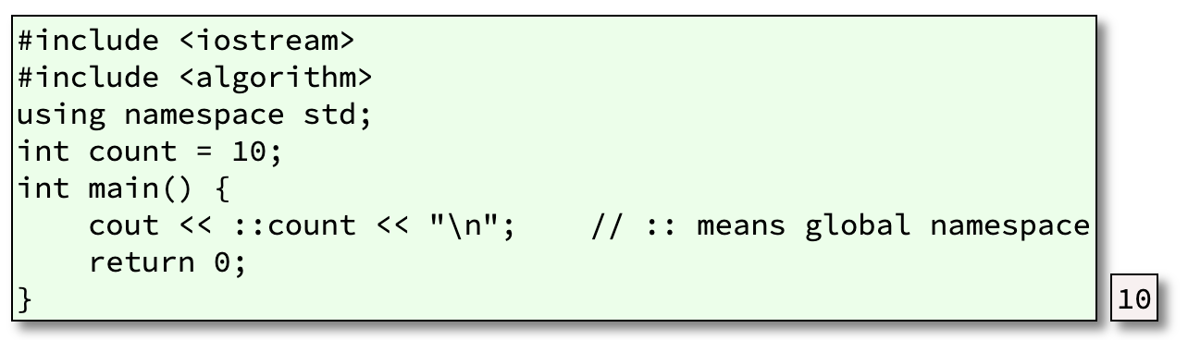
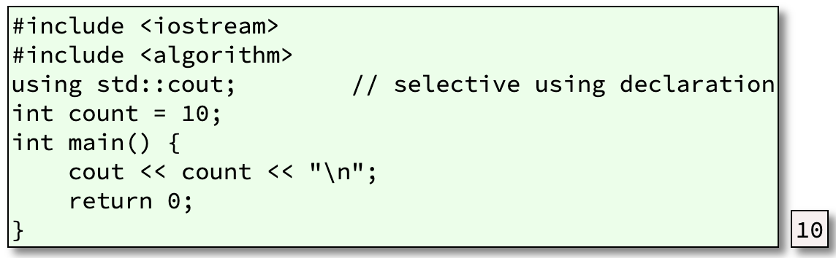
Real World Example
Solution 1
Solution 2

