Slide 1
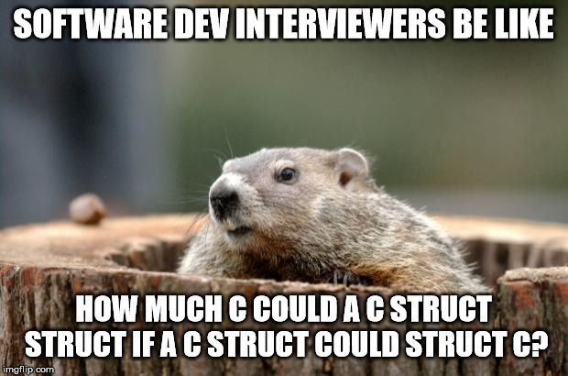
Structs

Slide 2
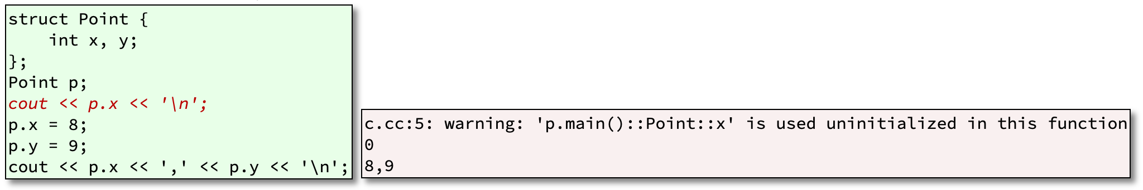
What The Heck Are Structs?
struct is the old C way of doing things
In C, there were no methods-only data members
Structs are still useful for holding unadorned data

Slide 3
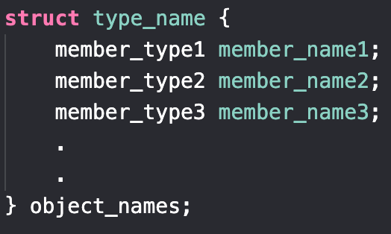
Basic Syntax
structs are data structures with a group of data elements all grouped under one name
These data elements, known as members, can have different types and lengths.

Slide 4
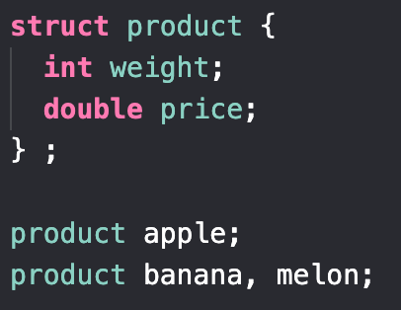
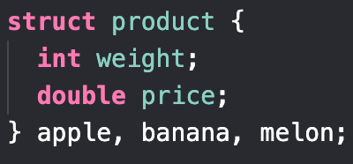
Two Ways of Definition
We can declare 2 ways.
The first is the struct skeleton and then defining individual ones.
The second, is to declare the struct and the object names all at once.

Slide 5
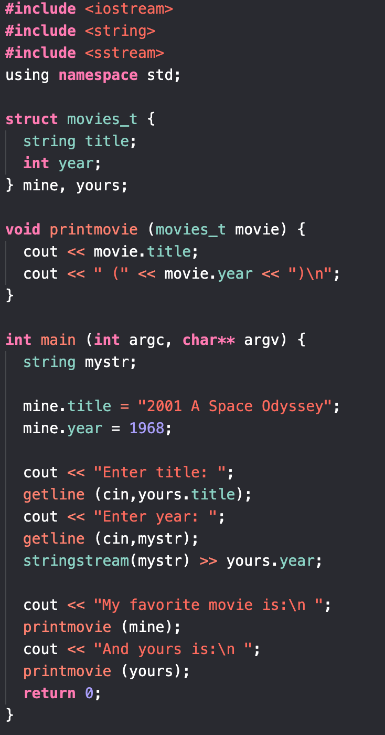
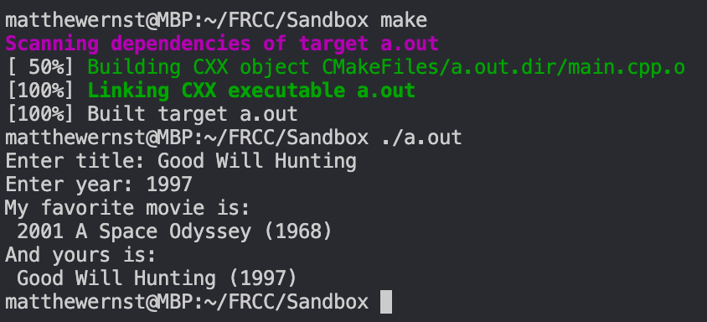
Example

