Slide 1
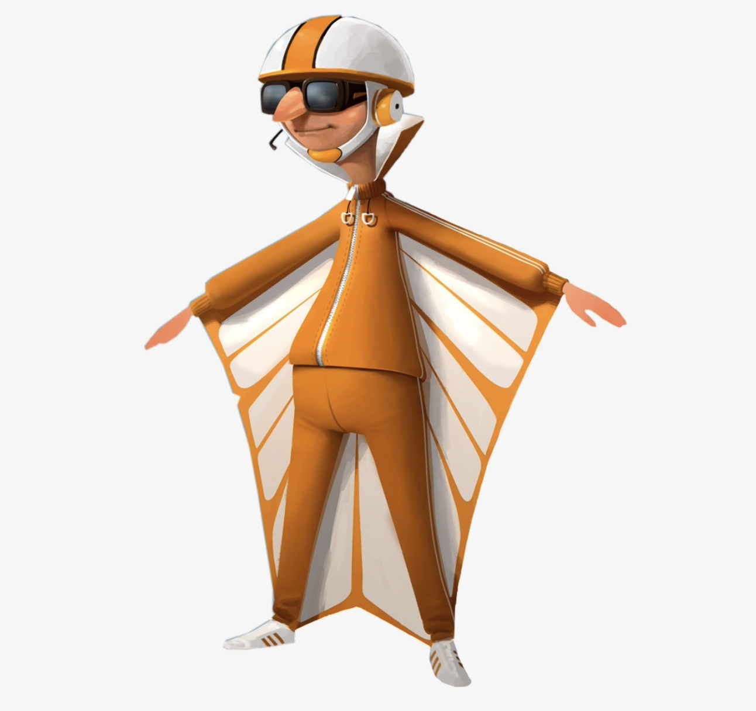
Vector

Slide 2
What Are Vectors?
A vector is a stretchy array. Need to #include <vector>
They have methods to change they vector

Slide 3
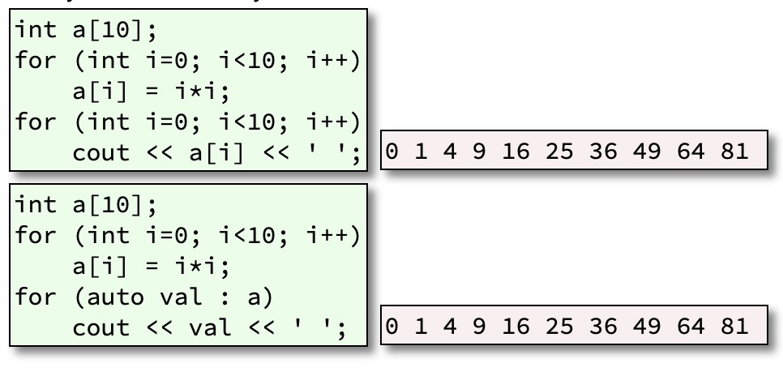
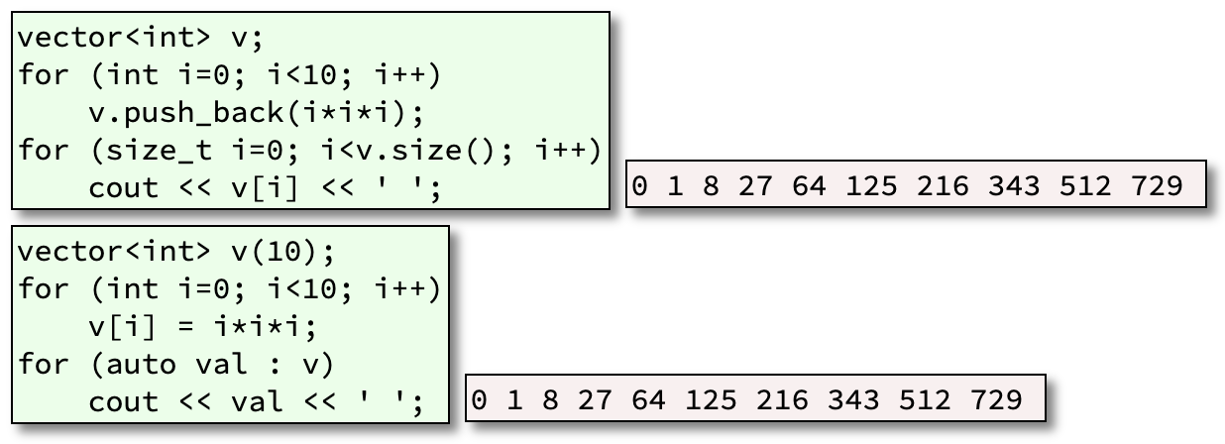
Old School VS New School
Old School
No methods
NOT stretchy
New School
Methods!!
STRETCHY!!

Slide 4
Useful Vector Methods
v.size(): return the current length as a size_t
v.push_back(): add an element to the end
v.pop_back(): remove an element from the end
v.erase(): erase an element from anywhere
v[i]: indexing
There are many many many more

Slide 5
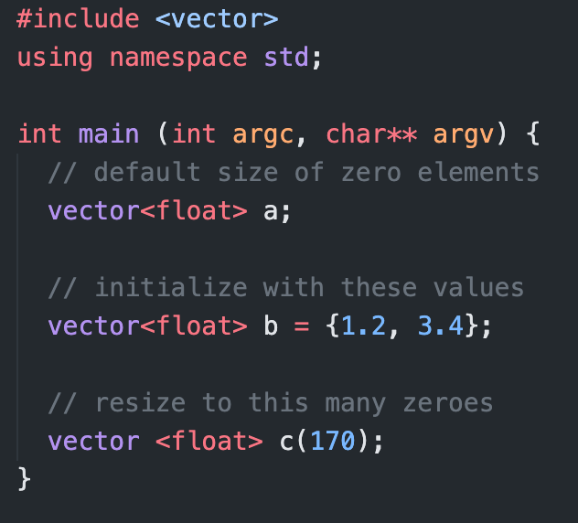
Vector Constructors (How to Make One)
Always vector followed by in angle brackets, the type you are making the vector for, then the vectors name.
These angle brackets are called templating

Slide 6
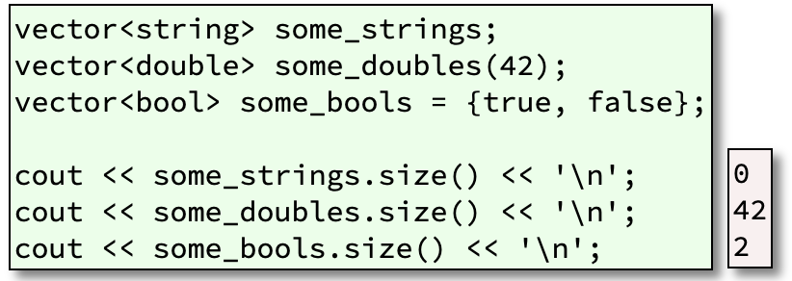
Vector Anything!

