Slide 1
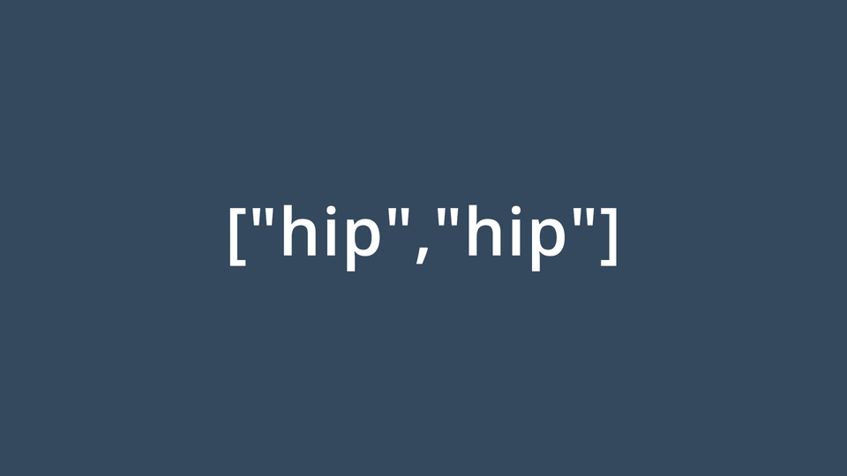
Arrays

Slide 2
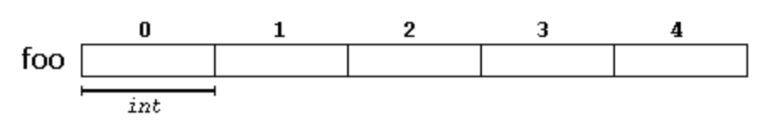
What Are Arrays?
An array is a series of elements of the same type placed in contiguous memory locations that can individually referenced
Arrays can hold any type but only a singular type
int arrays only hold ints
double arrays only hold doubles

Slide 3
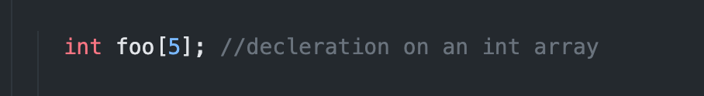
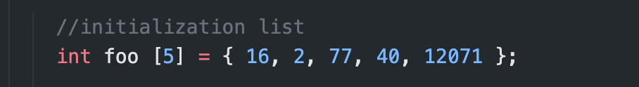
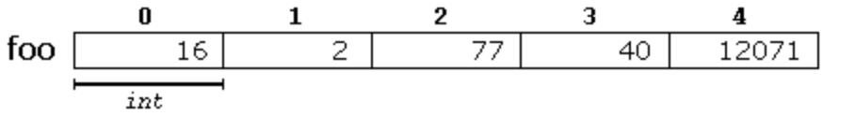
Declaring / Initialization Lists

Slide 4
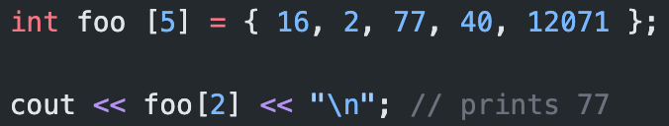
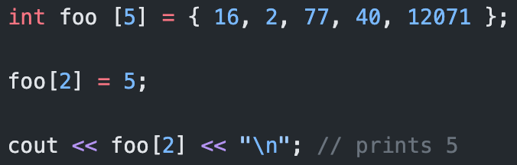
Working With Arrays (Access / Modify)
To access a value from an array we use the arrays name with the [ ] operator with a specified index.
To change a value in an array, we also use the [ ] operator as well as the assignment operator =.

Slide 5
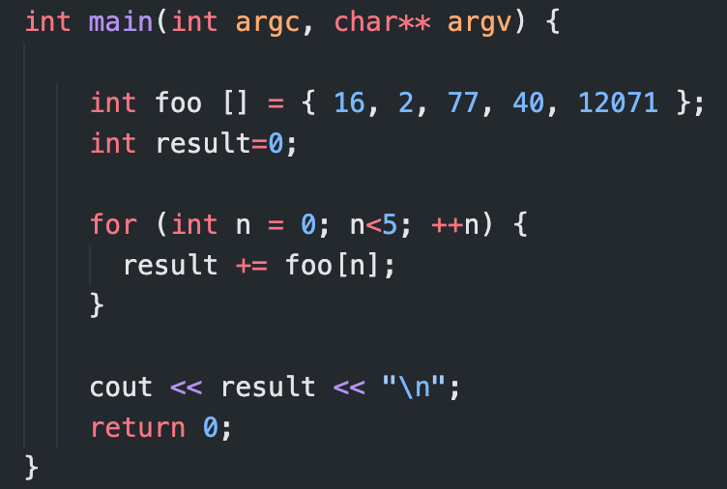
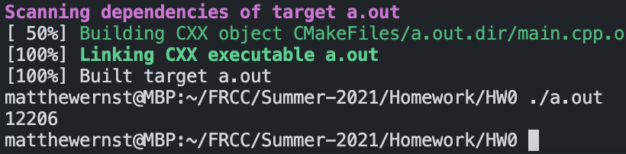
Example

Slide 6
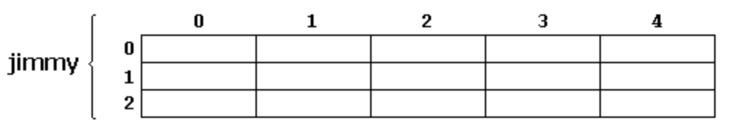

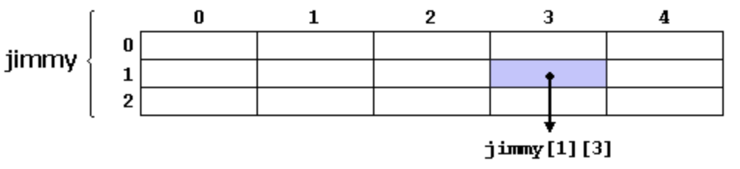
2D Arrays

