Slide 1
Pattern Recognition
CS129.18 - Lim
Section A

Slide 2
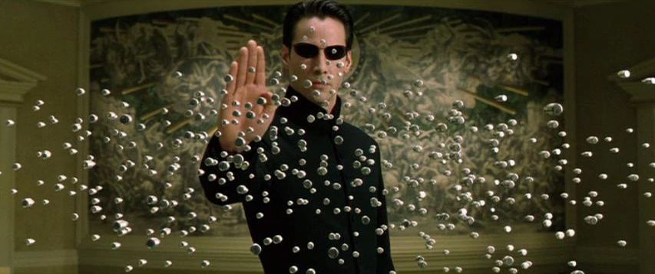

Slide 3
Intro to Linear Algebra
CS129.18 - Lim
Section A

Slide 4
Linear Algebra is a continuous form of mathematics and is applied throughout science and engineering because it allows you to model natural phenomena and to compute them efficiently.

Slide 5
In Linear Algebra, data is represented by linear equations, which are presented in the form of matrices and vectors.

Slide 6
Row Vector
[ 34, 5, -4 ]
[
]
Row(s) x Column(s)
[
]
34
5
-4
34, 5, -4, 2
20, 2, 0, 1
34
Column Vector
Scalar
Vector
Matrix

Slide 7
Matrices are denoted by CAPITAL letters
Vectors are denoted by lowercase letters

Slide 8
v₀ = 2
v₁ = 5
v₂ = -4
v is a 3-dimensional vector
v = [ 2, 5, -4 ]
A Vector is an ordered array of numbers and can be in a row or a column.
Vector
Magnitude + Direction

Slide 9
Matrix A := [ a _{ij}]_{mn}
M_{0,0} = 34
M_{1,2} = 0
M_{0,1} = 5
Row(s) x Column(s)
A_{ij}= ith row, jth column
34, 5, -4, 2
20, 2, 0, 1
M =
m rows, n columns
m = 2, n = 4
A Matrix is an ordered 2D array of numbers and it has two indices. The first one points to the row and the second one to the column.
Uppercase variables map to matrices
Lowercase variables map to vectors
Matrix
2D ordered array of numbers with rows and columns

Slide 10
c = 2
v = [ 3, 5, -4 ]
c * v = [ (2 x 3), (2 x 5), (2 x -4) ]
c * v = [ (c x v₁), (c x v₂), (c x v₃)...c x v_{n} ]
A Matrix is an ordered 2D array of numbers and it has two indices. The first one points to the row and the second one to the column.
Matrix Operations
Scalar x Vector Math

Slide 11
a b
c d
+
e f
g h
=
a+e b+f
c+g d+h
Cannot add unequal dimension matrices
Matrix Operations
Matrix + Matrix Math

Slide 12
c
a b
e d
a*c b*c
e*c d*c
x
=
Same process with vector * scalar multiplication
Matrix Operations
Scalar x Matrix Math

Slide 13
e f
g h
i j
a*e + b*f
a*g + b*h
a*i + b*j
a
b
x
=
Multiplying a Matrix by a Vector can be thought of as multiplying each row of the Matrix by the column of the Vector. The output will be a Vector that has the same number of rows as the Matrix.
Matrix Operations
Vector x Matrix Math

Slide 14
x = n x 1 matrix
A = m x n matrix
A * x = y
y = m-dimensional vector
Multiplying a Matrix by a Vector can be thought of as multiplying each row of the Matrix by the column of the Vector. The output will be a Vector that has the same number of rows as the Matrix.
Matrix Operations
Vector x Matrix Math

Slide 15
B = i x j matrix
A = m x n matrix
A * B = AB
AB = m x j dimensional matrix
Note that you can only multiply Matrices together if the number of the first Matrix’s columns matches the number of the second Matrix’s rows. The result will be a Matrix with the same number of rows as the first Matrix and the same number of columns as the second Matrix.
Matrix Operations
Matrix x Matrix Math

Slide 16
z k
g h
i j
a*z + b*g + c*i , a*k + b*h + c*j
d*z + e*g + f*i , d*k + e*h + f*j
a b c
d e f
x
=
3x2 matrix
2x3 matrix
2x2 matrix
Note that you can only multiply Matrices together if the number of the first Matrix’s columns matches the number of the second Matrix’s rows. The result will be a Matrix with the same number of rows as the first Matrix and the same number of columns as the second Matrix.
Matrix Operations
Matrix x Matrix Math

Slide 17
1 3
0 1
5 2
11 10
9 14
1 3 2
4 0 1
x
=
Multiplying two Matrices together isn’t that hard either if you know how to multiply a Matrix by a Vector.
Matrix Operations
Matrix x Matrix Math

Slide 18
1 3
0 1
5 2
11 10
9 14
1 3 2
4 0 1
x
=
Multiplying two Matrices together isn’t that hard either if you know how to multiply a Matrix by a Vector.
Matrix Operations
Matrix x Matrix Math

Slide 19
1 3
0 1
5 2
11 10
9 14
1 3 2
4 0 1
x
=
Multiplying two Matrices together isn’t that hard either if you know how to multiply a Matrix by a Vector.
Matrix Operations
Matrix x Matrix Math

Slide 20
3 x 7 = 7 x 3
A x B != B x A
Scalar Multiplication is commutative but Matrix Multiplication is not.
Matrix Properties
Things to note

Slide 21
5(3 x 7) = (5 x 3)7
A(B x C) = (A x B)C
Scalar and Matrix Multiplication are both associative.
Matrix Properties
Things to note

Slide 22
5(3 + 7) = (5*3 + 5*7)
C(A + B) = (A*C + B*C)
Scalar and Matrix Multiplication are also both distributive.
Matrix Properties
Things to note

Slide 23
0.2 0.4 0.1 0.9
0.1 1.0 0.8 0.01
0.2 0.2 0.4 0.7
0 .0 0.1 0.01 1.0
1 20 2
10 1 5
0 42 10
A square matrix is where the number of columns and rows are the same, and is defined by the ff:
Square Matrix
Square matrix = A_{mxm}
Things to note

Slide 24
1 0 0 0
0 1 0 0
0 0 1 0
0 0 0 1
1 0 0
0 1 0
0 0 1
You can spot an Identity Matrix by the fact that it has ones along its diagonals and that every other value is zero. It is also a “squared matrix,” meaning that its number of rows matches its number of columns.
Identity Matrix
Things to note

Slide 25
Thank You

