Slide 1
Decision Trees
CS129.18
CSCI214
Hadrian Paulo Lim

Slide 2
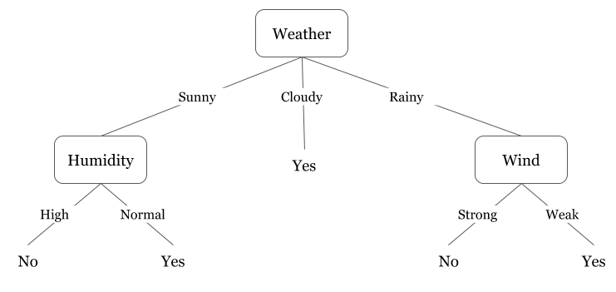
What is a Decision Tree?

Slide 3
What is a Decision Tree?
A decision tree is a tree-like graph with:
Nodes representing an attribute
Edges representing the answers to the question, which is commonly a binary decision; and
Leaves representing the actual output or class label.
They are used in non-linear decision making with simple linear decision surface.
Notes:
https://www.hackerearth.com/practice/machine-learning/machine-learning-algorithms/ml-decision-tree/tutorial/

Slide 4
What is a Decision Tree?
Two types of Decision Tree models:
Classification Tree
when the predicted outcome is the class (discrete) to which the data belongs.
Regression Tree
when the predicted outcome can be considered a real number (e.g. the price of a house, or a patient's length of stay in a hospital).
Notes:
https://www.hackerearth.com/practice/machine-learning/machine-learning-algorithms/ml-decision-tree/tutorial/

Slide 5
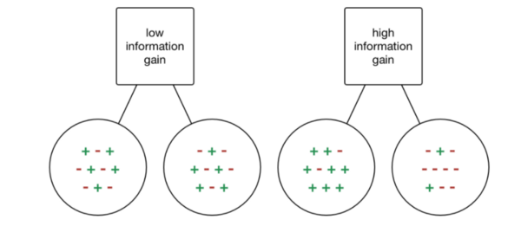
How is a Decision Tree Generated from a Dataset?
Gini Coefficient
Notes:
https://www.kdnuggets.com/2018/12/guide-decision-trees-machine-learning-data-science.html

Slide 6
How is a Decision Tree Generated from a Dataset?
After generating a deep tree, such that the Gini coefficient for all nodes ≃ 0 or some threshold value, pruning the tree is initiated.
Pruning is simply removing sub-trees or nodes that generally do not affect the value of the loss or cost function.
Notes:
https://www.kdnuggets.com/2018/12/guide-decision-trees-machine-learning-data-science.html

Slide 7
Decision Trees Pros and Cons
Pros
Simple to understand and to interpret. Trees can be visualised.
Requires little data preparation. Other techniques often require data normalisation, dummy variables need to be created and blank values to be removed. Note however that this module does not support missing values.
The cost of using the tree (i.e., predicting data) is logarithmic in the number of data points used to train the tree.
Able to handle both numerical and categorical data. Other techniques are usually specialised in analysing datasets that have only one type of variable. See algorithms for more information.
Uses a white box model. If a given situation is observable in a model, the explanation for the condition is easily explained by boolean logic.

Slide 8
Decision Trees Pros and Cons
Cons
Decision Trees easily overfit.
Regression Trees cannot generate values that are higher or lower than what it has seen from the data.
Decision trees can be unstable because small variations in the data might result in a completely different tree being generated.
Practical decision-tree learning algorithms are based on heuristic algorithms such as the greedy algorithm where locally optimal decisions are made at each node.
There are concepts that are hard to learn because decision trees do not express them easily, such as XOR, parity or multiplexer problems.
Decision tree learners create biased trees if some classes dominate. It is recommended to balance the dataset prior to fitting.

