Slide 1
Random Forests
CS129.18
CSCI214
Hadrian Paulo Lim

Slide 2
Weaknesses of Decision Trees
Cons
Decision Trees easily overfit.
Regression Trees cannot generate values that are higher or lower than what it has seen from the data.
Decision trees can be unstable because small variations in the data might result in a completely different tree being generated.
Practical decision-tree learning algorithms are based on heuristic algorithms such as the greedy algorithm where locally optimal decisions are made at each node.

Slide 3
Improving upon Decision Trees
We know that a Decision Tree learner easily overfits given the full training set..
Idea:
What if we train multiple and independent decision trees from samples or subsets of our data?
Then, with these independent trees, get the majority or average predictions.

Slide 4
Ensemble Learning
“Keep all hypotheses that are consistent with the facts!”
- Epicurus’ Principle of Multiple Explanations
Another perspective vs Occam’s Razor:
If multiple theories explain the data, keep them all!
Ensemble Learning is about using multiple learners and getting a majority decision.
Notes:
https://statmodeling.stat.columbia.edu/2007/10/11/epicurus-progress-netflix-prize/

Slide 5
What is a Random Forest?
A Random Forest is composed of:
Multiple Decision Trees trained on subsets of the dataset
Utilizes Bootstrapping or Sampling the Dataset with Replacement and
Employs a voting or averaging mechanism to generate predictions.

Slide 6
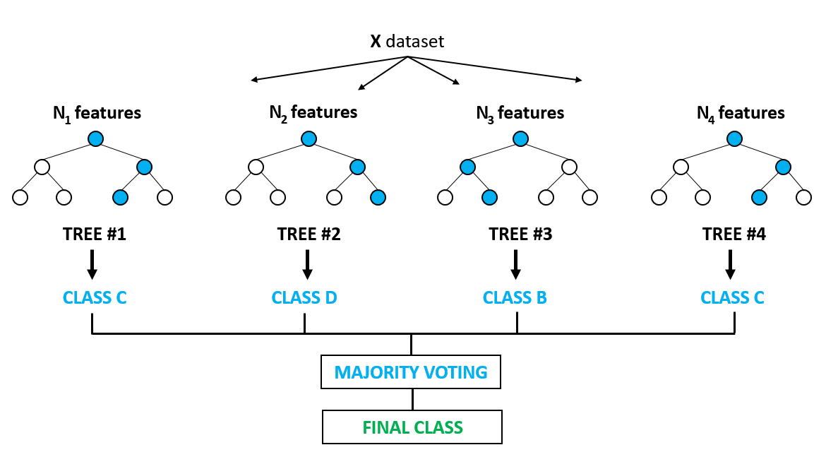
How is a Random Forest Generated from a Dataset?
Notes:
https://predictivesolutions.pl/blog/wp-content/uploads/2019/05/ggff5544hh.png

Slide 7
Random Forests Pros and Cons
Pros
(Was) state of the art in the early 2000s
Typically have very good performance
Remarkably good “out-of-the box” - very little tuning required
Built-in validation set - don’t need to sacrifice data for extra validation
No pre-processing required
Robust to outliers

Slide 8
Random Forests Pros and Cons
Cons
Can become slow on large data sets
Although accurate, often cannot compete with advanced boosting algorithms
Less interpretable compared to a single Decision Tree

