Slide 1
CPU
I/O Bus
Memory Bus
Input/Output
Memory

Slide 2
Data
What you could do with the data?
How you could find the answer
Answer

Slide 3
Item 1
Item 2
Item n
Param 1
Param 2
Param n
Name
Results
Computations

Slide 4
Value:
45
57
66
48
39
71
68
Index:
1
2
3
4
5
n-1
n

Slide 5
Logical Test
false
true
Code block
Default
end

Slide 6
Logical Test 1
Logical Test 2
Logical Test n
false
false
false
true
true
true
Code block 1
Code block 2
Code block n
Default
end

Slide 7
Iteration Vector
finished
not finished
Code block
end

Slide 8
Initialize
Finished?
true
false
Code block
end

Slide 9
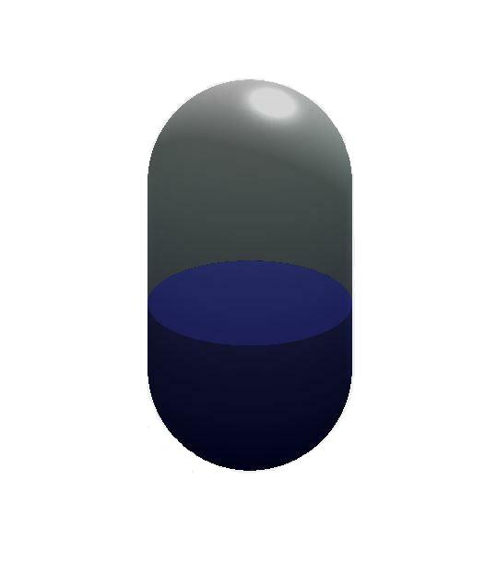
r
H
h

