Slide 1
CPU
I/O Bus
Memory Bus
Input/Output
Memory

Slide 2
Data
What you could do with the data?
How you could find the answer
Answer

Slide 3
Item 1
Item 2
Item n
Param 1
Param 2
Param n
Name
Results
Computations

Slide 4
Value:
45
57
66
48
39
71
68
Index:
1
2
3
4
5
n-1
n

Slide 5
Logical Test
false
true
Code block
Default
end

Slide 6
Logical Test 1
Logical Test 2
Logical Test n
false
false
false
true
true
true
Code block 1
Code block 2
Code block n
Default
end

Slide 7
Iteration Vector
finished
not finished
Code block
end

Slide 8
Initialize
Finished?
true
false
Code block
end

Slide 9
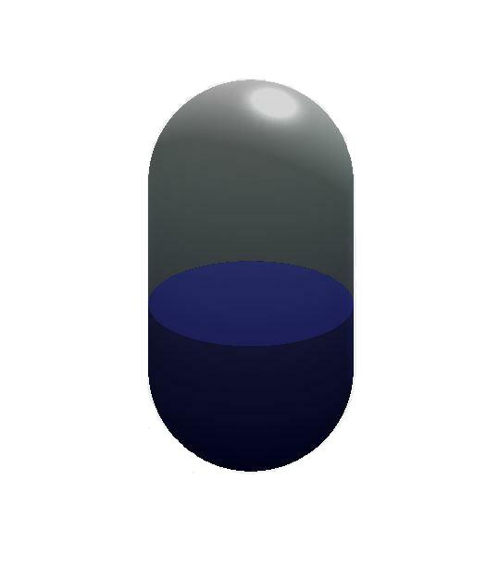
r
H
h

Slide 10
Overall Problem
Sub-Problem
Sub-Problem
Sub-Problem
Sub-Problem
Sub-Problem
Sub-Problem
Sub-Problem

Slide 11
cols:
3:
1
31
2:
1:
Obj_1_3
Obj_1_2
2
2
Obj_1_1
1:
Obj_2_3
3
1066
Obj_2_2
Obj_2_1
2:
Obj_3_3
Obj_3_2
Obj_3_1
rows
3:
Obj_4_3
Obj_4_2
Obj_4_1
4:
Obj_5_3
Obj_5_2
Obj_5_1
5:

Slide 12
names:
birth:
day
31
last:
first:
Obj(1).birth
Obj_(1).last
month
2
Obj(1).first
1:
Obj(2).birth
year
1066
Obj(2).last
Obj(2).first
2:
Obj(3).birth
Obj_(3).last
Obj(3).first
rows
3:
Obj(4).birth
Obj(4).last
Obj(4).first
4:
Obj(5).birth
Obj(5).last
Obj(5).first
5:

Slide 13
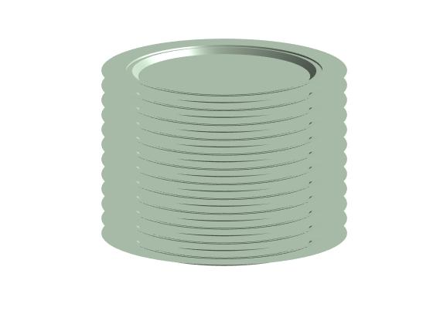
push
pop

Slide 14

Month:
1
2
3
4
5
6

Slide 15
34
55
8
5
3
21
13

Slide 16
Fig 10.1
Set the insertion point ins to 1
while C(ins) comes before item
done
ins = ins + 1
end
Concatenate C before ins, item and C at and after ins

Slide 17
Fig 10.2
Initialize the result
For item in C
done
Perform the required action on item
end
Finalize the result

Slide 18
Fig 10.3
Initialize an empty collection
For item in the data source
done
Insert item in the collection
end
Finalize the collection

Slide 19
Fig 10.4
Initialize the result
For item in the data source
done
Change the item
Insert the item in the result
end
Finalize the result

Slide 20
Initialize the result
Fig 10.5
For item in the collection
done
Keep the item?
no
yes
Insert the item in the result
end
Finalize the result

Slide 21
Initialize the result
Fig 10.6
For item in the collection
done
Accumulate required value in the result
end
Finalize the result

Slide 22
Set found to false
Fig 10.7
For item in the collection
done
Is this the item?
no
yes
Set found to true
end
Finalize the result

Slide 23
Fig 10.8a
Data
What you could do with the data?
How you could find the answer
Answer

Slide 24
Fig 10.8b
Data
What you could do with the data?
Qualified players sorted
Answer
Filter keep top 10

Slide 25
Fig 10.8c
Data
What you could do with the data?
Qualified players
Qualified players sorted
Answer
Sort by average
Filter keep top 10

Slide 26
Fig 10.8d
Data
Players with qual field
Qualified players
Qualified players sorted
Answer
Map add qual field
Filter keep qual true
Sort by average
Filter keep top 10

