Slide 1
Another view of Dijkstra…

Slide 2
A
3
4
R₁
4
R₃
R₂
4
3
2
R₄
R₅
2
4
B

Slide 3
A
R₁
R₃
R₂
R₄
R₅
B

Slide 4
A
3
R₁
4
4
R₂
R₃
4
2
3
R₄
R₅
4
2
B

Slide 5
Internet routing is hierarchical

Slide 6

All organizations (Autonomous Systems) use the same algorithm to talk to each other
CENIC
Internet2
Stanford University
Cambridge University

Slide 7
AS (Autonomous System) numbers
nickm> traceroute -q1 www.cam.ac.uk
traceroute to www.cam.ac.uk (131.111.150.25), 30 hops max, 40 byte packets
1 csmx-west-rtr.SUNet (171.64.74.2) 8.567 ms
2 dc-svl-rtr-vl8.SUNet (171.64.255.204) 0.334 ms
3 dc-svl-agg4--stanford-100ge.cenic.net (137.164.23.144) 1.041 ms
…
7 et-4-0-0.4079.sdn-sw.lasv.net.internet2.edu (162.252.70.28) 14.320 ms
…
14 internet2.mx1.lon.uk.geant.net (62.40.124.44) 144.085 ms
15 janet-gw.mx1.lon.uk.geant.net (62.40.124.198) 144.552 ms
…
24 primary.admin.cam.ac.uk (131.111.150.25) 150.353 ms
nickm> whois -h whois.cymru.com 62.40.124.198
[Querying whois.cymru.com]
[whois.cymru.com]
AS | IP | AS Name
20965 | 62.40.124.198 | GEANT The GEANT IP Service, GB
21320 | 62.40.124.198 | GEANT_IAS_VRF, EU
Notes:
Try traceroute -a www.cam.ac.uk. See multipath!!!
Try myipaddress.com
How does default routing work in an institution?

Slide 8
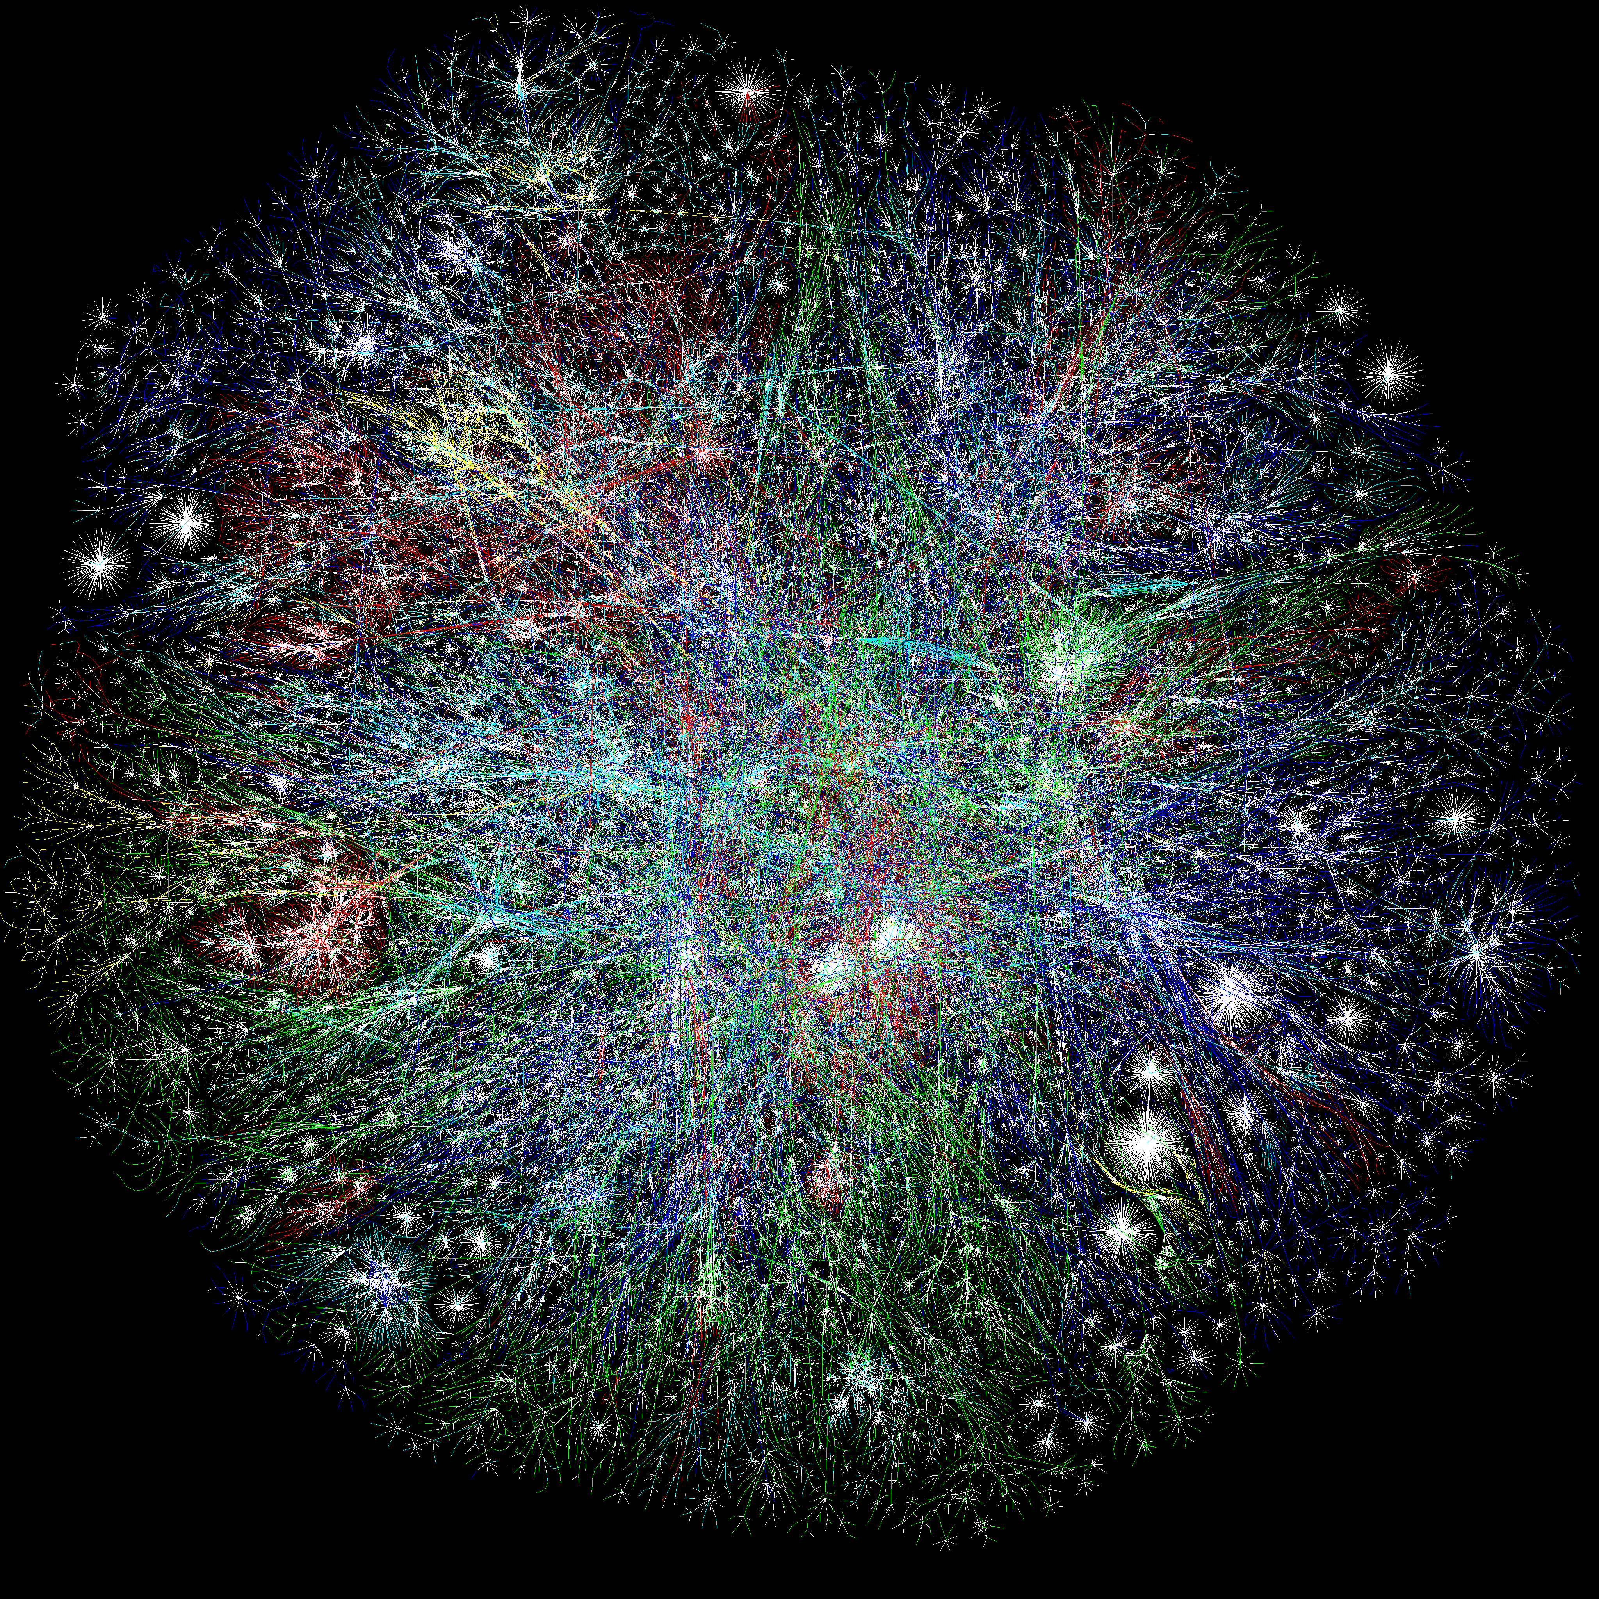

Slide 9
Border Gateway Protocol (BGP)
BGP neighbors (“peers”) establish a TCP connection.
BGP is not a link-state or a distance-vector routing protocol.
Instead, BGP uses what is called a “Path vector”.
For each prefix, a BGP router advertises a path of AS’s to reach it.
This is the “path vector”
Example of path vector advertisement:
“The network 171.64/16 can be reached via the path {AS1, AS5, AS13}”
When a link/router fails, the path vector is “withdrawn”

Slide 10
Border Gateway Protocol (BGP)
“The network 171.64/16 can be reached via the path {AS1, AS5, AS13}”
Paths with loops are detected locally and ignored.
Local policies pick the preferred path among all advertised paths.

Slide 11
Customers and Providers
provider
provider
customer
IP traffic
customer
Customer pays provider to carry its packets.

Slide 12
Customer-Provider Hierarchy
provider
customer
IP traffic

Slide 13
The Peering Relationship
peer
peer
Peers provide transit between
their respective customers
Peers do not provide transit
between peers
Peers (typically) do not exchange $$$
provider
customer
traffic
allowed
traffic NOT
allowed
So how does traffic from the left side reach the right side?

Slide 14
“Tier 1” Providers
A tier 1 network is a transit-free network that peers with every other tier 1 network
“Tier 1”
“Tier 1”
“Tier 1”
“Tier 1”

Slide 15
Tier 1 ISPs
Definition: A Tier 1 ISP has access to the entire Internet Region solely via its free and reciprocal peering agreements.
Definition: An Internet Region is a portion of the Internet network typically bounded by a country's geographical boundaries.
Each Internet Region has its own set of "Tier 1 ISPs.”
The litmus test:
"Does an ISP pay anyone to reach any destination in the Internet Region?" If the answer is "No" then it is a "Tier 1 ISP”, and If the answer is "Yes" then it is a "Tier 2 ISP."

Slide 16
Tier 1 ISPs by country
The U.S. Internet Region Tier 1 ISPs
AT&T
Verizon
Sprint (Softbank Broadband)
Century Link (Qwest)
Level 3 (with Global Crossing now)
NTT/Verio
Cogent
The Japan Internet Region Tier 1 ISPs
NTT
Japan Telecom (Softbank)
KDDI
IIJ
Powered.com

Slide 17
“Tier 1”
“Tier 1”
“Tier 1”
peer
peer
Peers provide transit between
their respective customers
Peers do not provide transit
between peers
Peers (typically) do not exchange $$$
provider
customer
traffic
allowed
traffic NOT
allowed

