Slide 1
EventHub
A Group-7 Production

Slide 2
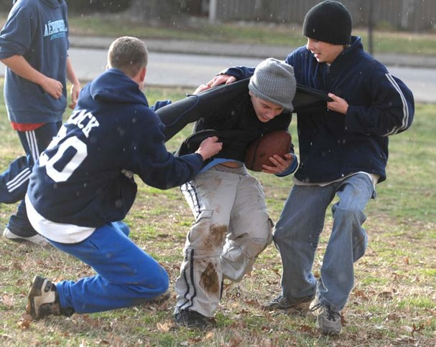
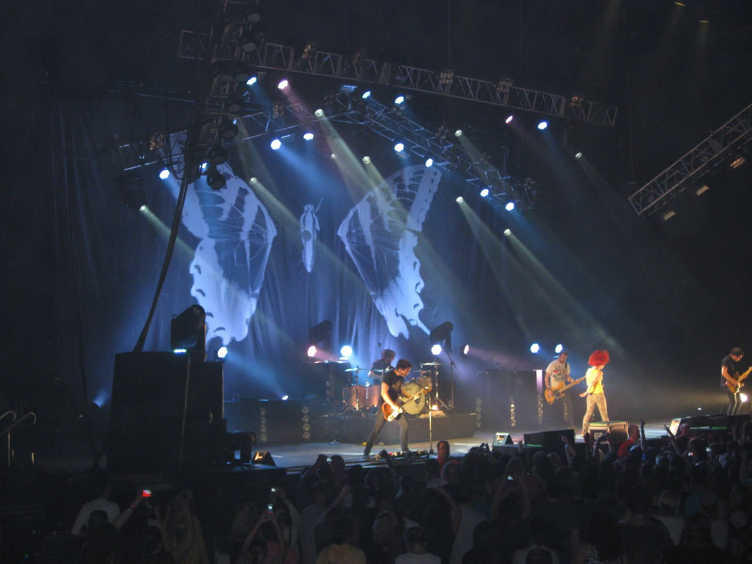
Product Mission
Act as a central hub for events happening anywhere!

Slide 3
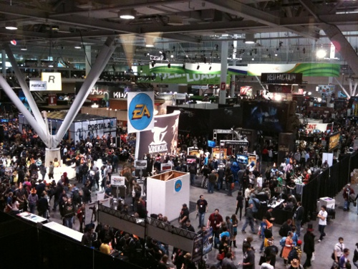
Functionality
Search for events
Set up events
Follow events

Slide 4
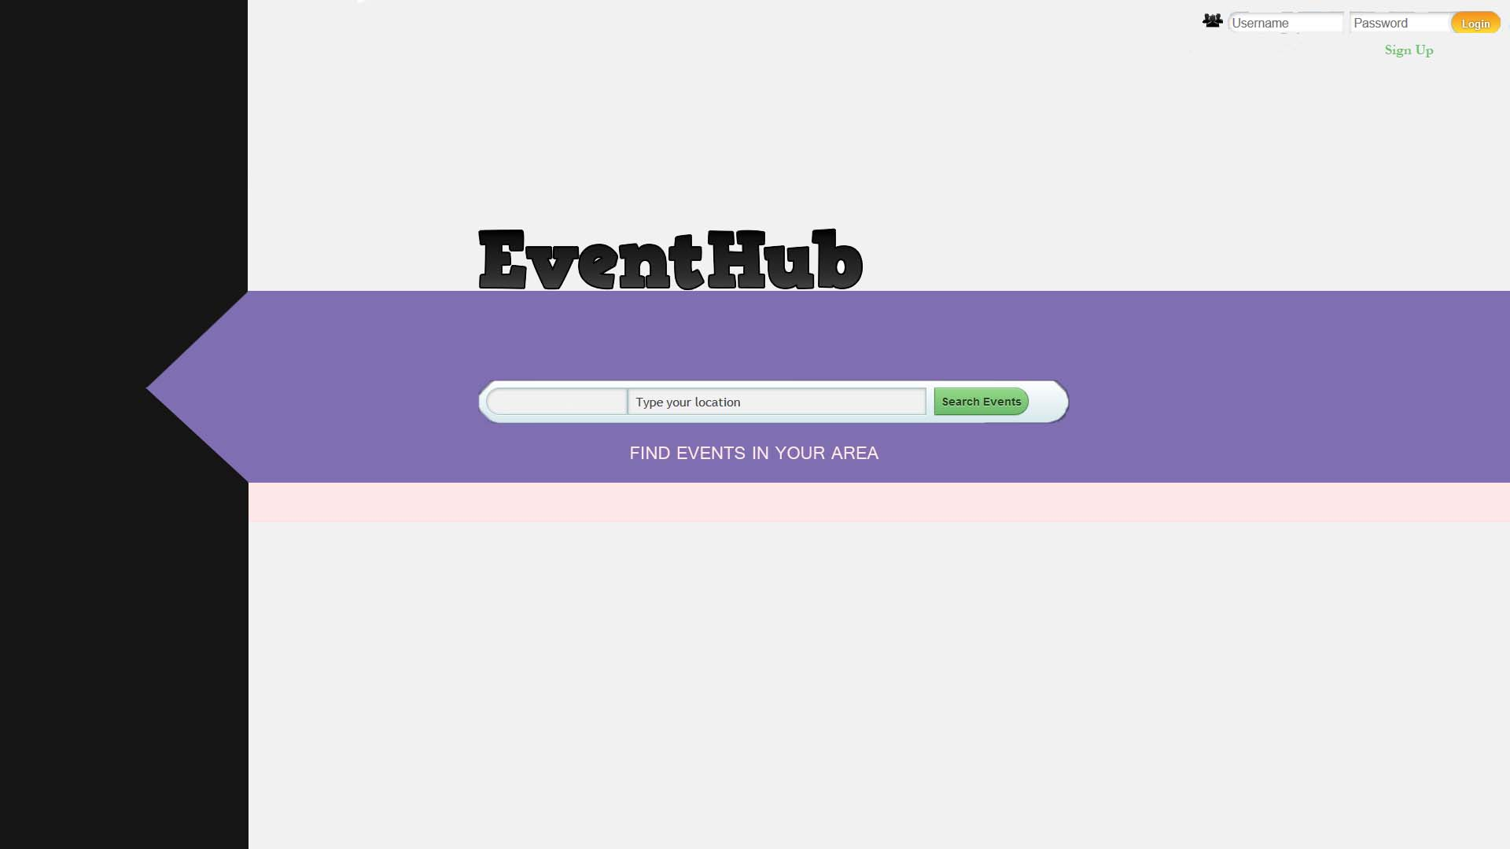

Slide 5
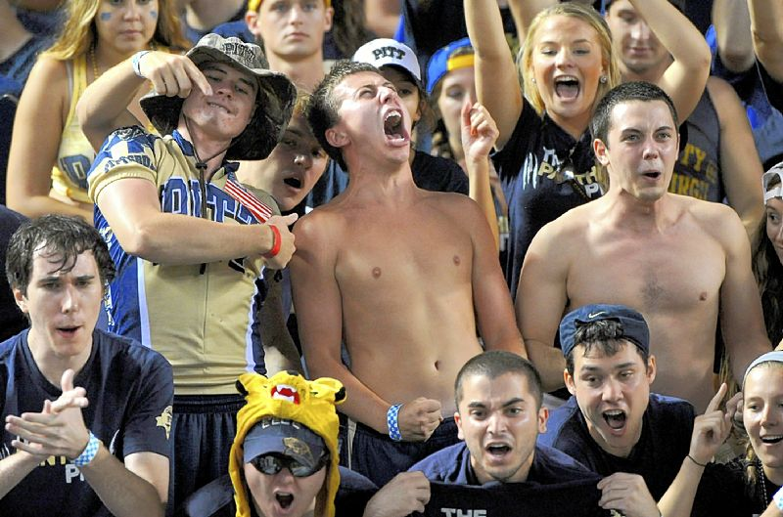
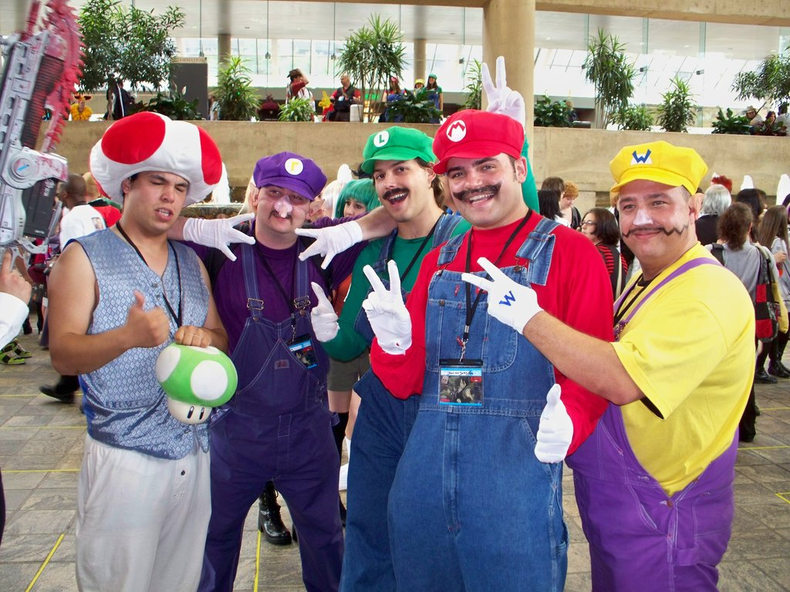
Why should you use EventHub?
Searching for events will be easy & organized
Provide a unique user experience centered around events
The potential for discovery is tremendous

Slide 6
Our Team
Jay Gallagher (Tester)
Software engineer for NASA
Joe Grzenda (Documentation)
Software manual team leader at Microsoft
Chris Lloyd (Application Developer)
Software developer for Nintendo
Alex Quinn (Project Leader)
Manages own independent software company – Quinn For-The-Win Software
Drew McDermott (Database)
Database manager for ABC News

Slide 7

We can’t wait to show you our final product!

