Slide 1
B.Tech Term Project
Indoor localization using bluetooth(BLE) beacons and Smartphone Sensors(Geomagnetic)
Team 12
Faculty Advisor – Dr. Venkata Ramana Badarla
Members – Abhishek Kaushik CS17B001
Nilesh Tiwari CS17B022

Slide 2
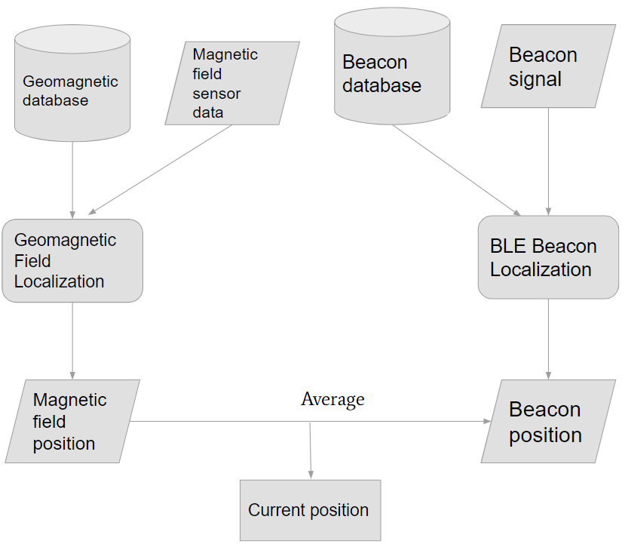
Introduction
Given a user with a smartphone in an indoor space, determine its location using sensors embedded in smartphone and other technologies such as Cellular Network, WiFi, BLE, etc.
System specifications : A user device sensing the current environmental status (magnetometer reading at user’s location, BLE data from BLE beacons within the indoor space), an RF infrastructure node (BLE beacons) installed inside the building to assist with positioning, and a server communicating with the user device for estimating the current position.
Offline Phase-
For the fingerprint map, we divide the service area into non-overlapping grid cells with the same size, then collect the RSSI of the beacon signal and intensity of the geomagnetic field at each reference point (RP) using the Bluetooth module and magnetometer in the smartphone and store them in a database at the server
1. as RSSI radio map for BLE data M_{ij} in the format : M_{ij} = [X_{i}, B_{j}, R_{ij}]
where X_{i} is the location of reference point i given by x and y coordinates [x, y], B_{j} is the BLE beacon identifier, and R_{ij} is the mean RSSI of 100 samples taken from the jth BLE beacon signal in all four directions at the ith RP.
2. as MFI map for magnetic field data in the format : M(x,y) = [X,Y, m_{x}, m_{y}, m_{z}, M_{A}]
where X and Y represent x and y coordinates of an RP , m_{x}, m_{y}, and m_{z} represent the three-axis intensities generated from the magnetic sensor, and M_{A} represents the average magnetic field intensity given as: M_{A} = (m²_{x} + m²_{y} + m²_{z})^{½}
Online Phase -
Input - Readings of Geomagnetic field and RSSI(Received signal strength) from different beacons collected by user smartphone in format similar to the offline phase (M = [m_{x}, m_{y}, m_{z}, M_{A}] for MFI data and M_{j} = [B_{j}, R_{j}] for RSSI data)
Proposed System - Take the input and send it to server to process this information with the information collected during offline phase. Model is explained in the next slides.
Output - Location(coordinates) of person - (X, Y)
Fig. 1 : Online phase of the system

Slide 3

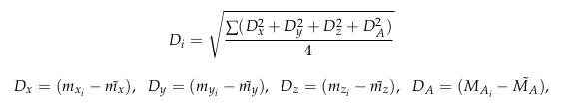

Fingerprint Matching Algorithm

Slide 4
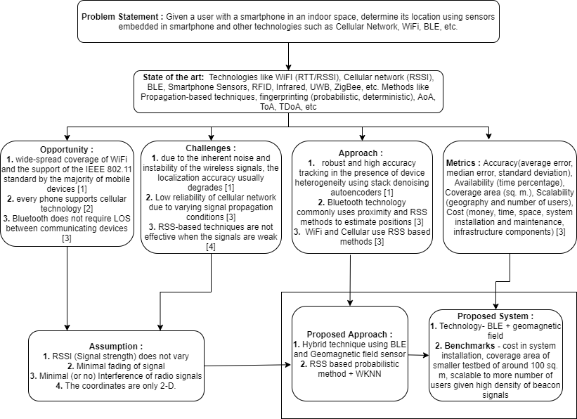
Concept Map

Slide 5
Assumption
Assumption 1 - We assume that RSSI and geomagnetic field values does not vary much but in a practical scenario these can vary e.g magnetic field value change whenever new ferromagnetic machines or things like Almirah are added or moved from one place to another inside the building.
Assumption 2 - As our system uses wireless BLE based technology there will be fading which as of now we assume to be very minimal.
Fading is variation of the attenuation of a signal with various variables. It can be because of time, geographical position, and radio frequency.
Assumption 3- We assume that there will be no interference of radio signal but in reality it can. Currently BLE operates in 2.4 GHz which is unlicensed, but new uses for it are to be expected, and as the spectrum becomes more widely used; radio interference is more likely to occur.
Assumption 4 - As of now we work for building that are single storey but in practical cases indoor positioning services are used in multi storey buildings like hospitals, shopping malls, etc.

Slide 6
Response to Top 5 reviews
In the previous feedback we were told from most of the reviewers that our top level idea was clear and we needed to dive in technical depth. So , this time we have covered the technical aspects, input , output of the system and the challenges.
We have looked at the basics and fundamental approaches that have been used or are currently used for positioning problems.
We have added references at the last.
Concept map is explained accordingly.
We have also designed a smartphone app based on Android to collect sensors data.

Slide 7
References
Abbas, Moustafa & Elhamshary, Moustafa & Rizk, Hamada & Torki, Marwan & Youssef, Moustafa. (2019). WiDeep: WiFi-based Accurate and Robust Indoor Localization System using Deep Learning. 10.1109/PERCOM.2019.8767421.
Rizk, Hamada. (2019). SoloCell: Efficient Indoor Localization Based on Limited Cell Network Information And Minimal Fingerprinting. 604-605. 10.1145/3347146.3363460.
Alarifi, Abdulrahman & Al-Salman, AbdulMalik & Alsaleh, Mansour & Alnafessah, Ahmad & Alhadhrami, Suheer & Al-Ammar, Mai & Al-Khalifa, Hend. (2016). Ultra Wideband Indoor Positioning Technologies: Analysis and Recent Advances. Sensors. 16. 1-36. 10.3390/s16050707.
Wang, Xuyu & Yu, Zhitao & Mao, Shiwen. (2020). Indoor Localization Using Smartphone Magnetic and Light Sensors: a Deep LSTM Approach. Mobile Networks and Applications. 25. 10.1007/s11036-019-01302-x.
Gang, Hui-Seon & Pyun, Jae-Young. (2019). A Smartphone Indoor Positioning System Using Hybrid Localization Technology. Energies. 12. 3702. 10.3390/en12193702.
Faragher, Ramsey & Harle, Robert. (2015). Location Fingerprinting With Bluetooth Low Energy Beacons. IEEE Journal on Selected Areas in Communications. 33. 1-1. 10.1109/JSAC.2015.2430281.

