Slide 1
B.Tech Term Project
Indoor localization using wifi, bluetooth based (Smartphone-based)
Team 12
Faculty Advisor – Dr. Venkata Ramana Badarla
Members – Abhishek Kaushik CS17B001
Nilesh Tiwari CS17B022

Slide 2
Introduction
Location-based services (LBS) in outdoor environments have been developed based on the development of GPS-based precision positioning technology which is heavily used by people in day to day life.
This kind of services is required in indoor environments where GPS positioning is not possible due to GPS signal strength inside a tunnel and buildings.
Other technologies such as Wi-Fi, Bluetooth, Ultra Wide-Band (UWB), Ultrasonic wave, Radio Frequency Identification (RFID), Geomagnetic field, and Inertial Measurement Unit (IMU) have been used for positioning.
The Indoor positioning services(IPS) can perform personal indoor smartphone navigation, marketing (shopping advertisements and proximity-based voucher sharing), location-based entertainment, indoor emergency localization, and so on.

Slide 3
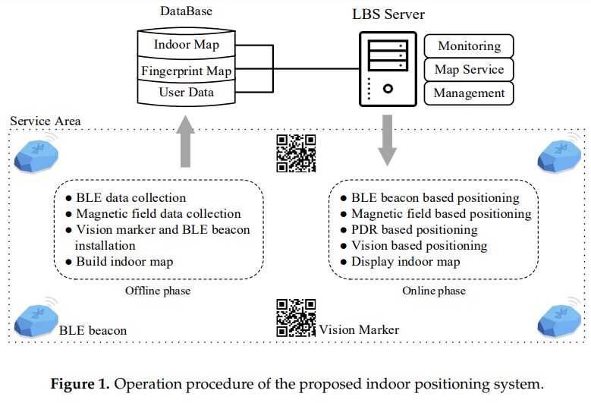
Concept Map
The WiFi RSS-based method would be more suitable in terms of cost and availability but will be prone to attenuation in signals.
Magnetic field and Light intensity is a reliable method for the basement or where WiFi connectivity is low.
Any BLE enabled device (also known as iBeacon or beacon) that uses RSSI to estimate the proximity between the iBeacon device and the user has low cost and energy consumption.
Although it gives less accurate results since all phones support cellular technology by definition, it becomes desirable to use cellular signals for localization. Furthermore, this consumes virtually no extra power in addition to the normal phone operation.
Out of the above-mentioned technology, we use Smartphone-based Hybrid technology due to ease of access and deployment, appropriate in handling various places like shopping mall (random people with random behavior) or office space(organized crowd) and various situations like normal or emergency.

Slide 4
Action Plan for this semester
Studying the state of the art study and Reproducing and analyzing the results using the Smartphone-based hybrid approach (Magnetic based and Bluetooth Beacon based).
Magnetic field fingerprint matching algorithm
Nearest neighbour search is implemented to find the current indoor location. The root mean square deviation (RMSD) of the average MFI (MA) between an offline dataset and an online dataset is performed to find the nearest neighbour. The nearest neighbour is selected when it has the smallest RMSD.
BLE based fingerprint matching algorithm-
We use the weighted K nearest neighbour (WKNN) method, which is a conventional and effective matching method for a user’s current location.

Slide 5
Action Plan for the next semester Phase-II
Modifying the technologies and models according to specific scenarios like emergencies(power failures) and marketing. Will add other complexities as we progress.
Evaluating the final results on the basis of
Availability
Tracking Accuracy
Cost
Ease of access
Ease of deployment

