Slide 1
B.Tech Term Project
Indoor localization using bluetooth(BLE) beacons and Smartphone Sensors(Geomagnetic)
Team 12
Faculty Advisor – Dr. Venkata Ramana Badarla
Members – Abhishek Kaushik CS17B001
Nilesh Tiwari CS17B022

Slide 2
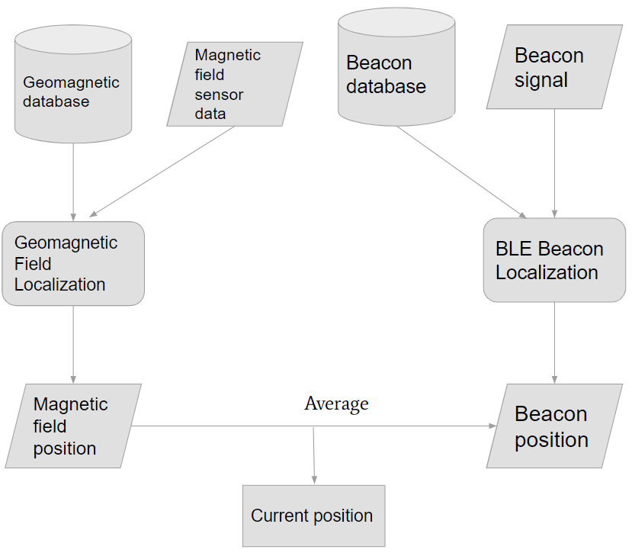
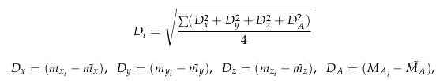


Introduction
Given a user with a smartphone in an indoor space, determine its location using sensors embedded in smartphone and other technologies such as Cellular Network, WiFi, BLE, etc.
Area - Indoor Localization
Sub area - Probabilistic fingerprinting method using BLE RSSI and magnetic field
Offline Phase-
1. RSSI radio map for BLE data M_{ij} in the format : M_{ij} = [X_{i}, B_{j}, R_{ij}]
X_{i} = location of reference point i given by x and y coordinates [x, y] , B_{j} is the BLE beacon identifier. R_{ij} is the mean RSSI of 50 samples taken from the jth BLE beacon signal.
2. MFI map for magnetic field data in the format : M(x,y) = [X,Y, m_{x}, m_{y}, m_{z}, M_{A}]
X , Y represent x and y coordinates of an RP , m_{x}, m_{y}, and m_{z} represent the three-axis intensities generated from the magnetic sensor. M_{A} = (m²_{x} + m²_{y} + m²_{z})^{½} is average magnetic field intensity
Online Phase -
Input - Readings of Geomagnetic field and RSSI(Received signal strength) from different beacons collected
Model - Take the input and process with the reading collected in offline phase
Output - Location(coordinates) of person - (X, Y)
Fig. 1 : Online phase of the system

Slide 3
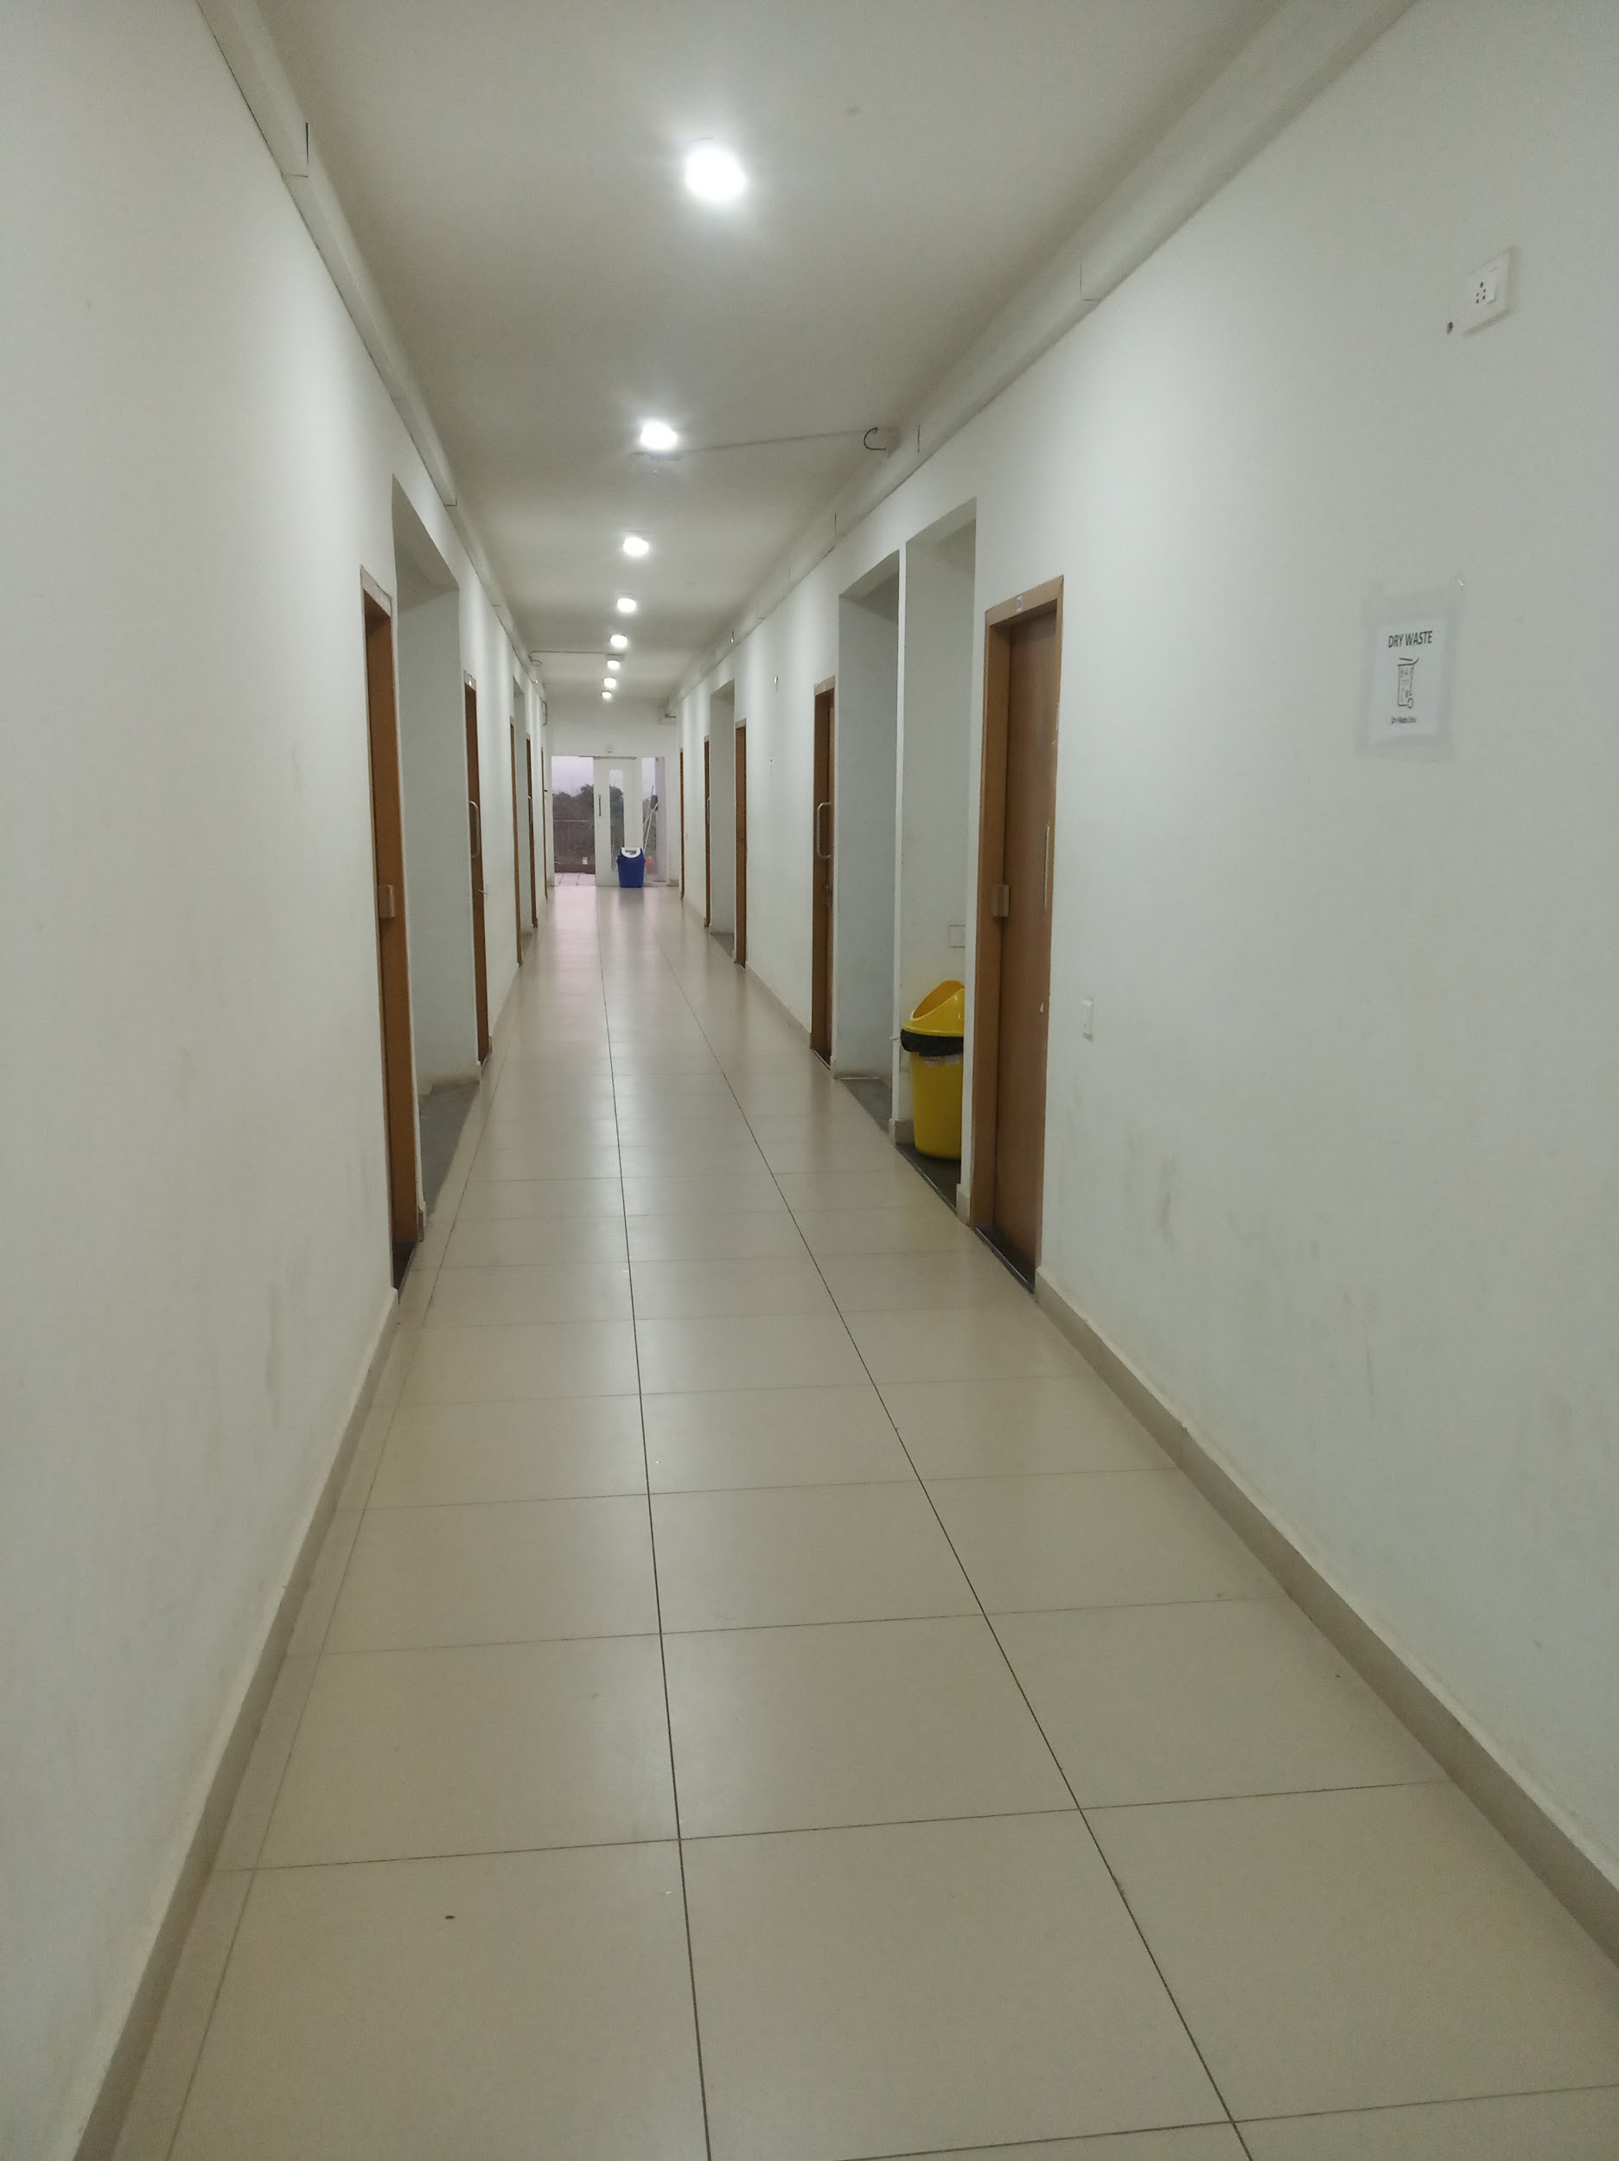
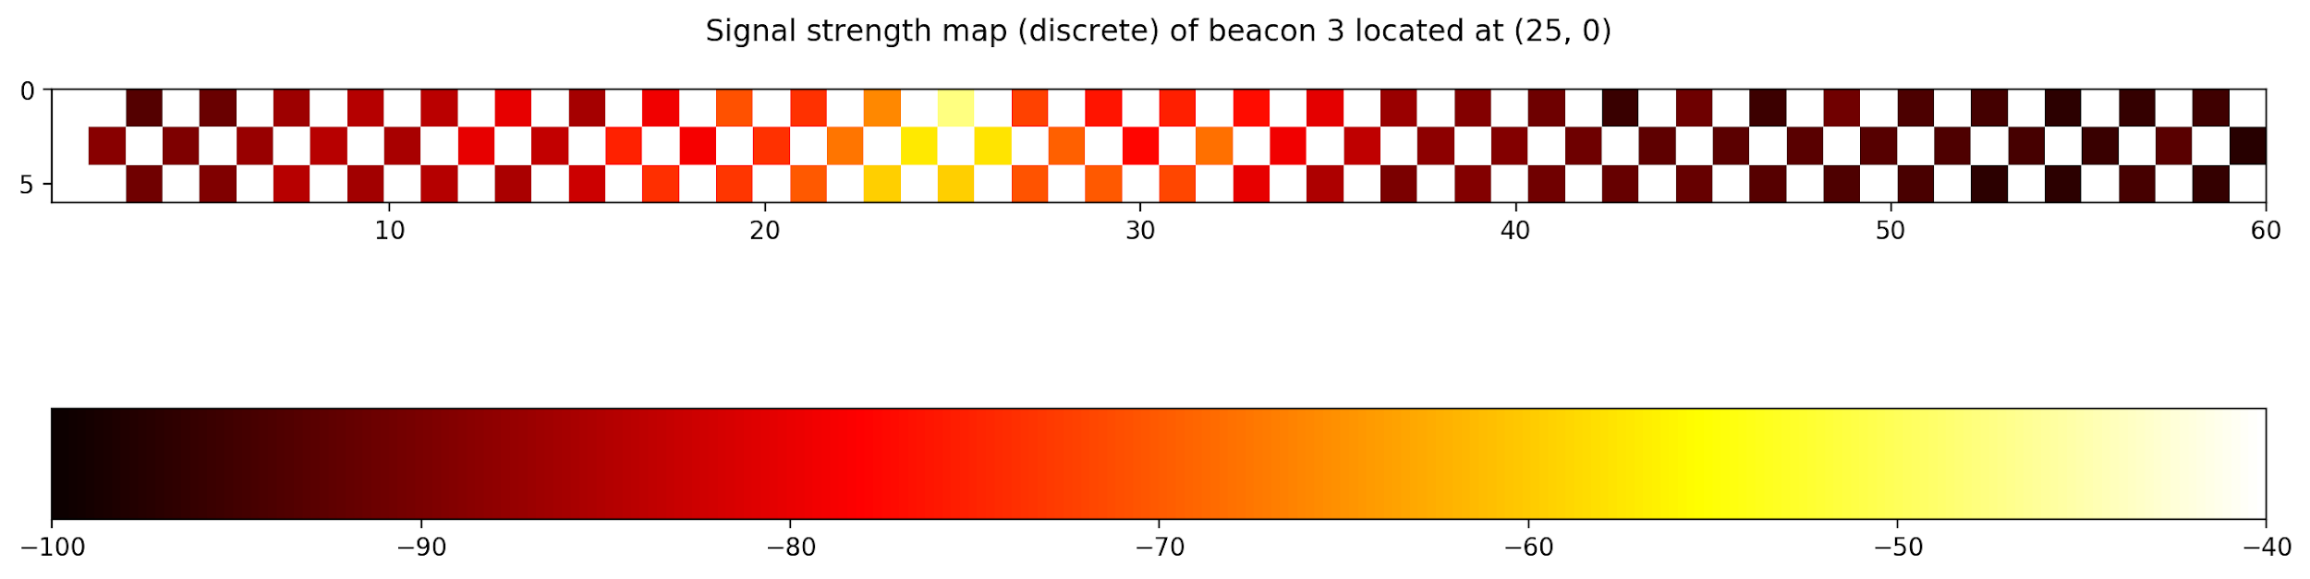
Work done till now
1. Built the Android app to collect the magnetic field and Bluetooth signal strength
2. Chose the Testbed and collected the readings( Highly Labor intensive) in the form specified above
3. Built signal strength map for each beacon and magnetic field.
4. Implemented the WKNN model and analyzed the relation between different parameters( distance, rssi, x-coordinate, y-coordinate, sampling time, fingerprint dimensionality, magnetic field intensity, magnetic field’s components).
Fig. 2 Experimental environment (Transit Campus Hostel C Block Ground Floor Corridor)
Fig. 3 Top view of Experimental environment

Slide 4
Action plan for the semester
Metrics and parameters of the current model:
MAE = 3.91 m
RMSE (X) = 4.67 m
RMSE (Y) = 0.50 m
Max Error = 10.30 m
Testbed area = 64.8 sq. m.
Beacon density = 10.8 sq. m/beacon
Fingerprint dimensionality = 6
Window length = 5 seconds
Transmit power = 0 dBm
Advertising frequency = 10 Hz
Github Link of the project:
https://github.com/CS17B022/BTP
Graphs/Figures:
https://github.com/CS17B022/BTP/tree/main/Graphs
1. Improving the accuracy of the model by correcting RSSI data using methods like regression, normalization.
2. Building RSSI distance model for each beacon.
2. Using other machine learning models.
3. Varying fingerprint construction parameters (window length, filter algorithm, transmission power, advertising frequency, beacon density)
5. Ensuring scalability i.e. this model also works not just for smaller test area but for bigger spaces as well with varying beacon density.

Slide 5
References
Abbas, Moustafa & Elhamshary, Moustafa & Rizk, Hamada & Torki, Marwan & Youssef, Moustafa. (2019). WiDeep: WiFi-based Accurate and Robust Indoor Localization System using Deep Learning. 10.1109/PERCOM.2019.8767421.
Rizk, Hamada. (2019). SoloCell: Efficient Indoor Localization Based on Limited Cell Network Information And Minimal Fingerprinting. 604-605. 10.1145/3347146.3363460.
Alarifi, Abdulrahman & Al-Salman, AbdulMalik & Alsaleh, Mansour & Alnafessah, Ahmad & Alhadhrami, Suheer & Al-Ammar, Mai & Al-Khalifa, Hend. (2016). Ultra Wideband Indoor Positioning Technologies: Analysis and Recent Advances. Sensors. 16. 1-36. 10.3390/s16050707.
Wang, Xuyu & Yu, Zhitao & Mao, Shiwen. (2020). Indoor Localization Using Smartphone Magnetic and Light Sensors: a Deep LSTM Approach. Mobile Networks and Applications. 25. 10.1007/s11036-019-01302-x.
Gang, Hui-Seon & Pyun, Jae-Young. (2019). A Smartphone Indoor Positioning System Using Hybrid Localization Technology. Energies. 12. 3702. 10.3390/en12193702.
Faragher, Ramsey & Harle, Robert. (2015). Location Fingerprinting With Bluetooth Low Energy Beacons. IEEE Journal on Selected Areas in Communications. 33. 1-1. 10.1109/JSAC.2015.2430281.

