Slide 1
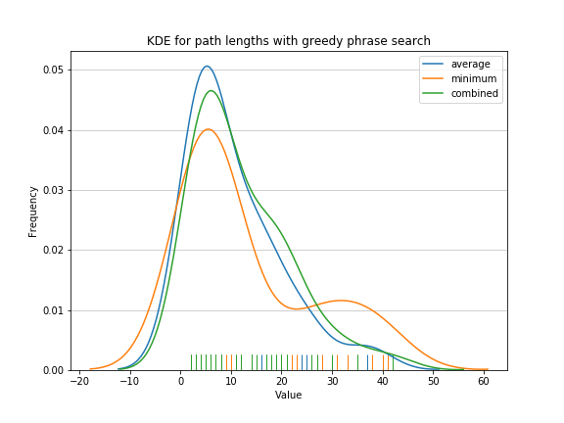
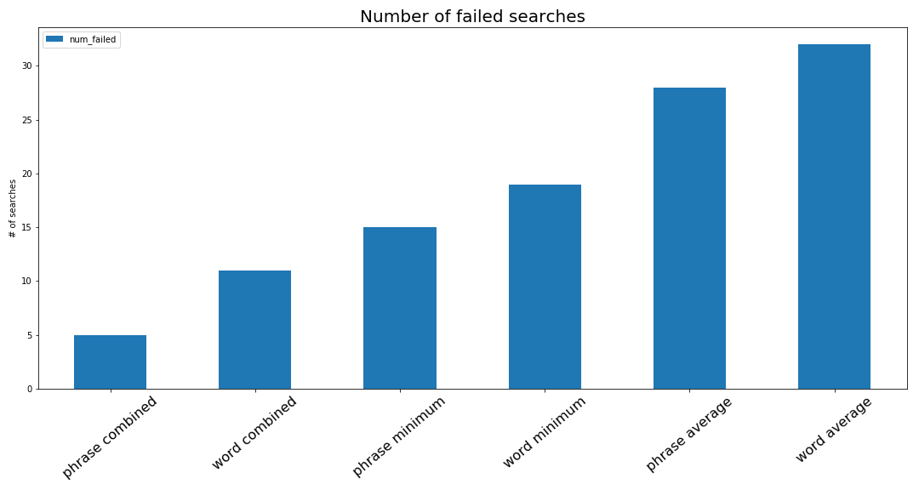
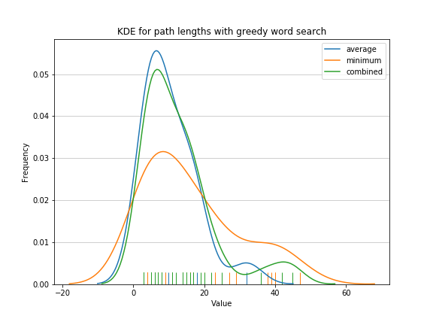

The Wikipedia Game
Mark Kong, Benjamin Rafetto, and Claire Stolz
CS 182 --- Final Project --- Fall 2018
The Wikipedia Game is a path-finding challenge where a player is presented with two Wikipedia pages and is asked to find a path from the start page to the goal page by clicking links to travel from article to article. The player’s score is determined by the length of the path and the time it took to find the path. Due to the interconnectedness of various topics and moderately large branching factor, there is a wide variety of possible paths. Our goal is to solve this game in as efficient a manner as possible.
Introduction
Greedy search using Google’s word2vec package.
Avg., min, and combined distance measure based on words
Avg., min, and combined distance measure based on phrases
Trained on full text of linked page ✯
Additional word2vec training on Wikipedia corpus
A* search ✯
Heuristic based on text only (as above, in Greedy search)
Heuristic based on branching factor
Compound heuristic using 1 & 2, with a possibility of learning heuristic feature weights
Clustering based on interconnectedness
✯ indicates that the algorithm uses data or techniques not available to the typical human player.
Given two Wikipedia pages the problem is to find a path between the two. Each page is a state, and each link to a page is a directed edge of cost 1.
For example, given Sherlock Holmes → Magnetic resonance imaging, one path is Sherlock Holmes → Benedict Cumberbatch → Doctor Strange (2016 film) → Neurosurgery → Magnetic resonance imaging.
Rewards are determined by the length of the
path and the number of nodes expanded. Here, the number of nodes expanded is a proxy for the amount of time taken to find the path. Technically the Wikipedia game also forbids backtracking, meaning humans must use a strictly greedy approach. We develop algorithms for solving the classic game (e.g. playing as a human), and a game where backtracking is allowed.
Figure 2: Kernel density estimate of average path length for greed phrase search
Results
Data
Figure 3: Bar graph of # of failed searches, by algorithm
We present our preliminary results for Greedy search using Google’s word2vec package, for word2vec distance metrics based on (1) words only, and (2) phrases. For each heuristic, we also develop 3 sub-heuristics based on the closest word2vec value, the average value, and the average of the two previous values.
In comparing our algorithms, we consider both the average path length and the number of failed searches. (Searches can fail if an algorithm cannot backtrack and reaches a page with no outgoing links, or if there is no path between pages.)
Conclusion
Naturally, our data come from Wikipedia. Presently, we use the the pywikibot library to live-query the Wikipedia API. This library gives us access to a large amount of information about each page, but the most important features are the page text, the ingoing links, and the outgoing links for each page. We only use pages in English.
We also use word2vec, which models the “closeness” of words. The primary word2vec model is a two-layer neural network trained on a large dataset of text, or ‘corpus.’ Initially, we use the word2vec package trained on a set of Google news articles.
The results section that follows uses a set of 50 randomly chosen word pairs to evaluate each algorithm.
Our greedy heuristics performed similarly over successful searches with the average and combined approaches, while minimum word distance performed slightly worse. For minimizing failed searches, however, the combined approach performed by far the best. Incorporating phrases consistently improved results.
Moving forward, our first priority is to download and compile a subset of Wikipedia for faster search execution. The Wikipedia API is too slow to efficiently find the shortest paths using BFS when paths exceed 5 pages. BFS and bi-directional BFS will allow us to develop a path benchmark.
Next, we will focus on implementing A* and developing a consistent, admissible, and effective heuristic. Given that failed searches are more likely than previously believed, we will place greater emphasis on improving success rates moving forward.
Approach
Sources
We consider the following algorithmic approaches:
Breadth first search ✯
Bi-directional breadth first search ✯
Figure 1: Kernel density estimate of average path length for greed word search
John A. Paulson School of Engineering and Applied Sciences

