Slide 1
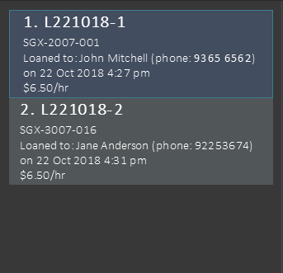


(Nric: Gxxxxx67U)
(Nric: Gxxxxx89U)

