Slide 1
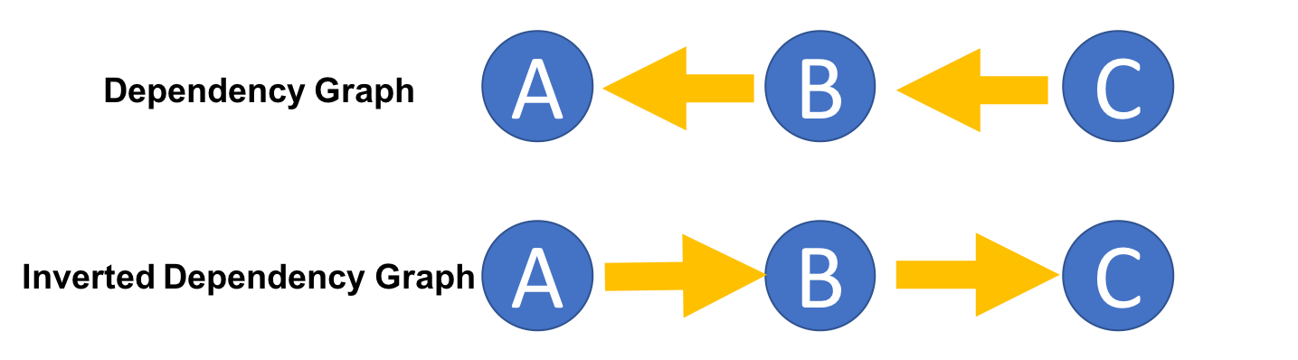

Slide 2
 | A | B | C
Due Date | 1-2-19 | 1-1-19 | 1-3-19
Effective Due Date | 1-1-19 | 1-1-19 | 1-3-19

