Slide 1


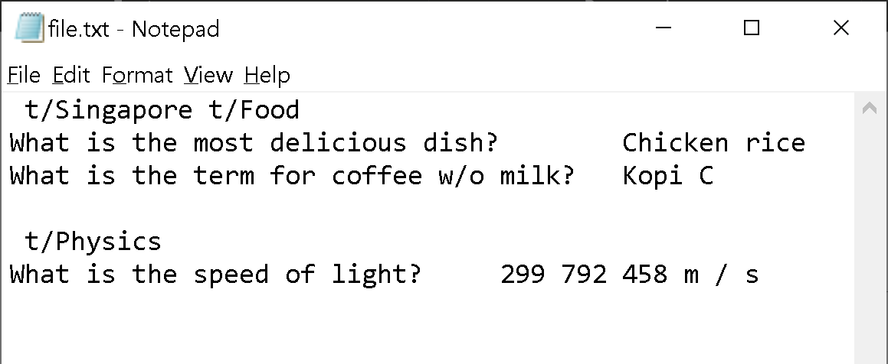

SPACE + “t/”
TAB
NEW LINE
Notes:
Formatting however you want, separate topics
Unhappy with your import, use undo! To revert to status before import

Slide 2
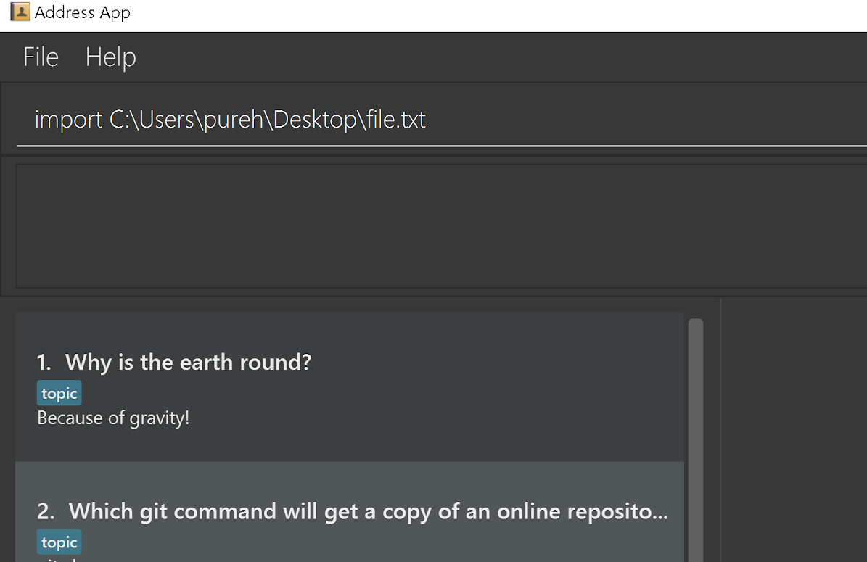
Enter import command here

Slide 3
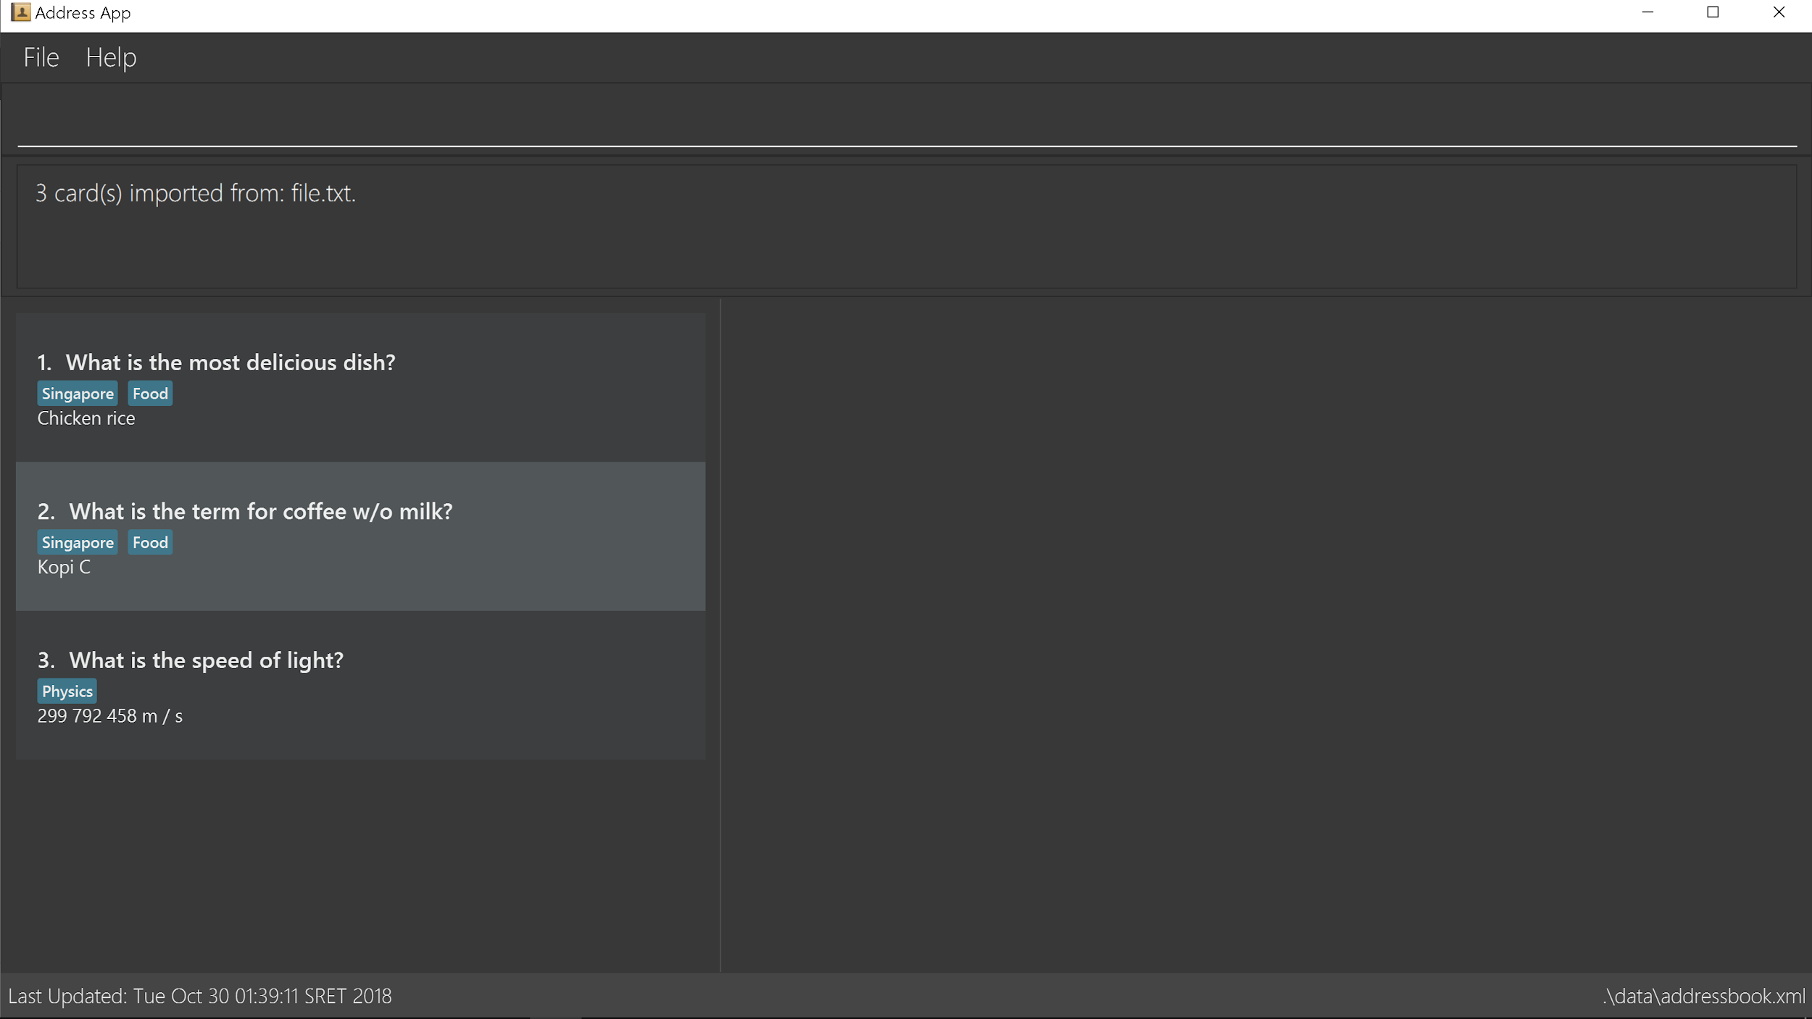
Recently imported cards will appear here

