Slide 1
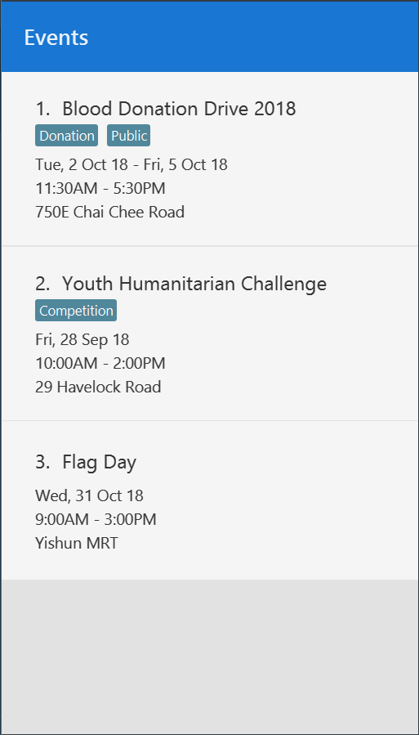
Notes:
Add event- after1

Slide 2
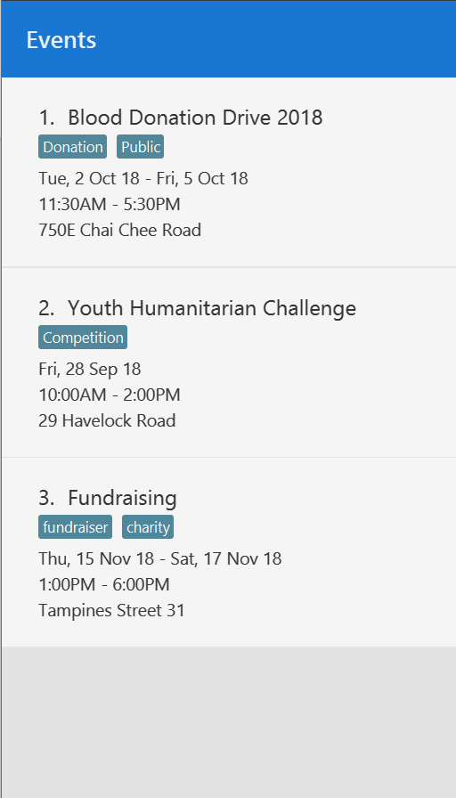
Notes:
Add event- after2

Slide 3
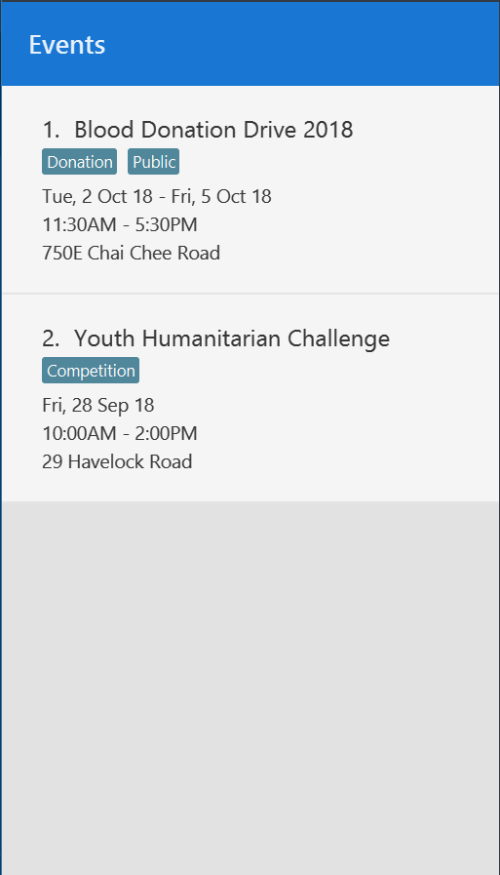
Notes:
Update event-Before

Slide 4
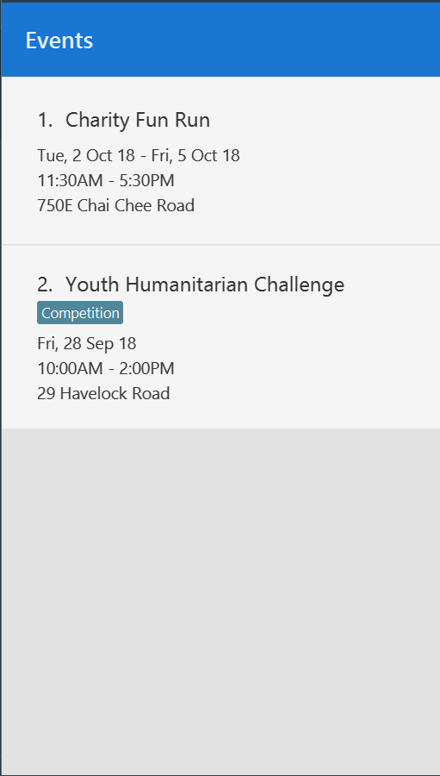
Notes:
Update event-After

