Slide 1
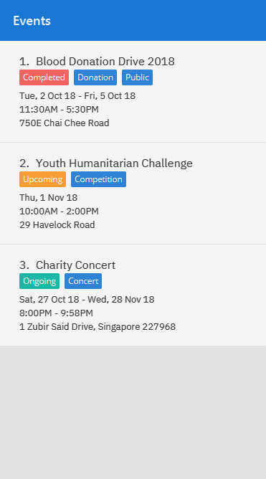
Notes:
Add event – Event Index
C: The EVENT_INDEX

Slide 2
Notes:
Example:
C: Before adding an event

Slide 3
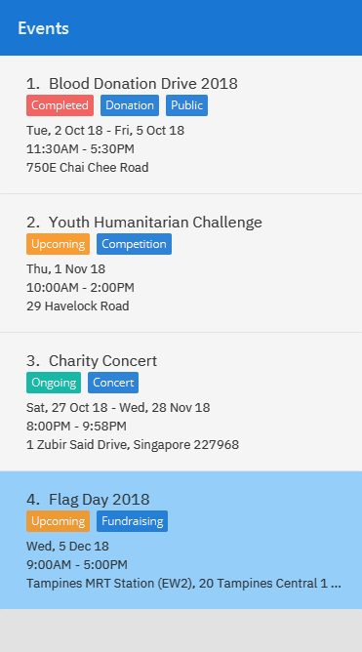
Notes:
C: Output of `add n/Flag Day 2018 l/Tampines MRT Station (EW2), 20 Tampines Central 1 529538 sd/05-12-2018 ed/05-12-2018 st/09:00 et/17:00 d/Raising funds and spreading awareness for a cause. t/Fundraising`
add n/Flag Day 2018 l/Tampines MRT Station (EW2), 20 Tampines Central 1 529538 sd/05-12-2018 ed/05-12-2018 st/09:00 et/17:00 d/Raising funds and spreading awareness for a cause. t/Fundraising

Slide 4
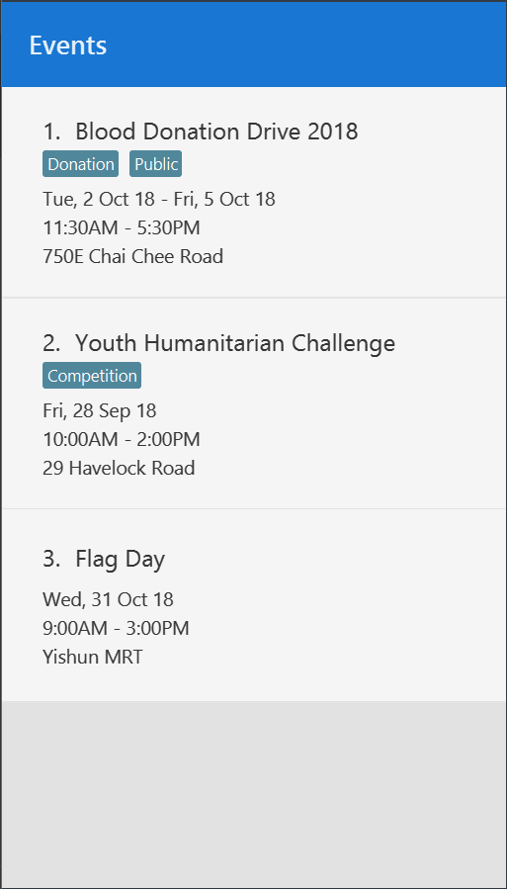
Notes:
Add event- after1

Slide 5
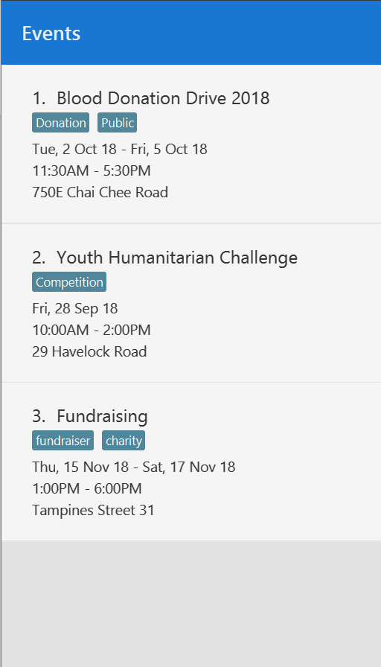
Notes:
Add event- after2

Slide 6
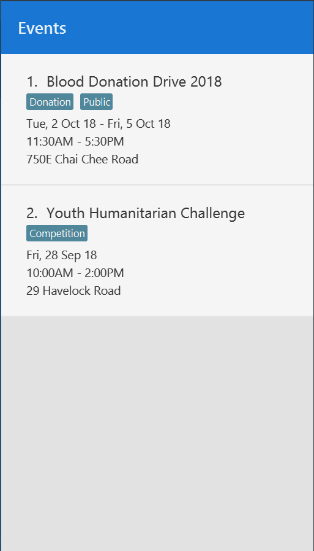
Notes:
Update event-Before

Slide 7
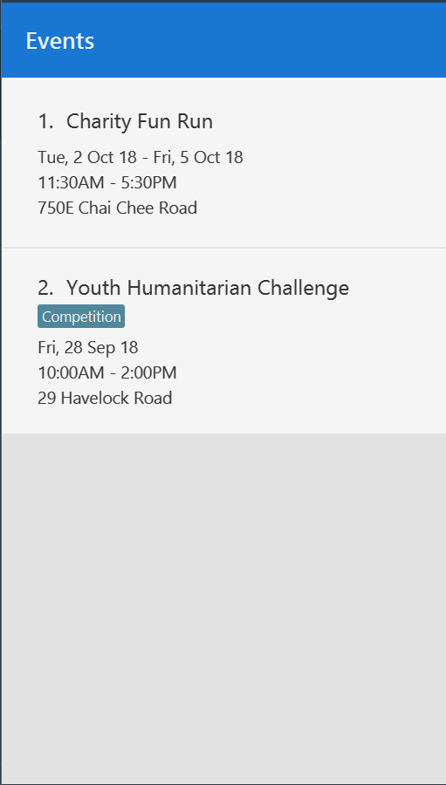
Notes:
Update event-After

