Slide 1
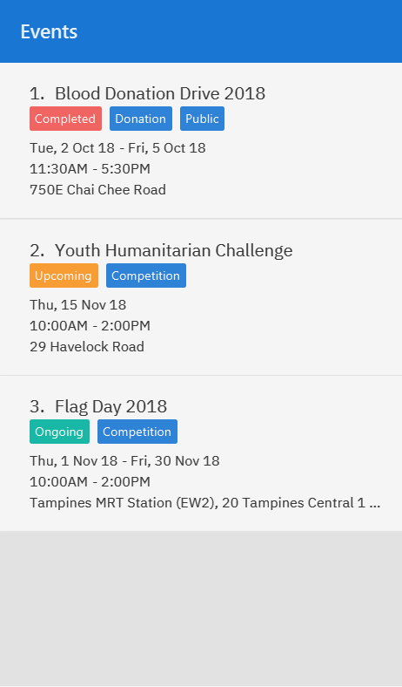
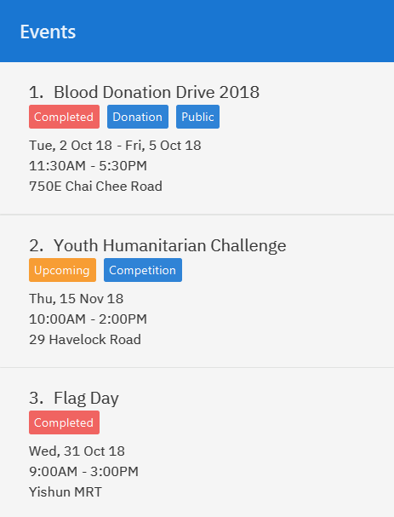
Notes:
Effect of add command
add n/Flag Day l/Yishun MRT sd/31-10-2018 ed/31-10-2018 st/09:00 et/15:00 d/For the children’s home

Slide 2
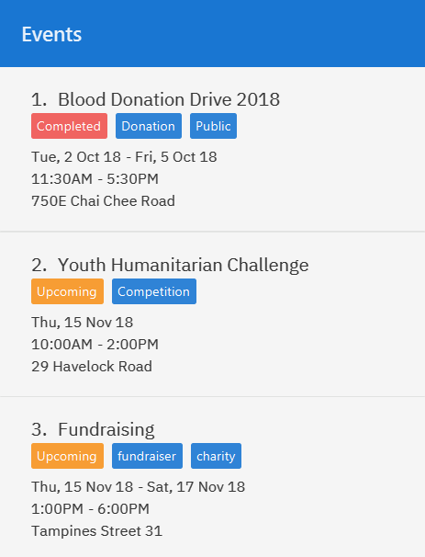
Notes:
Effect of add command
add n/Fundraising l/Tampines Street 31 sd/15-11-2018 ed/17-11-2018 st/13:00 et/18:00 d/Raising funds t/fundraiser t/charity

Slide 3
Notes:
EVENT_INDEX

Slide 4
Notes:
Effect of edit command
edit 1 n/Charity Fun Run t/

Slide 5
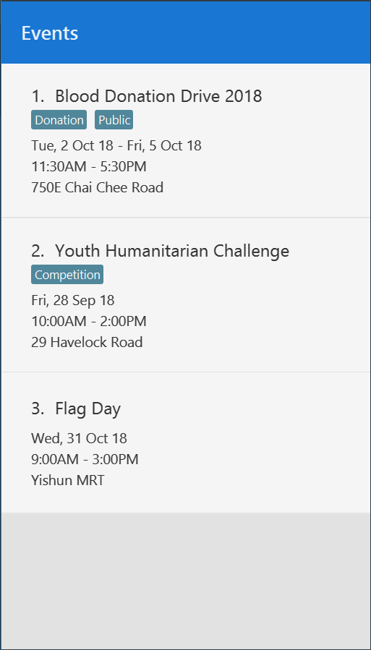
Notes:
Add event- after1

Slide 6
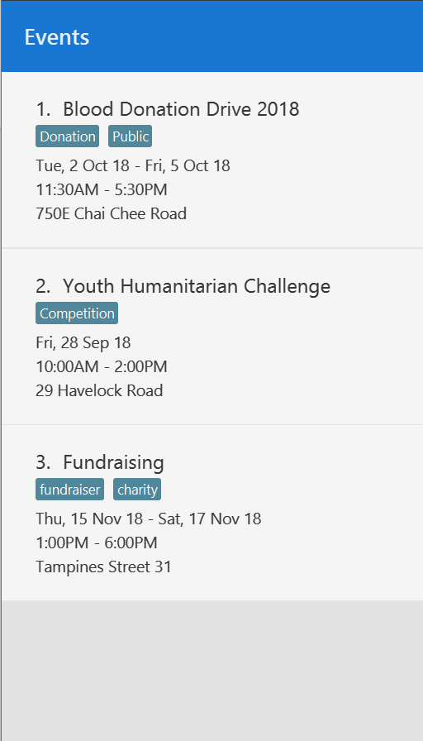
Notes:
Add event- after2

Slide 7
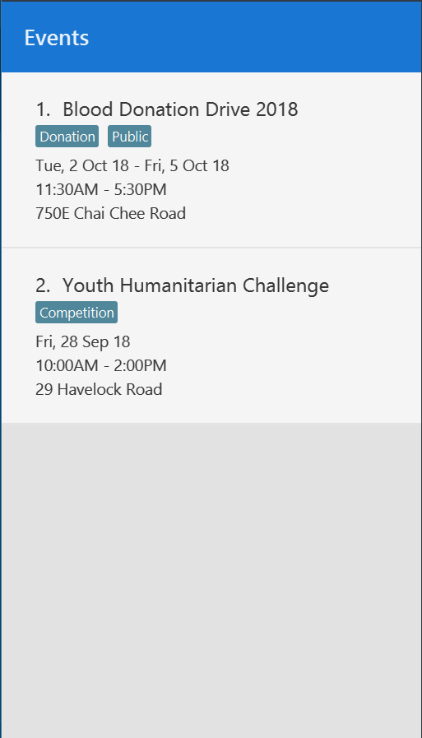
Notes:
Update event-Before

Slide 8
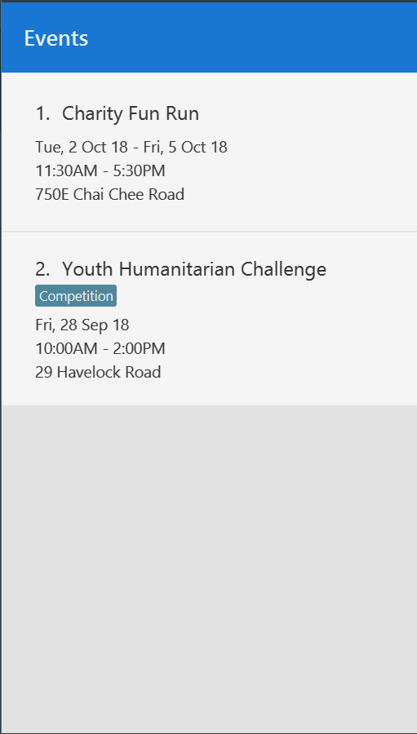
Notes:
Update event-After

