Slide 1
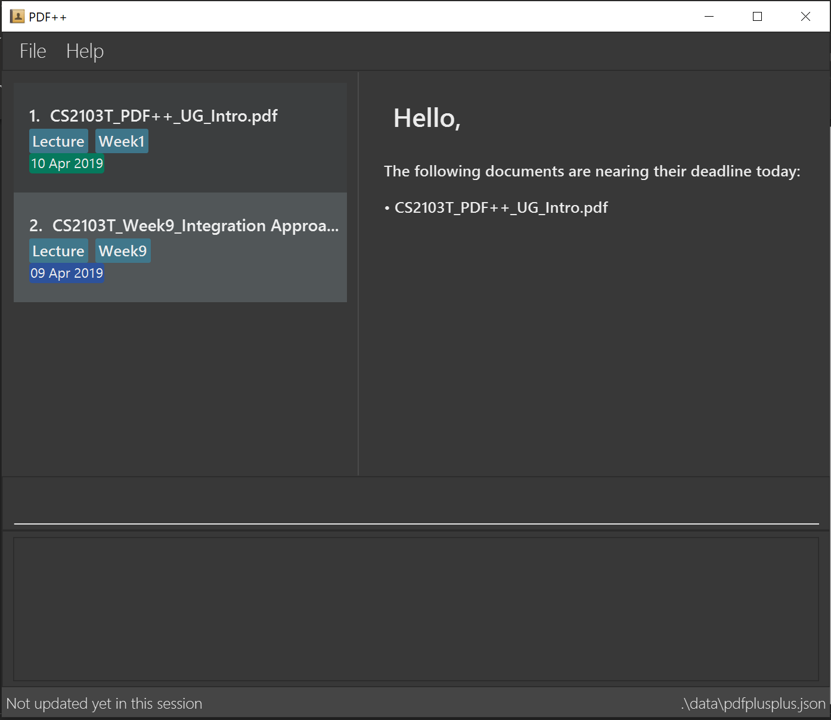

Slide 2
INDEX of the file you wish to encrypt

Slide 3
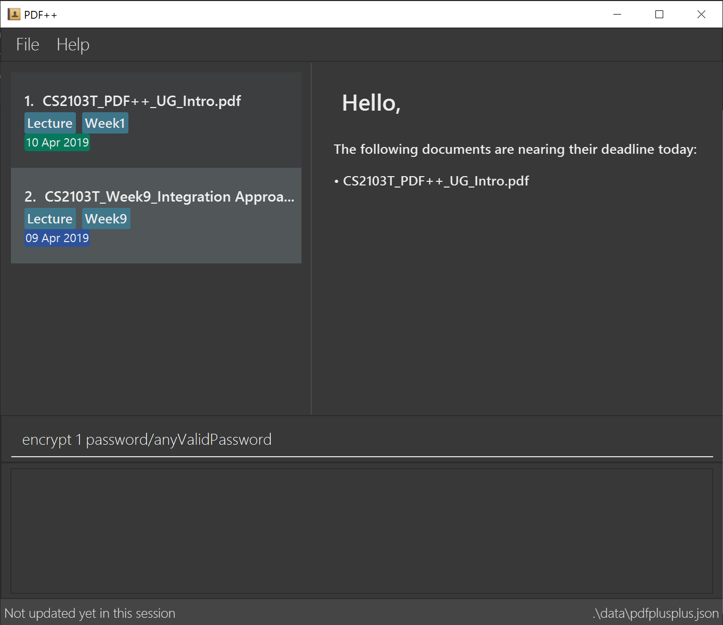
Format: encrypt INDEX password/PASSWORD

