Slide 1
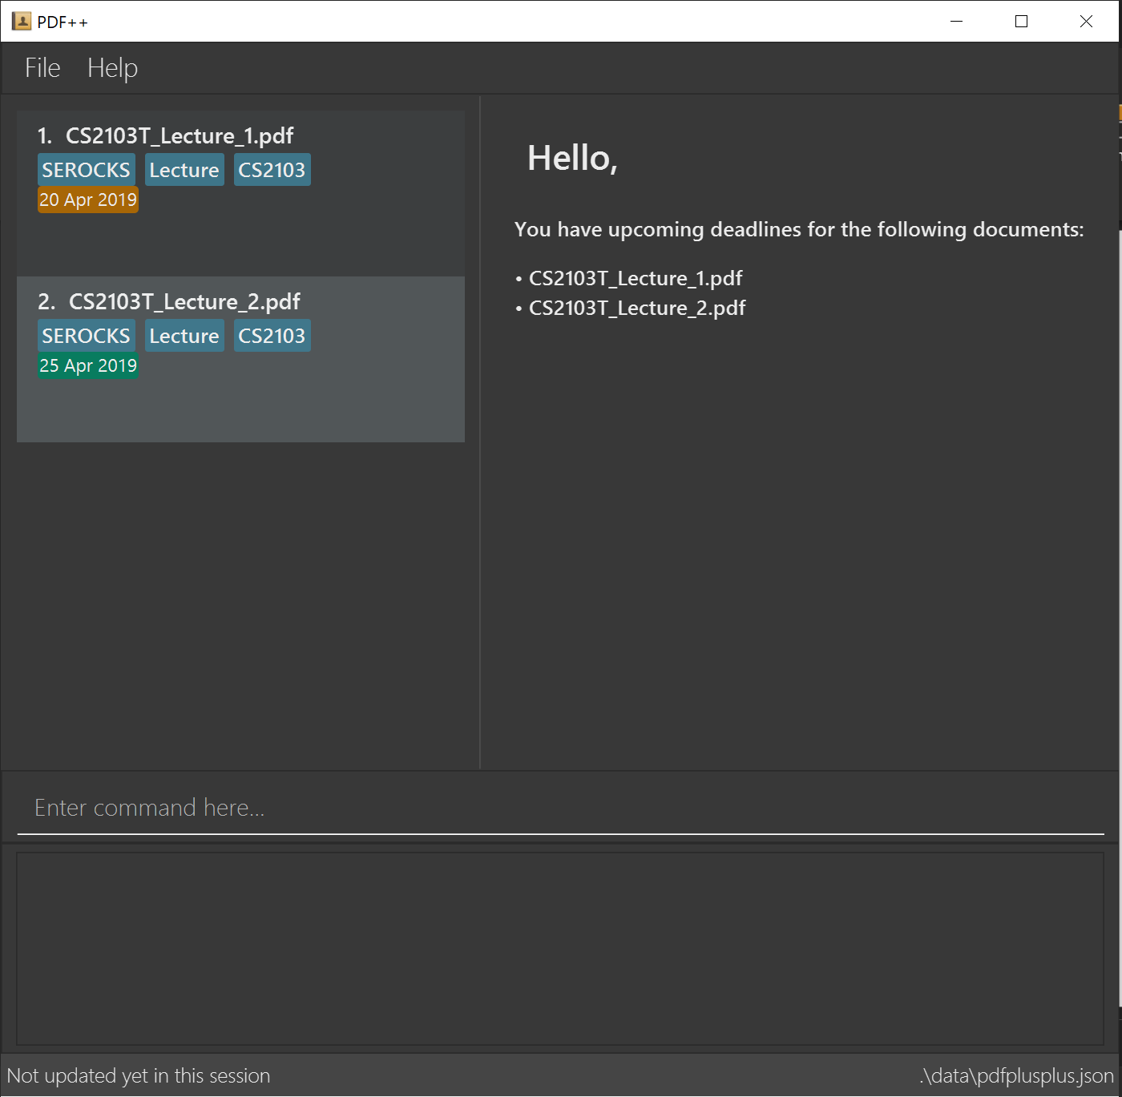

Slide 2
INDEX of the file you wish to encrypt

Slide 3
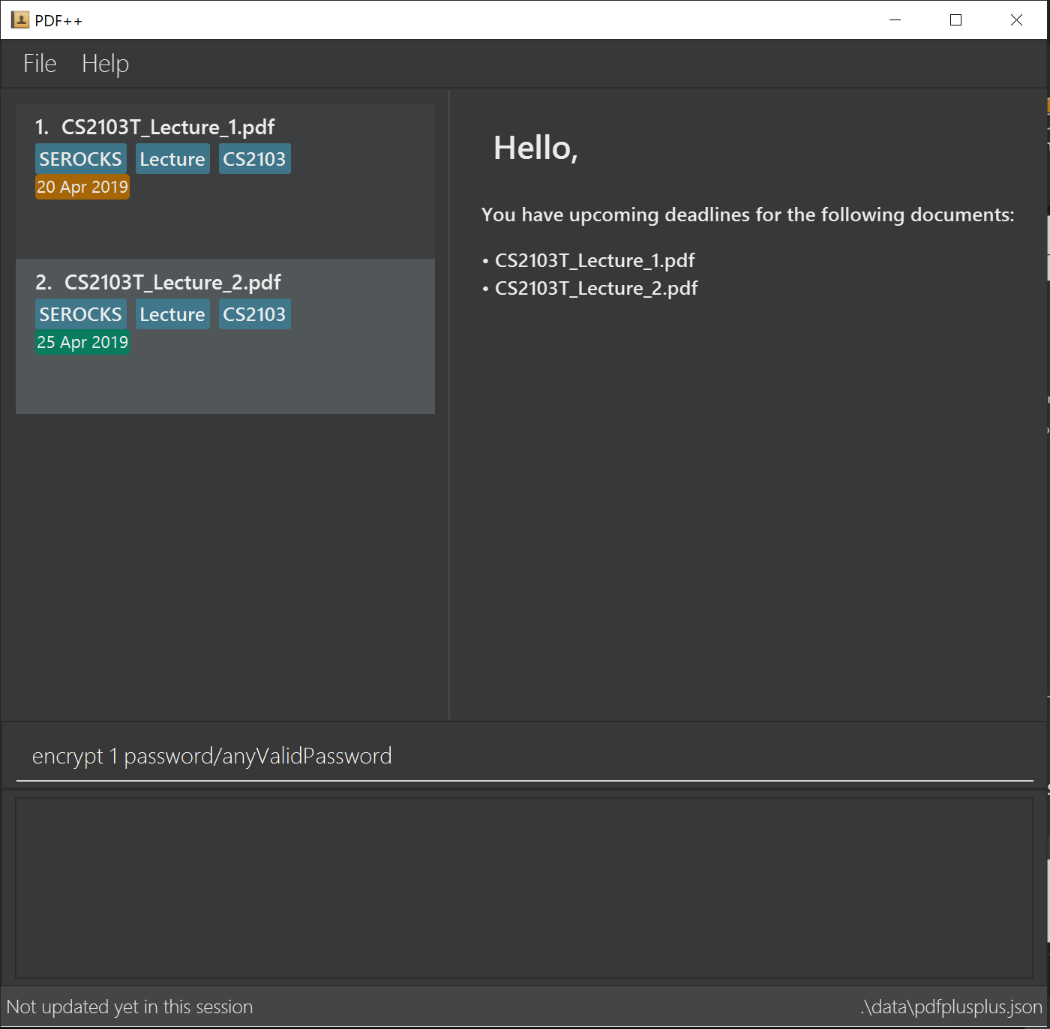
Format: encrypt INDEX password/PASSWORD

Slide 4
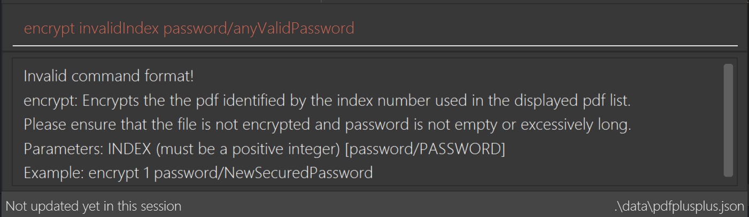
Not a number

Slide 5
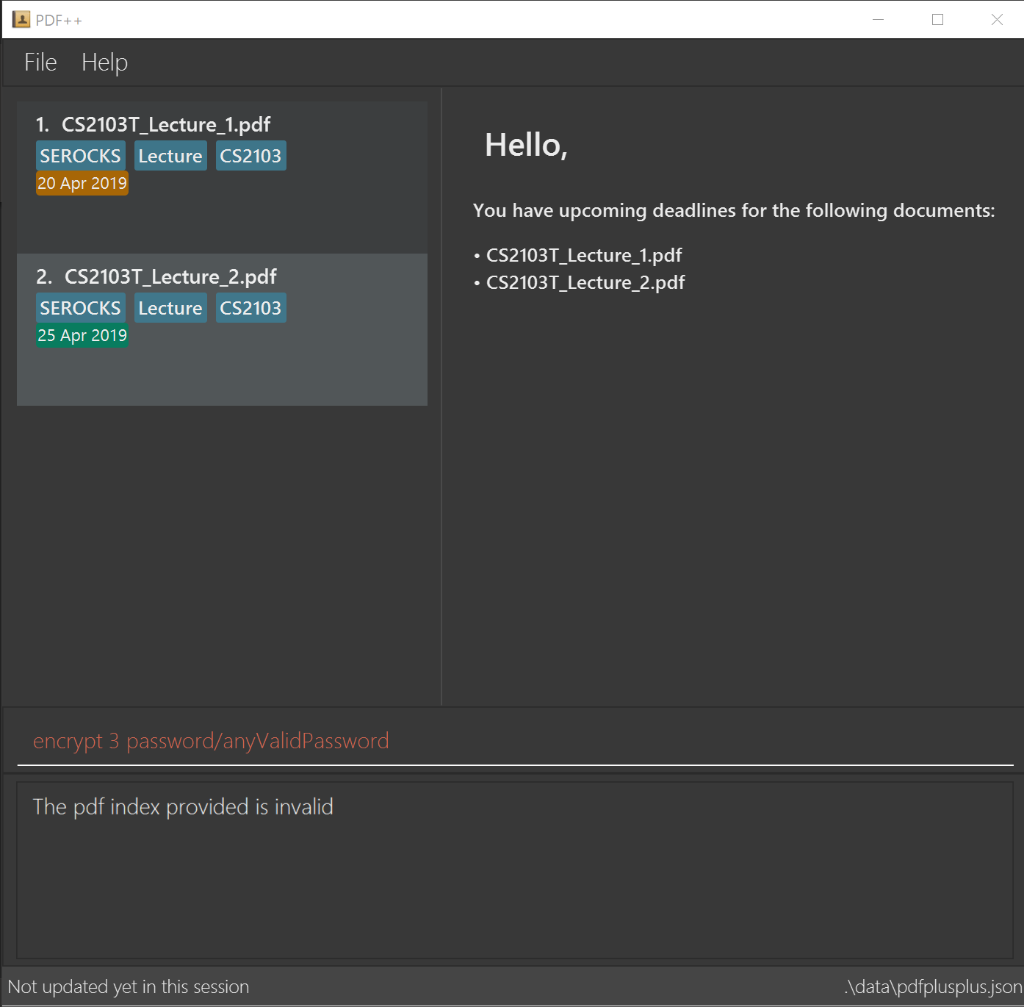
INDEX is not within the number of documents in
PDF++

Slide 6
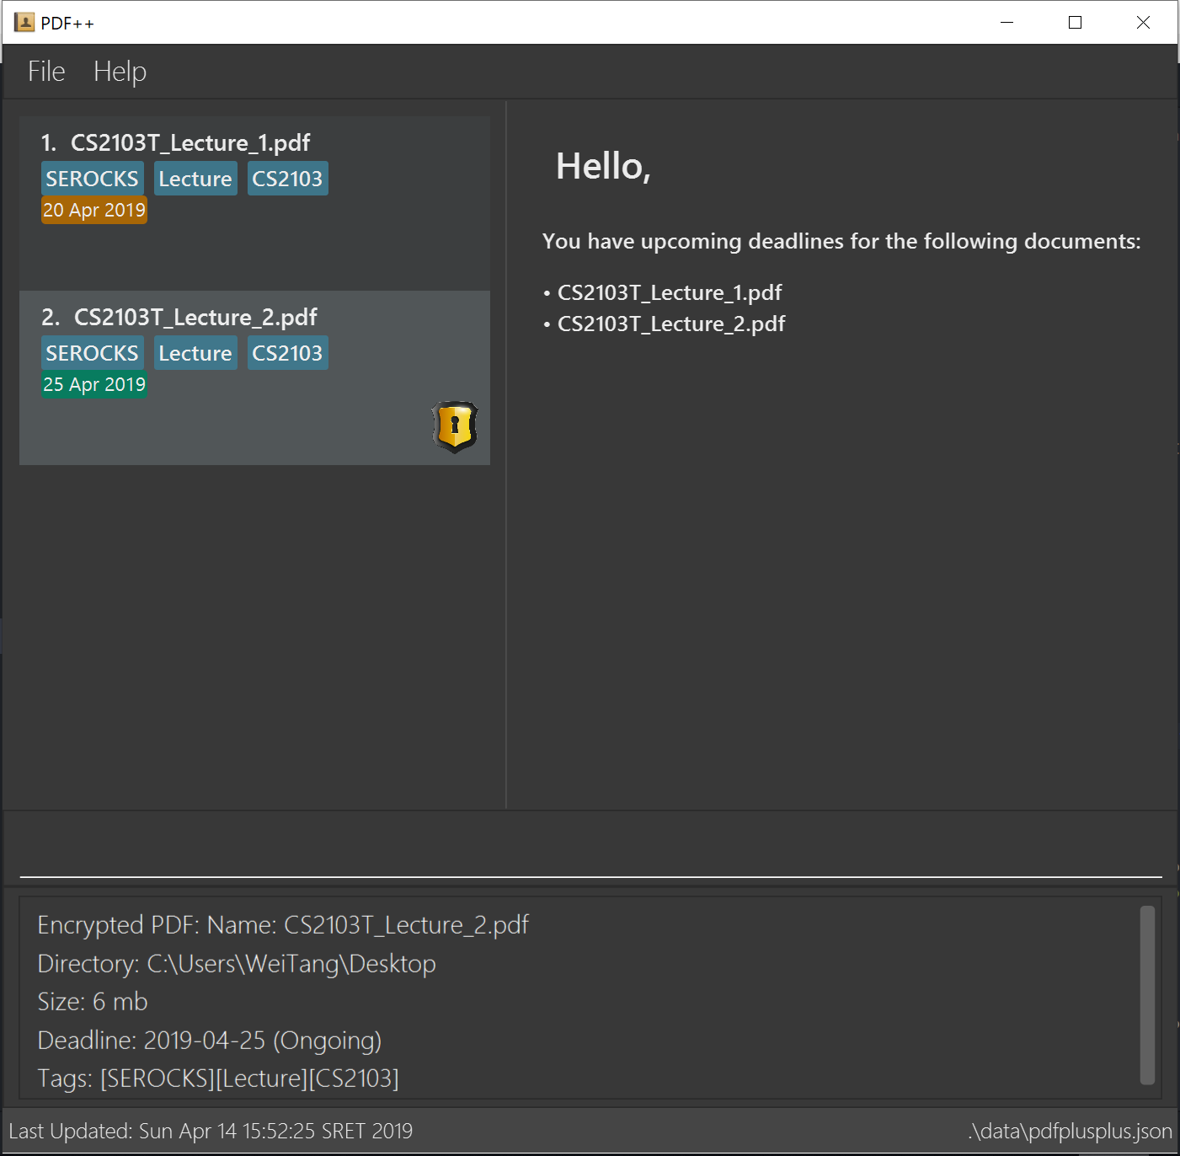
This icon indicates that the file is an encrypted file

Slide 7
