Slide 1
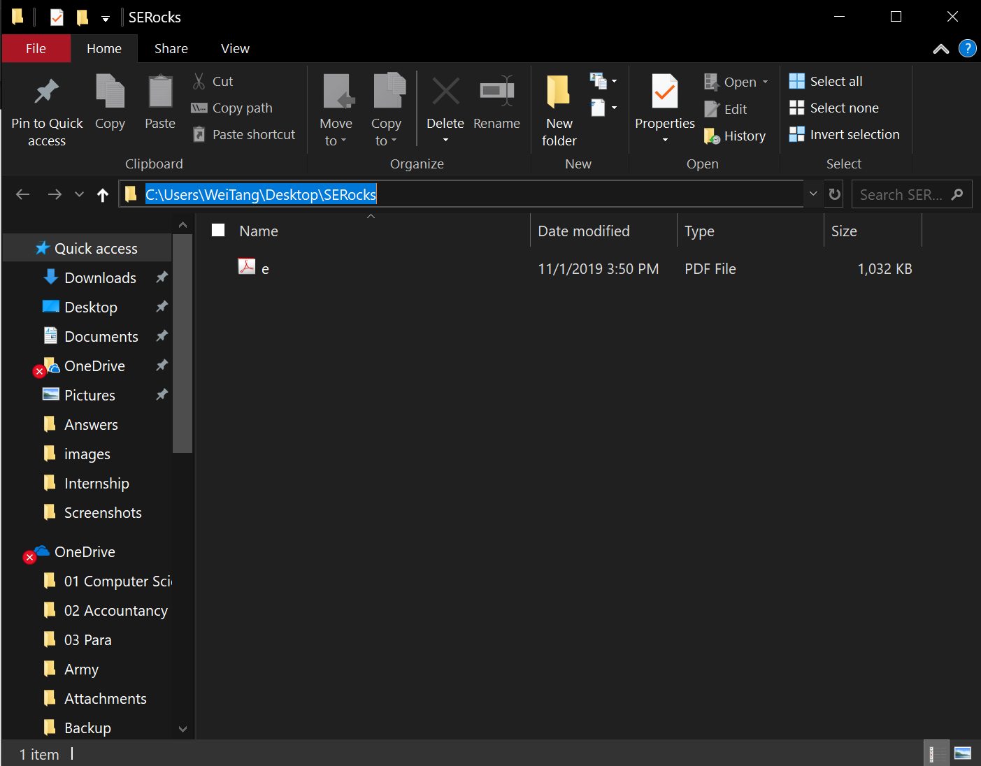
Click here and copy

Slide 2
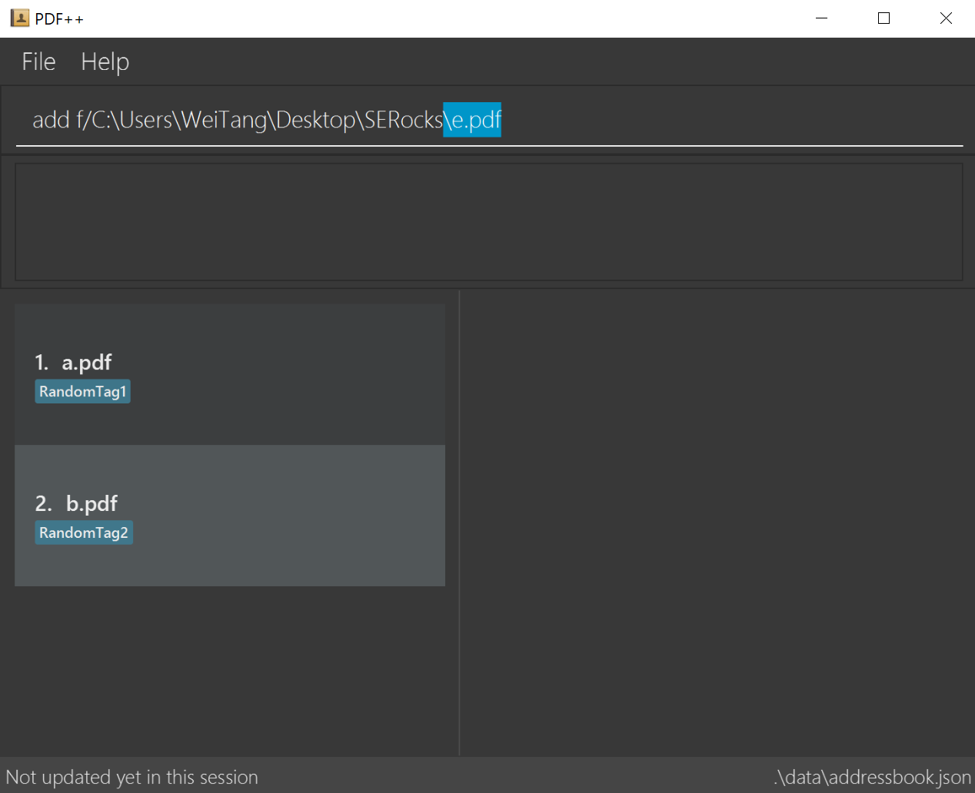
Enter the filename here

Slide 3
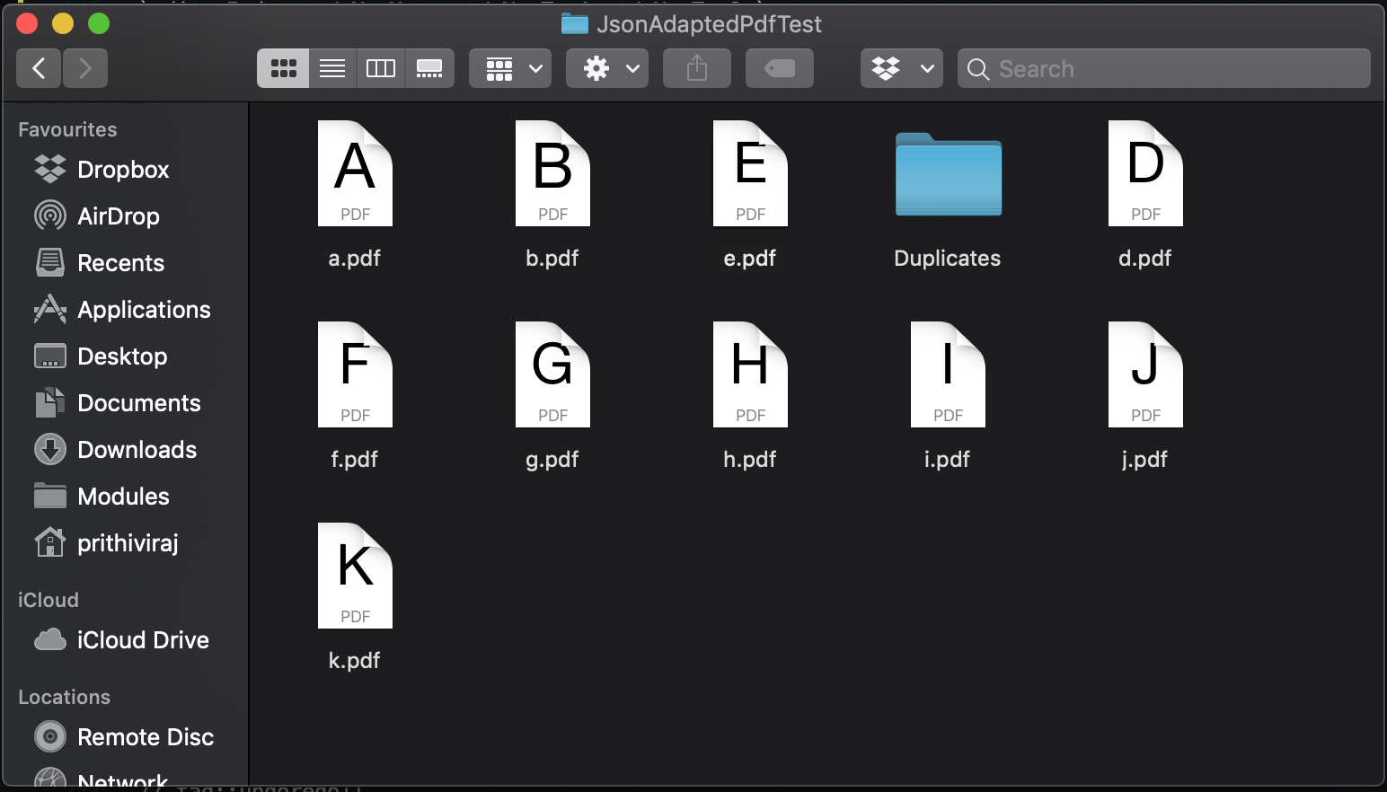
1
AddCommand
check directory
for e.pdf
2
file does not exist
3
proceed to edit

Slide 4
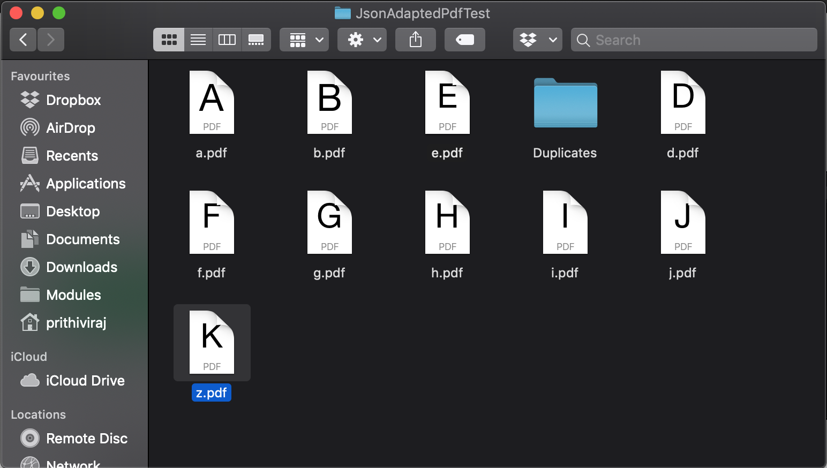
3
throw DuplicatePDF
exception
1
EditCommand
check directory
for e.pdf
2
file exists

