Slide 1
UI
RootLayoutController
logic
resultDisplay
UserInputField
inputFeedbackArea
reminderList
currentSessionLabel

Slide 2
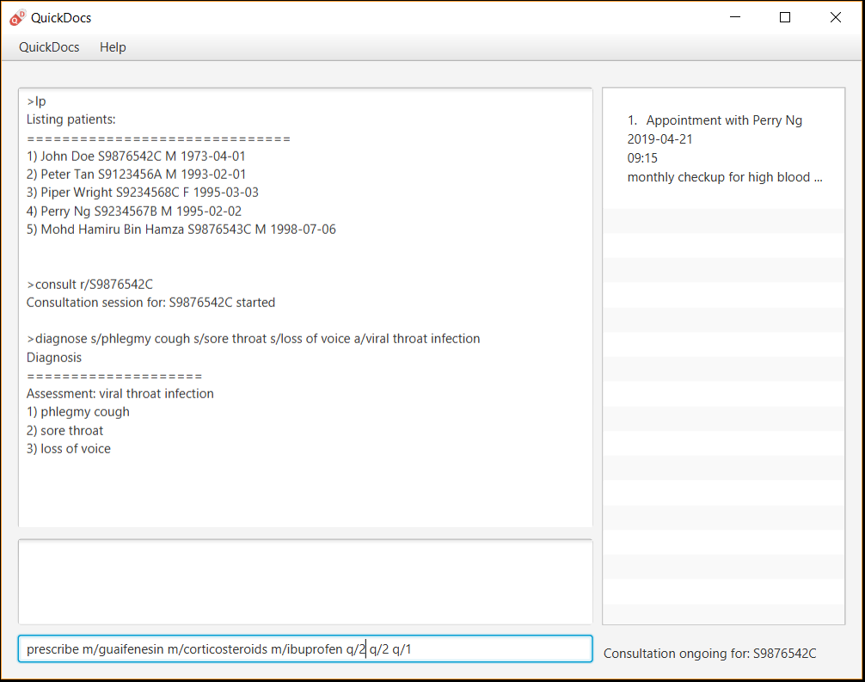
1
4
3
5
2

Slide 3
Patient
Name
Nric
Email
Address
Contact
Gender
Dob
tagList
addpat n/John Doe r/S9237171D e/jd@example.com a/4 Fort Road c/97818841 g/M d/1960-04-15 t/Osteoporosis

Slide 4
Patient
Name
Nric
Email
Address
Contact
Gender
Dob
tagList
PatientEditedFields
Name
Nric
Contact
tagList
editpat n/John Doe r/S9237172D c/97819961 t/Osteoporosis t/highbloodpressure

Slide 5
Current Consultation
Patient

Slide 6
Current Consultation
Patient
Diagnosis
diagnose s/coughing s/sore throat a/throat infection

Slide 7
Current Consultation
Patient
Diagnosis
diagnose s/constant coughing s/sore throat s/watery eyes a/throat infection
Replaced diagnosis
Current Consultation
Patient
Diagnosis

Slide 8
Current Consultation
ArrayList<Prescription>
Patient
Diagnosis
Prescription 1
Prescription 2
prescribe m/Dextromethorphan m/ibuprofen q/1 q/2

Slide 9
Current Consultation
ArrayList<Prescription>
Patient
Diagnosis
Prescription 1
Prescription 2
prescribe m/Dextromethorphan m/ibuprofen m/Guaifenesin q/1 q/3 q/1
Replaced prescriptions
Current Consultation
ArrayList<Prescription>
Patient
Diagnosis
Prescription 1
Prescription 2
Prescription 3

Slide 10
LogicManager
QuickDocs
Parser
execute
(“consult”)
execute(“consult”)
parseCommand
(“consult”)
Consultation
Parser
parse
ConsultationCommand
Model
Manager
Patient
Manager
Consultation
Manager
consultationCommand
execute()
getPatientByNric()
getPatientByNric()
patient
patient
createConsultation
(patient)
createConsultation(patient)
createConsultation
(patient)
Consultation
commandResult

Slide 11
LogicManager
QuickDocs
Parser
execute
(“diagnose ….”)
execute(“diagnose …”)
parseCommand
(“diagnose …”)
Diagnosis
Parser
parse
Diagnosis
Command
Model
Manager
Consultation
Manager
Consultation
DiagnosisCommand
execute()
diagnosePatient
(diagnosis)
diagnosePatient
(diagnosis)
diagnosePatient
(diagnosis)
commandResult

Slide 12
LogicManager
QuickDocs
Parser
execute
(“prescribe ….”)
execute(“prescribe …”)
parseCommand
(“prescribe …”)
Prescription
Parser
parse
Prescription
Command
Model
Manager
Consultation
Manager
Consultation
PrescriptionCommand
execute()
prescribeMedicine
(prescriptions)
prescribeMedicine
(prescriptions)
prescribeMedicine
(prescriptions)
commandResult

Slide 13
LogicManager
QuickDocs
Parser
execute
(“endconsult”)
Execute
(“endconsult”)
parseCommand
(“endconsult”)
Model
Manager
Storage
Manager
EndConsultation
Command
Consultation
Manager
EndConsultationCommand
execute()
endConsultation()
endConsultation()
commandResult
saveQuickDocs
(quickDocs)
saveQuickDocs(quickDocs)

Slide 14
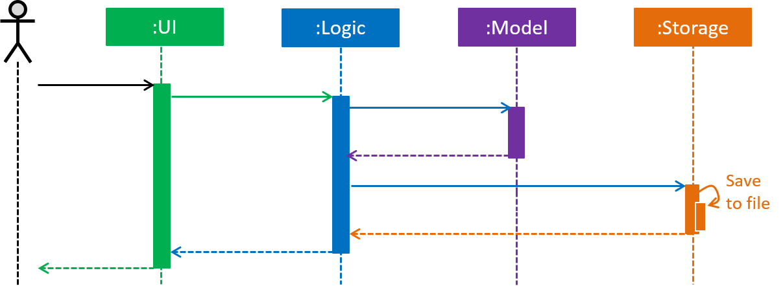
addpat …
execute(padd …)
addPatient(p)
saveQuickDocs(quickDocs)

