Slide 1
TaskList
Over-Do-It
Diagrams

Slide 2
Web
UI
Logic
Storage
Events Center
Model
Logs Center
Main
Commons

Slide 3
:UI
:Logic
:Model
:EventsCenter
delete 1
execute(“delete 1”)
deleteTask(t)
post(TaskListChangedEvent)
:UI
:EventsCenter
:Storage
post(TaskListChangedEvent)
handleTaskListChangedEvent()
Save to file
Update status bar
handleTaskListChangedEvent()

Slide 4
:UI
:Logic
:EventsCenter
exit
execute(“exit”)
post(ExitAppRequestEvent)
:EventsCenter
:Storage
post(ExitAppRequestEvent)
handleTaskListChangedEvent()
Save to file
Application close

Slide 5
:Logic
:Model
:TaskList
:UI
clear
resetData(newData)
execute(“clear”)
resetData(TaskList.getEmptyTaskList())
:UI
:EventsCenter
:Storage
post(TaskListChangedEvent)
handleTaskListChangedEvent()
Save to file
Update status bar
handleTaskListChangedEvent()

Slide 6
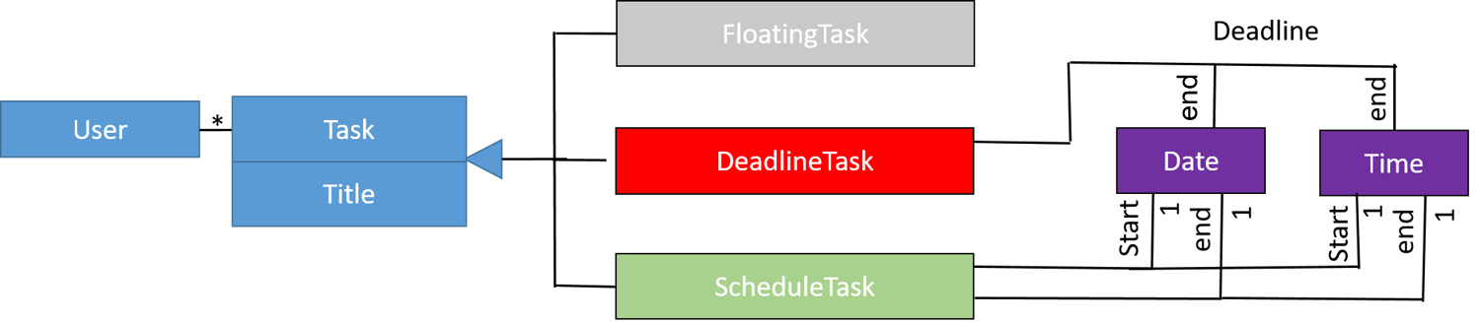

Slide 7
UI
UiManager
UiPartLoader
{abstract} UiPart
MainWindow
Logic
<<interface>>
Ui
CommandBox
ResultsDisplay
BrowserPanel
TaskListPanel
TaskCard
StatusBarFooter
Model
HelpWindow

Slide 8
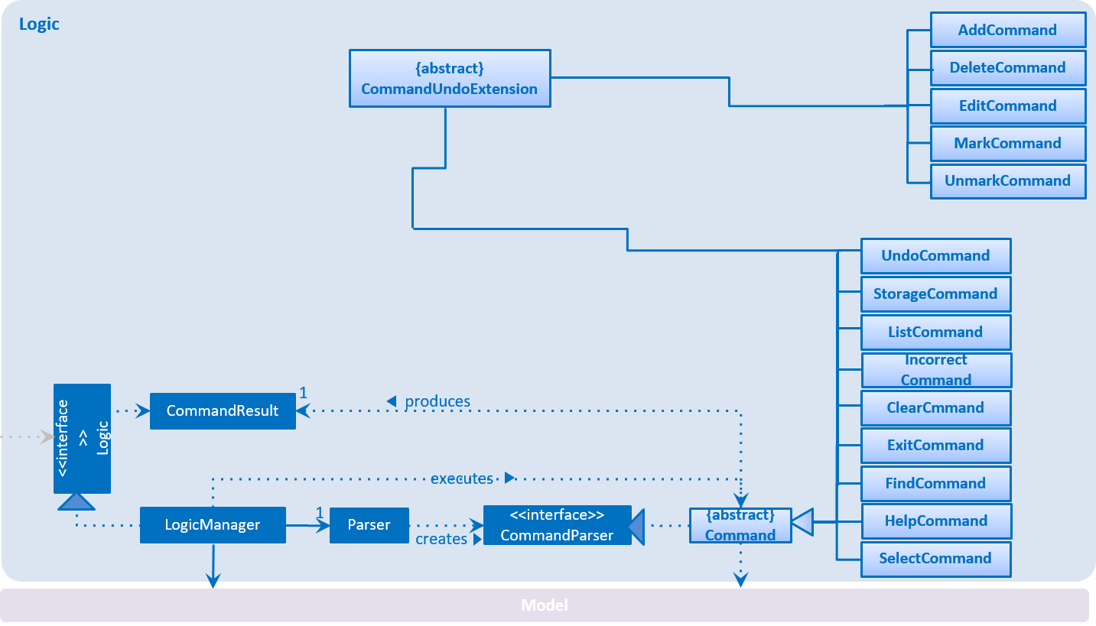

Slide 9
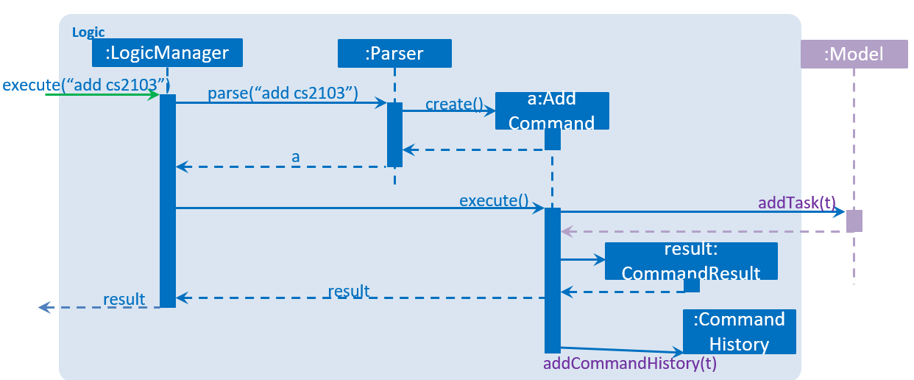

Slide 10
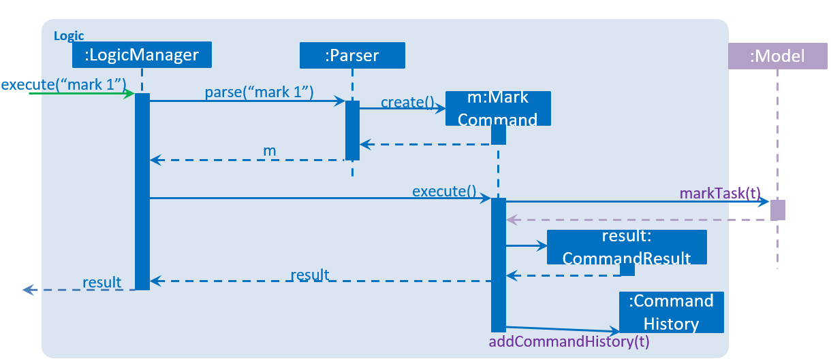

Slide 11
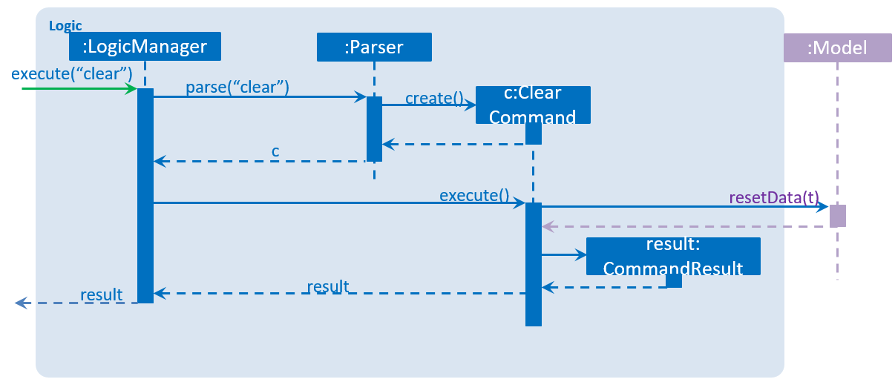

Slide 12
Model
<<interface>> ReadOnlyTaskList
UniqueTagList
Tag
TaskList
Title
<<interface>>
Model
ModelManager
UniqueTaskList
Task
Description
UserPref
StartDate
<<interface>> ReadOnlyTask
filtered list
DueDate
<<interface>> UnmodifiableObservableList

Slide 13
Storage
<<interface>> UserPrefsStorage
JsonUserPrefs Storage
XmlAdaptedTag
<<interface>>
Storage
StorageManager
<<interface>> TaskListStorage
XmlTaskList Storage
XmlSerializable TaskList
XmlAdaptedTask

Slide 14
CLI
Task Display
Display
# Task Left
# Task Completed

