Slide 1
TaskList
Over-Do-It
Diagrams

Slide 2
Web
UI
Logic
Storage
Events Center
Model
Logs Center
Main
Commons

Slide 3
:UI
:Logic
:Model
:EventsCenter
delete 1
execute(“delete 1”)
deleteTask(t)
post(TaskListChangedEvent)
:UI
:EventsCenter
:Storage
post(TaskListChangedEvent)
handleTaskListChangedEvent()
Save to file
Update status bar
handleTaskListChangedEvent()

Slide 4
:UI
:Logic
:Model
:EventsCenter
add CS2103
execute(“add CS2103”)
addTask(CS2103)
post(TaskListChangedEvent)
:UI
:EventsCenter
:Storage
post(TaskListChangedEvent)
handleTaskListChangedEvent()
Save to file
Update status bar
handleTaskListChangedEvent()

Slide 5
:UI
:Logic
:Model
:EventsCenter
mark 1
unmark 1
execute(“mark 1”)
markTask(t)
execute(“unmark 1”)
unmarkTask(t)
post(TaskListChangedEvent)
:UI
:EventsCenter
:Storage
post(TaskListChangedEvent)
handleTaskListChangedEvent()
Save to file
Update status bar
handleTaskListChangedEvent()

Slide 6
:UI
:Logic
:Model
:EventsCenter
storage docs/tasklist.xml
post(ChangePathEvent)
execute(“storage docs/tasklist.xml”)
updateTaskListAfterFilePathChange
post(TaskListChangedEvent)
:UI
:EventsCenter
:Storage
post(ChangePathEvent)
post(TaskListChangedEvent)
handleUpdatedFilePathEvent()
Save to file
Update status bar
handleTaskListChangedEvent()

Slide 7
:UI
:Logic
:EventsCenter
exit
execute(“exit”)
post(ExitAppRequestEvent)
:EventsCenter
:Storage
post(ExitAppRequestEvent)
Save file
storage.saveUserPrefs(userPrefs)
System.exit()

Slide 8
:UI
:Logic
:EventsCenter
Help
execute(“help”)
ShowHelpRequestEvent()
:UI
:EventsCenter
ShowHelpRequestEvent()
HelpWindow.load(primaryStage)

Slide 9
:UI
:Logic
: EventsCenter
adds CS2103
IncorrectCommand()
post(IncorrectCommandAttemptedEvent)
:UI
:EventsCenter
post(IncorrectCommandAttemptedEvent)
Update status bar
handleTaskListChangedEvent()

Slide 10
:UI
:Logic
: EventsCenter
select 1
execute(“select 1”)
post(JumpToListRequestEvent)
:UI
:EventsCenter
post(JumpToListRequestEvent)
Update status bar
handleTaskListChangedEvent()

Slide 11
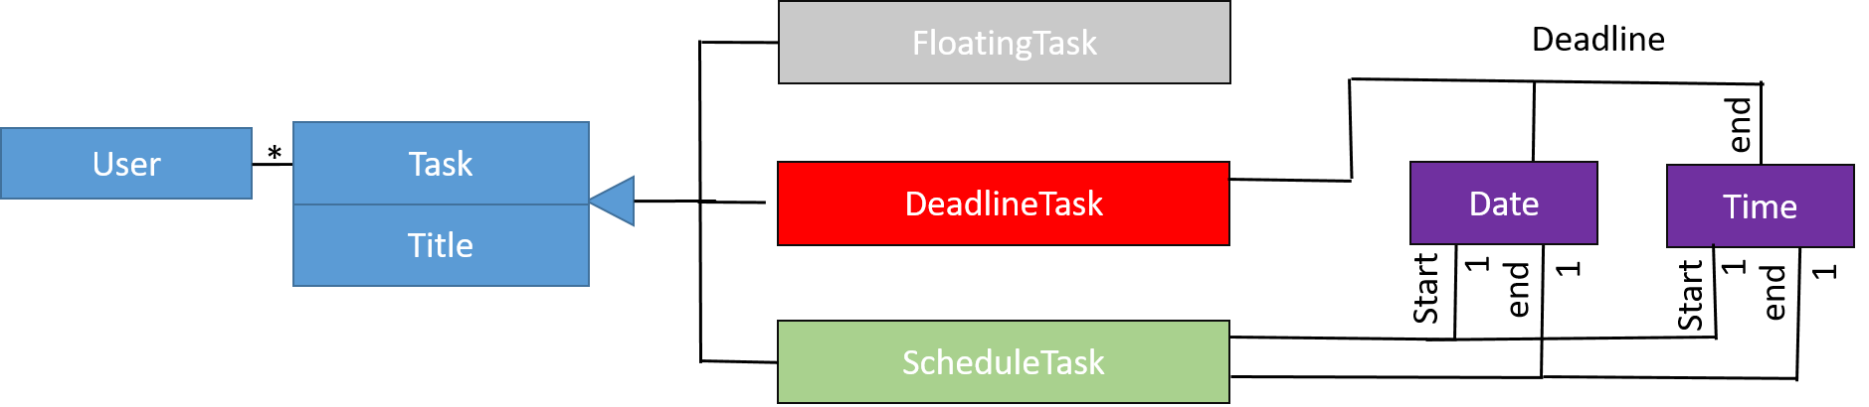
end

Slide 12
UI
UiManager
UiPartLoader
{abstract} UiPart
MainWindow
Logic
<<interface>>
Ui
CommandBox
ResultsDisplay
BrowserPanel
TaskListPanel
TaskCard
StatusBarFooter
Model
HelpWindow

Slide 13
Logic
AddCommand
{abstract} CommandUndoExtension
DeleteCommand
EditCommand
MarkCommand
UnmarkCommand
UndoCommand
StorageCommand
ListCommand
Incorrect Command
CommandResult
1
produces
ClearCmmand
<<interface>>
Logic
ExitCommand
executes
FindCommand
LogicManager
1
Parser
<<interface>>
CommandParser
{abstract} Command
HelpCommand
creates
SelectCommand
Model

Slide 14
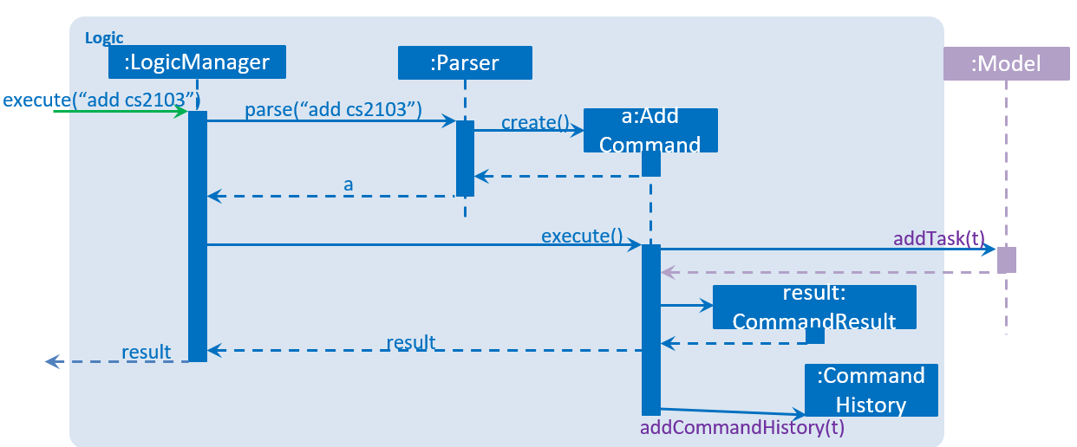

Slide 15
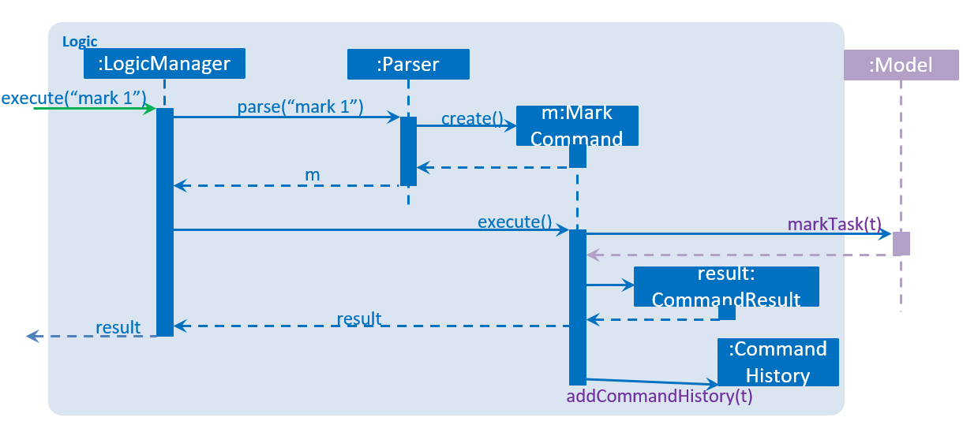

Slide 16
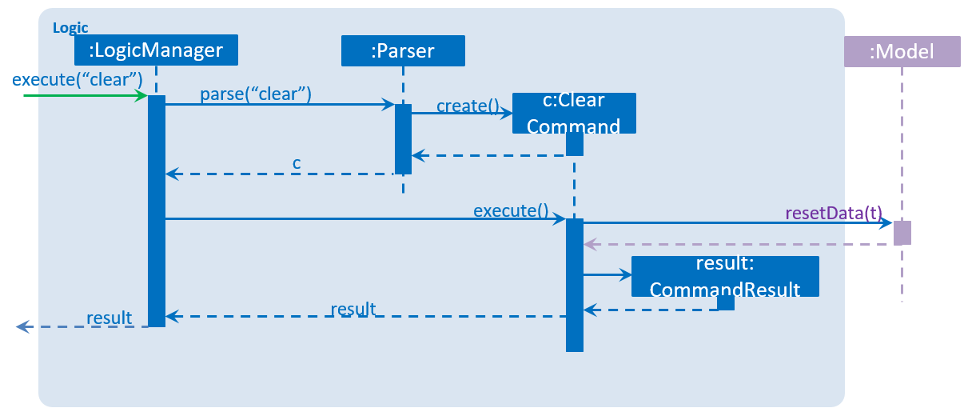

Slide 17
Model
<<interface>> ReadOnlyTaskList
UniqueTagList
Tag
TaskList
Title
<<interface>>
Model
ModelManager
UniqueTaskList
Task
Description
UserPref
StartDate
<<interface>> ReadOnlyTask
filtered list
DueDate
<<interface>> UnmodifiableObservableList

Slide 18
Storage
<<interface>> UserPrefsStorage
JsonUserPrefs Storage
XmlAdaptedTag
<<interface>>
Storage
StorageManager
<<interface>> TaskListStorage
XmlTaskList Storage
XmlSerializable TaskList
XmlAdaptedTask

Slide 19
CLI
Task Display
Display
# Task Left
# Task Completed

