Slide 1
Task Scheduler
Diagrams

Slide 2
UI
Logic
Storage
Events Center
Model
Logs Center
Main
Commons

Slide 3
Delete
:UI
:Logic
:Model
:EventsCenter
delete 1
execute(“delete 1”)
deleteTask (p)
post(TaskSchedulerChangedEvent)
Delete
:UI
:EventsCenter
:Storage
post(TaskSchedulerChangedEvent)
handleTaskSchedulerChangedEvent()
Save to file
Update status bar
handleTaskSchedulerChangedEvent()

Slide 4
UI
UiManager
UiPartLoader
{abstract} UiPart
MainWindow
Logic
<<interface>>
Ui
CommandBox
ResultsDisplay
TagListPanel
TagCard
PriorityListPanel
TaskListPanel
TaskCard
Model
StatusBarFooter
HelpWindow
LabelCompleted
LabelPending
LabelOverdue

Slide 5
Logic
{abstract} CommandParser
AddCommandParser
ListCommandParser
CommandHistory
records
Delete CommandParser
…
CommandResult
1
produces
AddCommand
<<interface>>
Logic
ListCommand
executes
Incorrect Command
LogicManager
1
Parser
{abstract} Command Parser
{abstract} Command
creates
creates
…
Model

Slide 6
Model
<<interface>> ReadOnlyTaskScheduler
*
Tag
1
UniqueTagList
1
1
TaskScheduler
Name
<<interface>>
Model
ModelManager
UniqueTaskList
Task
TaskDateTime
UserPref
1
*
TaskDateTime
1
<<interface>> ReadOnlyTask
filtered list - 1
Location
<<interface>> UnmodifiableObservableList
Deadline Task
Task
Event Task
Floating Task

Slide 7
Storage
<<interface>> UserPrefsStorage
JsonUserPrefs Storage
XmlAdaptedTag
<<interface>>
Storage
StorageManager
<<interface>> TaskScheduler Storage
XmlTaskScheduler Storage
XmlSerializable TaskScheduler
XmlAdaptedTask

Slide 8
:UI
:Logic
:Model
:EventsCenter
recur 1 every 3 days until next week
execute(“recur 1 every 3 days until next week ”)
addTask (taskArray)
post(TaskSchedulerChangedEvent)
addMutateCmd( “recur”, taskArray)
:UI
:EventsCenter
:Storage
post(TaskSchedulerChangedEvent)
handleTaskSchedulerChangedEvent()
Save to file
Update status bar
handleTaskSchedulerChangedEvent()

Slide 9
:UI
:Logic
:Model
:EventsCenter
edit 1 do homework by today
execute(“edit 1 do homework by today”)
editTask (old, new)
post(TaskSchedulerChangedEvent)
addMutateCmd( “edit”, old)
:UI
:EventsCenter
:Storage
post(TaskSchedulerChangedEvent)
handleTaskSchedulerChangedEvent()
Save to file
Update status bar
handleTaskSchedulerChangedEvent()

Slide 10
:UI
:Logic
:Model
:EventsCenter
undo
execute(“undo”)
performUndo (affectedTask(s))
retrieve(affectedTask(s))
post(TaskSchedulerChangedEvent)
:UI
:EventsCenter
:Storage
post(TaskSchedulerChangedEvent)
handleTaskSchedulerChangedEvent()
Save to file
Update status bar
handleTaskSchedulerChangedEvent()

Slide 11
:UI
:Logic
:EventsCenter
exit
execute(“exit”)
post(ExitAppRequestEvent)
:Main
:EventsCenter
post(ExitAppRequestEvent)
Stops ()
handleExitAppRequestEvent ()

Slide 12
:UI
:Logic
:Model
:EventsCenter
mark 1
execute(“mark 1”)
markTask(task)
post(TaskSchedulerChangedEvent)
addMutateCmd (“mark”, 1 , task)
:UI
:EventsCenter
:Storage
post(TaskSchedulerChangedEvent)
handleTaskSchedulerChangedEvent()
Save to file
Update status bar
handleTaskSchedulerChangedEvent()

Slide 13
:UI
:Logic
:EventsCenter
Setpath filename
execute(“setpath filename”)
post(FilePathChangedEvent)
:UI
:EventsCenter
:Storage
post(FilePathChangedEvent)
handleFilePathChangedEvent ()
Save to file
Update status bar
handleFilePathChangedEvent ()

Slide 15
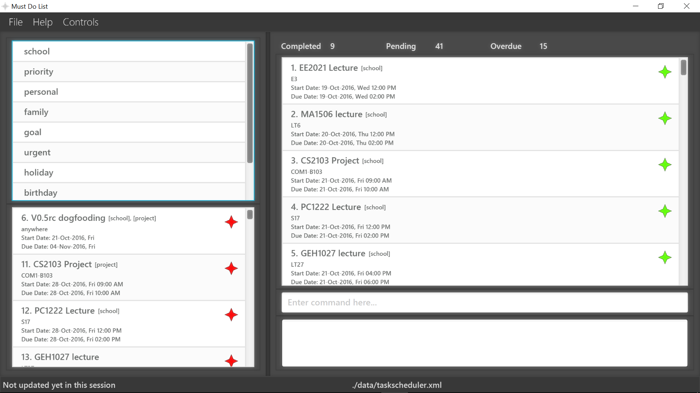

Slide 16

Status
Here shows application status and its current data location

Slide 17


Result Display
Here displays the result after executing each command

Slide 18

Command Box
Here is where you key in your commands - Shortcut key -> Ctrl + F4

Slide 19


Task list
Here displays all your tasks
- Green star represents completed, Red star represents overdue
- Shortcut key -> Ctrl + F3

Slide 20

Statistics
Here is the statistic display - it shows the no. of completed, pending, overdue tasks in your task list

Slide 21


Pending list
Here displays all the pending tasks
- You can see what you need to do in a quick glace
- Shortcut key -> Ctrl + F2

Slide 22

Tag list
Here displays all the tags you have added
- Selecting them will display all the tasks with the corresponding tag
- Shortcut key -> Ctrl + F1

Slide 23
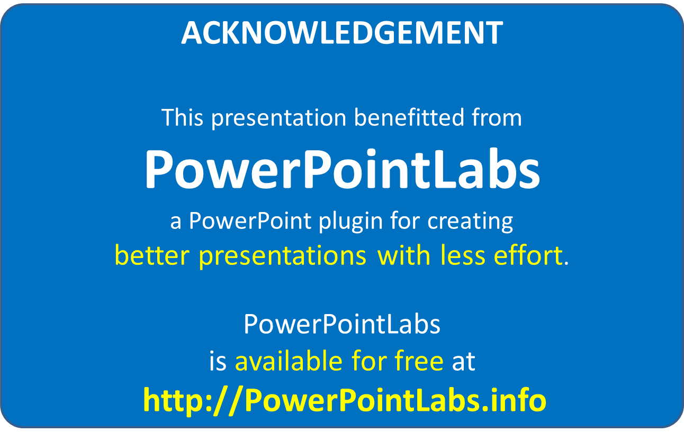

Slide 24
Activity Diagram
Free to do some work
Task assigned to user
Pick something to do
Can be done immediately?
Can be done immediately?
Yes
No
Yes
No
Do it right away
Add task into Must Do List
Do it right away
Reschedule task
Archive the task
Mark as “done”
Update Must Do List

Slide 25
Object Oriented Domain Model
Floating
Task
User
*
Task
Deadline
Task
deadline
DateTime
Name
start
1
end
1
hasCompleted()
isOverdue()
Event

