Slide 1
TaskManager – ForgetMeNot
Diagrams

Slide 2
Web
UI
Logic
Storage
Events Center
Model
Logs Center
Main
Commons

Slide 3
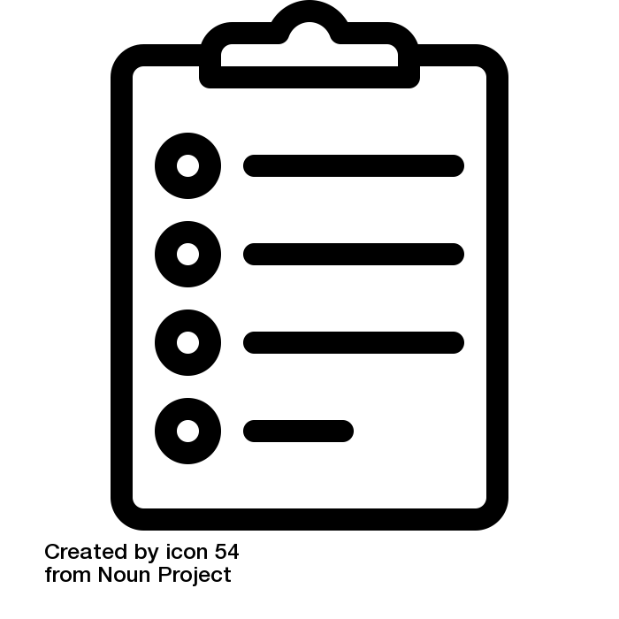
:UI
:Logic
:Model
:EventsCenter
delete 1
execute(“delete 1”)
deleteTask(p)
Post(TaskManagerChangedEvent)
:UI
:EventsCenter
:Storage
Post(TaskManagerChangedEvent)
handleTaskManagerChangedEvent()
Save to file
Update status bar
handleTaskManagerChangedEvent()

Slide 4
UI
UiManager
UiPartLoader
{abstract} UiPart
MainWindow
Logic
<<interface>>
Ui
CommandBox
ResultsDisplay
BrowserPanel
TaskListPanel
TaskCard
StatusBarFooter
Model
HelpWindow

Slide 5
Logic
CommandResult
1
produces
AddCommand
<<interface>>
Logic
ListCommand
executes
Incorrect Command
LogicManager
1
Parser
{abstract} Command
creates
…
Model

Slide 6
Logic
:LogicManager
:Parser
:Model
execute(“delete 1”)
parse(“delete 1”)
create()
d:Delete Command
d
execute()
deleteTask(p)
result: CommandResult
result
result

Slide 7
Model
<<interface>> ReadOnlyTaskManager
UniqueTagList
Tag
TaskManager
Name
<<interface>>
Model
ModelManager
UniqueTaskList
Task
StartTime
UserPref
EndTime
<<interface>> ReadOnlyTask
filtered list
Done
<<interface>> UnmodifiableObservableList

Slide 8
Storage
<<interface>> UserPrefsStorage
JsonUserPrefs Storage
XmlAdaptedTag
<<interface>>
Storage
StorageManager
<<interface>> TaskManagerStorage
XmlTaskManager Storage
XmlSerializable TaskManager
XmlAdaptedTask

