Slide 1
AddressBook – Level 4
Diagrams

Slide 2
Web
UI
Logic
Storage
Events Center
Model
Logs Center
Main
Commons

Slide 3
:UI
:Logic
:Model
:EventsCenter
delete 1
execute(“delete 1”)
deleteTask(p)
post(LifekeeperChangedEvent)
:UI
:EventsCenter
:Storage
post(LifekeeperChangedEvent)
handleLifekeeperChangedEvent()
Save to file
Update status bar
handleLifekeeperChangedEvent()

Slide 4
UI
UiManager
UiPartLoader
{abstract} UiPart
MainWindow
Logic
<<interface>>
Ui
CommandBox
ResultsDisplay
OverdueTaskListPanel
OverdueTaskCard
ActivityListPanel
Model
ActivityCard
StatusBarFooter
HelpWindow

Slide 5
Logic
CommandResult
1
produces
AddCommand
<<interface>>
Logic
ListCommand
executes
Incorrect Command
LogicManager
1
Parser
{abstract} Command
creates
…
Model

Slide 6
Logic
:LogicManager
:Parser
:Model
execute(“add Activity1”)
parse(“add Activity1”)
create()
c:Add Command
c
execute()
deleteActivity(a)
result: CommandResult
result
result

Slide 7
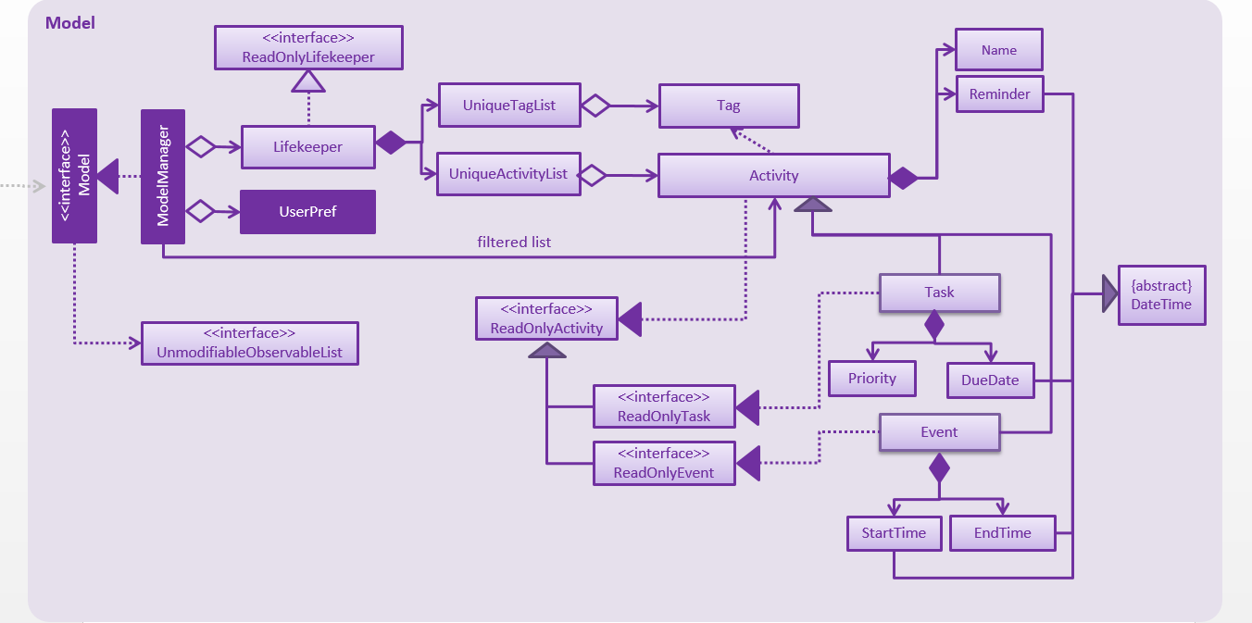

Slide 8
Storage
<<interface>> UserPrefsStorage
JsonUserPrefs Storage
XmlAdaptedTag
<<interface>>
Storage
StorageManager
<<interface>> AddressBookStorage
XmlLifekeeper Storage
XmlSerializable Lifekeeper
XmlAdaptedTask

