Slide 1
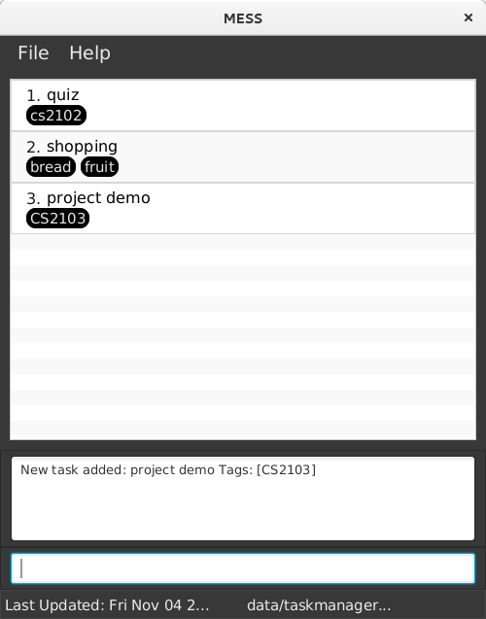
TaskCard
TaskListPanel
MainWindow
ResultDisplay
CommandBox
StatusBarFooter

