Slide 1
MESS
Diagrams

Slide 2
Web
UI
Logic
Storage
Events Center
Model
Logs Center
Main
Commons

Slide 3
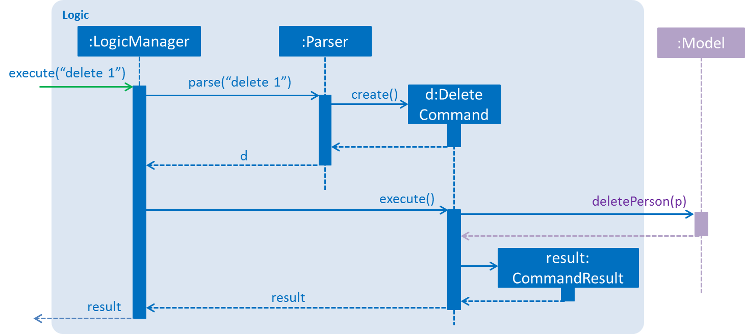
deleteTask(p)

Slide 4
Logic
AddCommand
CommandResult
1
produces
DeleteCommand
<<interface>>
Logic
ClearCommand
executes
FindCommand
1
ExitCommand
LogicManager
Parser
{abstract} Command
creates
HelpCommand
IncorrectCommand
ListCommand
SelectCommand
UpdateCommand
CompleteCommand
PinCommand
UndoCommand
Model

Slide 5
Model
<<interface>> ReadOnlyTaskManager
UniqueTagList
Tag
TaskManager
openTime
<<interface>>
Model
ModelManager
UniqueTaskList
Task
closeTime
UserPref
isComplete
<<interface>> ReadOnlyTask
filtered list
isImportant
<<interface>> UnmodifiableObservableList

Slide 6
:UI
:Logic
:Model
:EventsCenter
delete 1
execute(“delete 1”)
deleteTask(p)
post(TaskManagerChangedEvent)

Slide 7
:UI
:EventsCenter
:Storage
post(TaskManagerChangedEvent)
handleTaskManagerChangedEvent()
Save to file
Update status bar
handleTaskManagerChangedEvent()

Slide 8
Storage
<<interface>> UserPrefsStorage
JsonUserPrefs Storage
XmlAdaptedTag
<<interface>>
Storage
StorageManager
<<interface>> TaskManagerStorage
XmlTaskManager Storage
XmlSerializable TaskManager
XmlAdaptedTask

Slide 9
UI
UiManager
UiPartLoader
{abstract} UiPart
MainWindow
Logic
<<interface>>
Ui
CommandBox
ResultsDisplay
BrowserPanel
TaskListPanel
TaskCard
StatusBarFooter
Model
HelpWindow

