Slide 1
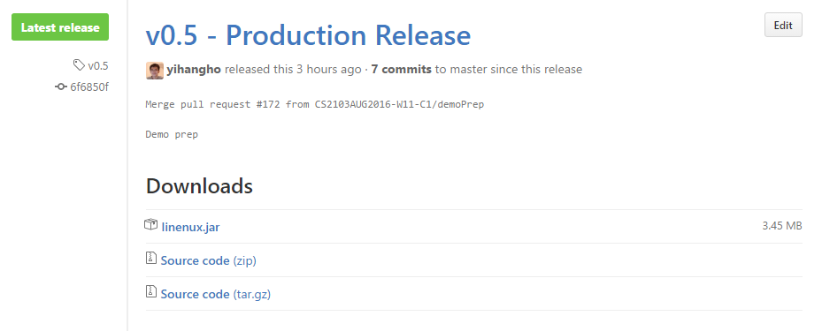
Figure 1: Downloading linenux.jar file

Slide 2
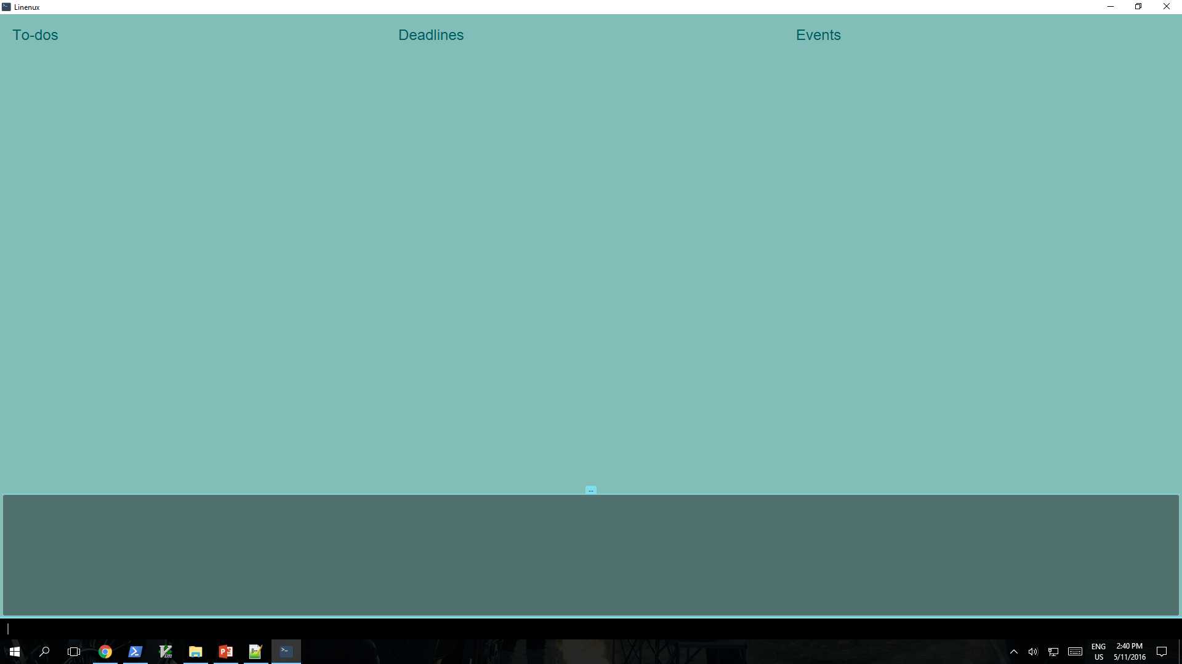
To-do Panel
Deadline Panel
Event Panel
Result Panel
Command Box
Figure 2: Main Window of Linenux

Slide 3
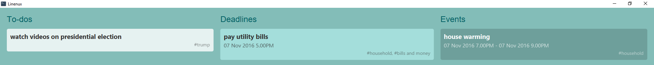
Figure 3: Adding Tasks

Slide 4
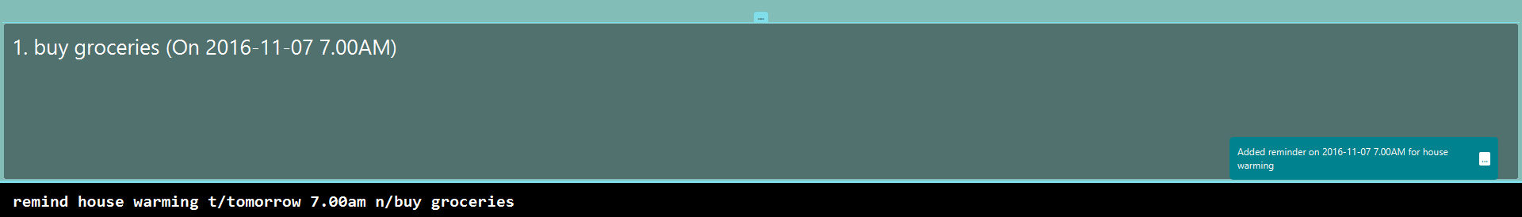
Figure 4: Setting a Reminder

Slide 5
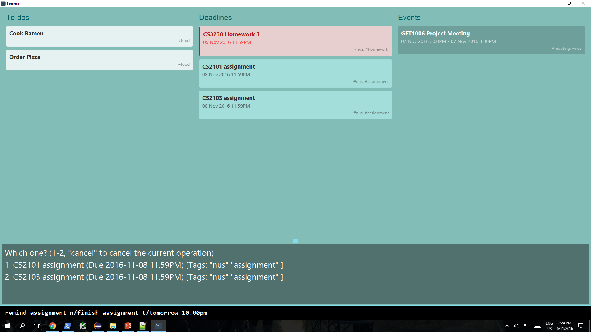
Figure 5: Multiple Tasks Found

Slide 6
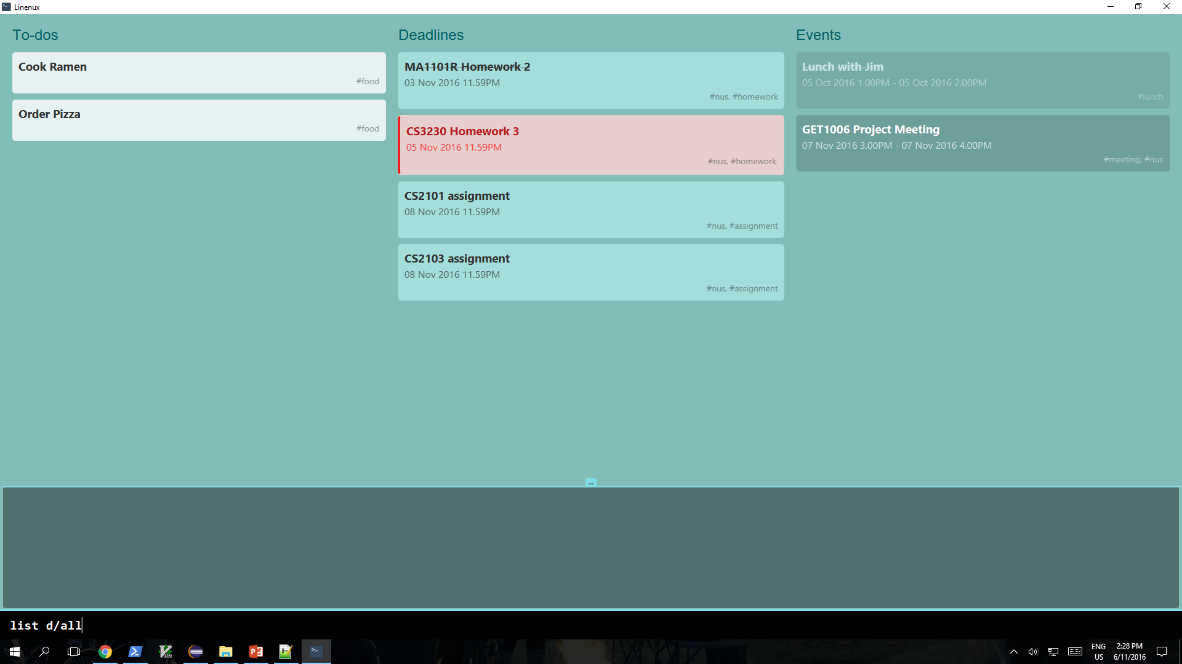
Figure 6: Listing All Tasks

Slide 7
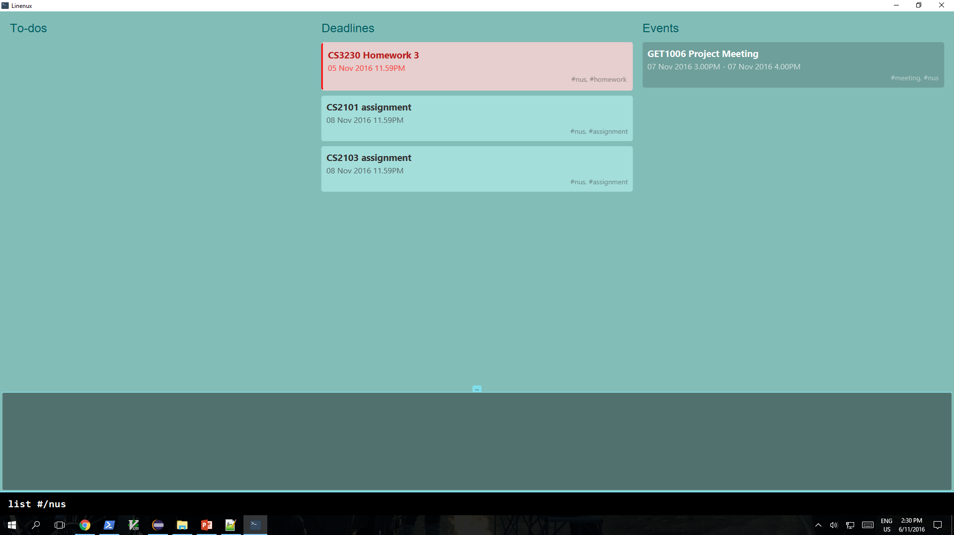
Figure 7: Listing Tasks with NUS Tag

Slide 8
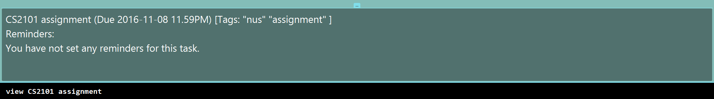
Figure 8: Viewing a Task

Slide 9
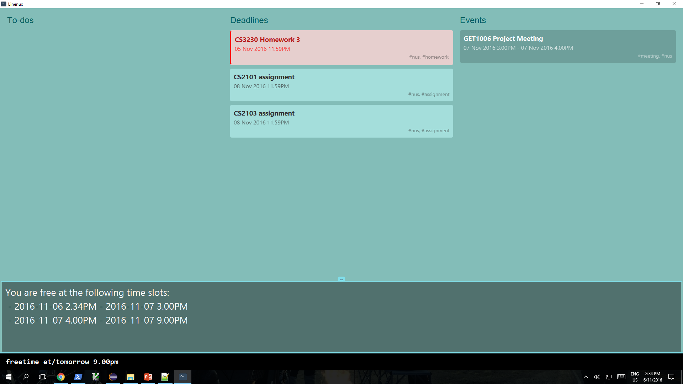
Figure 9: Freetime

Slide 10
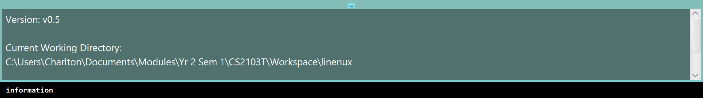
Figure 10: Program Information

Slide 11

Figure 11: Help for Information Command

