Slide 1
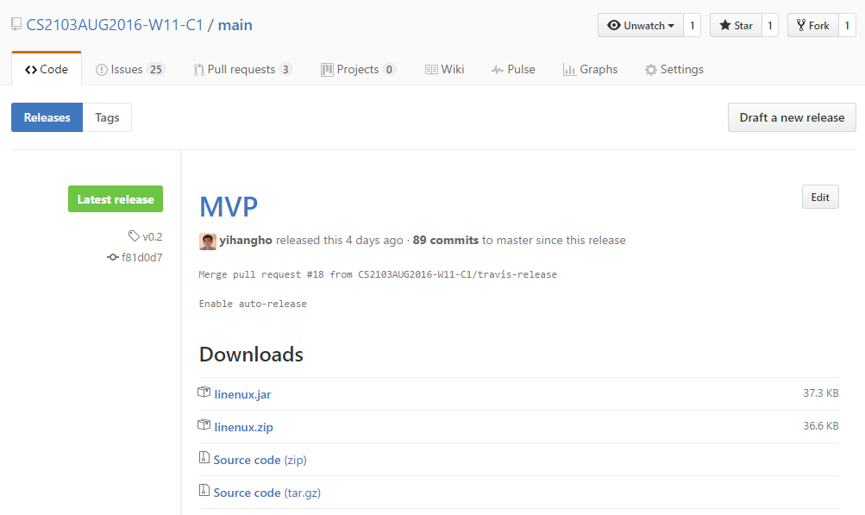
Figure 1: Downloading linenux.jar file

Slide 2
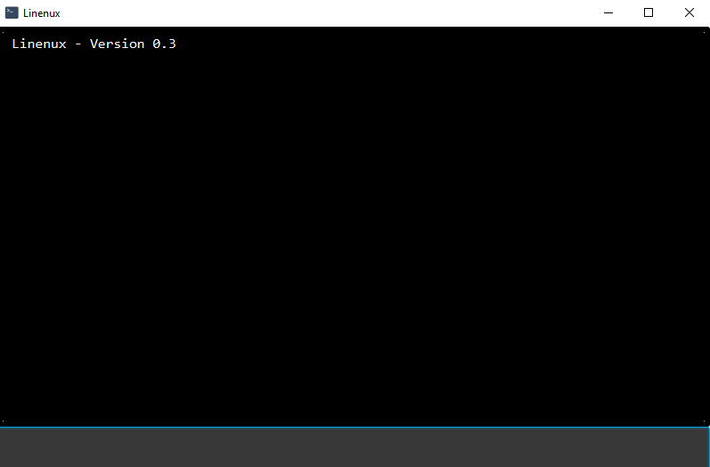
Figure 2: Linenux’s main window

Slide 3
To-do Panel
Deadline Panel
Event Panel
Display Panel
Command Box
Figure 3: Main Window Diagram

